Slide 1
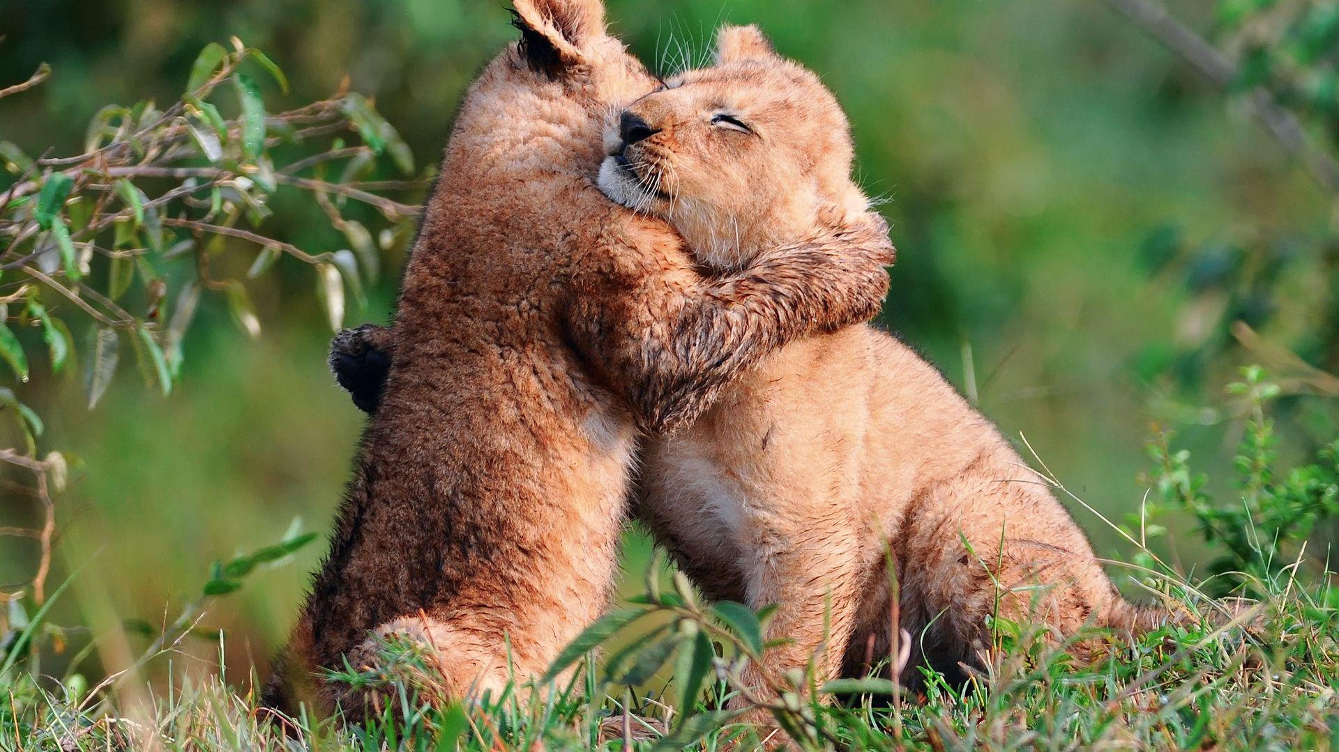
ENCOURAGEMENT

Slide 2
Acts 9:31
31 The church then had peace throughout Judea, Galilee, and Samaria…and with the encouragement of the Holy Spirit, it also grew in numbers. NLT

Slide 3
John 14:16-17
16 And I will ask the Father, and he will give you another Helper (encouragement partner), to be with you forever, 17 even the Spirit of truth. You know him, for he dwells with you and will be in you. ESV

Slide 4
Greek: paraklesis
paraklesis NT:3874, means "a calling to one's side" (para, "beside," kaleo, "to call"); Literally “encouragement.” This is the word used most often for comfort or encouragement, or consolation.

Slide 5
Who needs encouragement?
Encouraging words give hope, lift up, advance, strengthen, inspire, egg on, boost, support, instill confidence.

Slide 6
Do these words help?
“Good job….you’re the best…..good going….that’s so smart….you’re great…..want a hug?…..you’re going to make it….you can do it….can I help you?….it’s going to be okay….I’ll go with you….I love you.”

Slide 7
If you told everyone you met today….
“God loves you and wants to shower your life with favor and blessings. He loves you, forgives you, and wants to fill your life with good things….plus He wants to be your friend.”

Slide 8
Acts 4:36
36 Thus Joseph, who was also called by the apostles Barnabas (which means son of encouragement)… ESV

Slide 9
1 Corinthians 14:3
3 On the other hand, the one who prophesies speaks to people for their upbuilding and encouragement and consolation. ESV

Slide 10
2 Corinthians 1:3-4
3 Blessed be the God and Father of our Lord Jesus Christ, the Father of mercies and God of all encouragement, 4 who encourages us in all our affliction, so that we may be able to encourage those who are in any affliction, with the encouragement with which we ourselves are encouraged by God. ESV

Slide 11
The world has enough critics. We are low on encouragers. Will you sign up?

