Slide 1
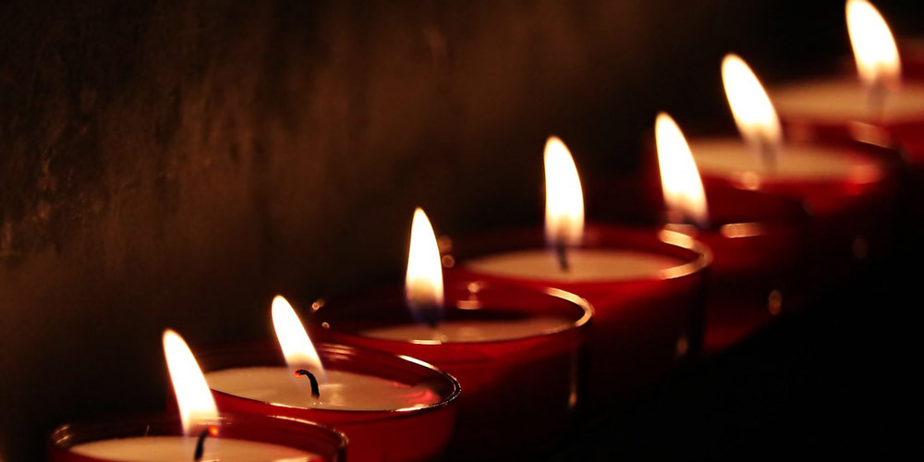
The Seven-Fold Spirit of God

Slide 2
LOVE
HUMILITY WISDOM TRUTH
→
PRESENCE
REVIEW
THE GRACE CONNECTIONS

Slide 3
LOVE
GRACE
?
?
←
PEOPLE
REVIEW
THE GRACE CONNECTIONS

Slide 4
For the law was given by Moses, but grace and truth came by Jesus Christ.
JOHN 1:17
THE GRACE
CONNECTIONS

Slide 5
GRACE
God’s
Resources
At
Christ’s
Expense
REVIEW
THE GRACE CONNECTIONS

Slide 6
GRACE & THE LOVE CONNECTION
GRACE & HUMILITY CONNECTION
GRACE & THE FAITH CONNECTION
REVIEW
THE GRACE
CONNECTIONS

Slide 7
THE SPIRIT OF GRACE
Involves LOVE, HUMILITY, and FAITH
- Open your heart
- Drop resistance
- Receive grace
REVIEW
THE GRACE
CONNECTIONS

Slide 8
THE SPIRIT OF GRACE
Involves LOVE, HUMILITY, and FAITH
- Open your heart
- Drop resistance
- Receive grace
REVIEW
THE GRACE
CONNECTIONS

Slide 9
When the day of Pentecost came, they were all together in one place.² Suddenly a sound like the blowing of a violent wind came from heaven and filled the whole house where they were sitting.
INTRODUCTION
THE GRACE
ARRIVAL

Slide 10
³ They saw what seemed to be tongues of fire that separated and came to rest on each of them. ⁴ All of them were filled with the Holy Spirit and began to speak in other tongues^{[a]} as the Spirit enabled them.
INTRODUCTION
THE GRACE
ARRIVAL

Slide 11
⁵ Now there were staying in Jerusalem God-fearing Jews from every nation under heaven. ⁶ When they heard this sound, a crowd came together in bewilderment, because each one heard their own language being spoken.
INTRODUCTION
THE GRACE
ARRIVAL

Slide 12
⁷ Utterly amazed, they asked: “Aren’t all these who are speaking Galileans? ⁸ Then how is it that each of us hears them in our native language?
INTRODUCTION
THE GRACE
ARRIVAL

Slide 13
⁹ Parthians, Medes and Elamites; residents of Mesopotamia, Judea and Cappadocia, Pontus and Asia,^{[b]} ¹⁰ Phrygia and Pamphylia, Egypt and the parts of Libya near Cyrene; visitors from Rome
INTRODUCTION
THE GRACE
ARRIVAL

Slide 14
¹¹(both Jews and converts to Judaism); Cretans and Arabs—we hear them declaring the wonders of God in our own tongues!” ¹² Amazed and perplexed, they asked one another, “What does this mean?”
INTRODUCTION
THE GRACE
ARRIVAL

Slide 15
POINT #1
UNITY
THE GRACE
ARRIVAL

Slide 16
POINT #2
SUDDENLY
THE GRACE
ARRIVAL

Slide 17
FILLED THE ROOM
POINT #3
THE GRACE
ARRIVAL

Slide 18
POINT #4
FIRE
THE GRACE
ARRIVAL

Slide 19
POINT #5
LANGUAGE
THE GRACE
ARRIVAL

Slide 20
POINT #6
SPIRIT-ENABLED
THE GRACE
ARRIVAL

Slide 21
POINT #7
BEWILDERMENT
THE GRACE
ARRIVAL

Slide 22
What can we do to prepare a place for expression of Grace
CONCLUSION
THE GRACE
ARRIVAL

