Slide 1
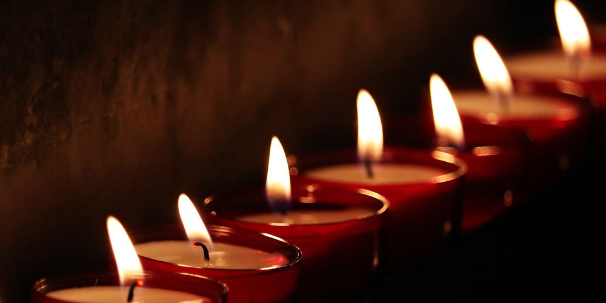
The Seven-Fold Spirit of God

Slide 2
LOVE
HUMILITY WISDOM TRUTH
REVIEW
FOUR LIGHTS

Slide 3
Lucifer offers us:
S PIN
T ORTURED LOGIC
A SSERTED FALSEHOODS
R EPARSING LANGUAGE
REVIEW
TRUTH:
Naked & Unashamed

Slide 4
The Ten Commandments do not grant life – they condemn the human nature to eternal capital punishment
CONCLUSION
TEN INCONVENIENTTRUTHS

Slide 5
LOVE
HUMILITY WISDOM TRUTH
→
PRESENCE
INTRODUCTION
THE GRACE CONNECTIONS

Slide 6
LOVE
GRACE
?
?
←
PEOPLE
INTRODUCTION
THE GRACE CONNECTIONS

Slide 7
GRACE
God’s
Resources
At
Christ’s
Expense
INTRODUCTION
THE GRACE CONNECTIONS

Slide 8
GRACE
God’s Stuff
Super-abundant
Provided
Awaiting Acceptance
INTRODUCTION
THE GRACE CONNECTIONS

Slide 9
For the law was given by Moses, but grace and truth came by Jesus Christ.
JOHN 1:17
THE GRACE
CONNECTIONS

Slide 10
GRACE & THE LOVE CONNECTION
POINT #1
THE GRACE
CONNECTIONS

Slide 11
Love (Chesed)
Loving-kindness
Mercy
POINT #1
THE GRACE
CONNECTIONS

Slide 12
The twin pools near the sheep gate (Bethesda) illustrate the intimate connection between MERCY & GRACE
POINT #1
THE GRACE
CONNECTIONS

Slide 13
GRACE & THE HUMILITY CONNECTION
POINT #2
THE GRACE
CONNECTIONS

Slide 14
5 Likewise you younger people, submit yourselves to your elders. Yes, all of you be submissive to one another, and be clothed with humility, for
“God resists the proud,
But gives grace to the humble.”
6 Therefore humble yourselves under the mighty hand of God, that He may exalt you in due time,
1 Peter 5:5,6
POINT #2
THE GRACE
CONNECTIONS

Slide 15
6 But He gives more grace. Therefore He says:
“God resists the proud,
But gives grace to the humble.”
James 4:6-7
POINT #2
THE GRACE
CONNECTIONS

Slide 16
GRACE & THE FAITH CONNECTION
POINT #3
THE GRACE
CONNECTIONS

Slide 17
8 For by grace you have been saved through faith, and that not of yourselves; it is the gift of God, 9 not of works, lest anyone should boast
Ephesians 2:8,9
POINT #3
THE GRACE
CONNECTIONS

Slide 18
Nevertheless, when the Son of Man comes, will He really find faith on the earth?”
Luke 18:8
POINT #3
THE GRACE
CONNECTIONS

Slide 19
But without faith it is impossible to please Him, for he who comes to God must believe that He is, and that He is a rewarder of those who diligently seek Him. Hebrews 11:6
POINT #3
THE GRACE
CONNECTIONS

Slide 20
Jesus had access to all GRACE
He distributed it not according to need but according to FAITH.
POINT #3
THE GRACE
CONNECTIONS

Slide 21
The Spirit of Grace
Involves LOVE, HUMILITY, and FAITH
Drop resistance
Receive grace
CONCLUSION
THE GRACE
CONNECTIONS

Slide 22
²⁹ Of how much worse punishment, do you suppose, will he be thought worthy who has trampled the Son of God underfoot, counted the blood of the covenant by which he was sanctified a common thing, and insulted the Spirit of grace? Hebrews 10:29
CONCLUSION
THE GRACE
CONNECTIONS

Slide 23
THE SPIRIT OF GRACE
Involves LOVE, HUMILITY, and FAITH
- Open your heart
- Drop resistance
- Receive grace
CONCLUSION
THE GRACE
CONNECTIONS

