Slide 1
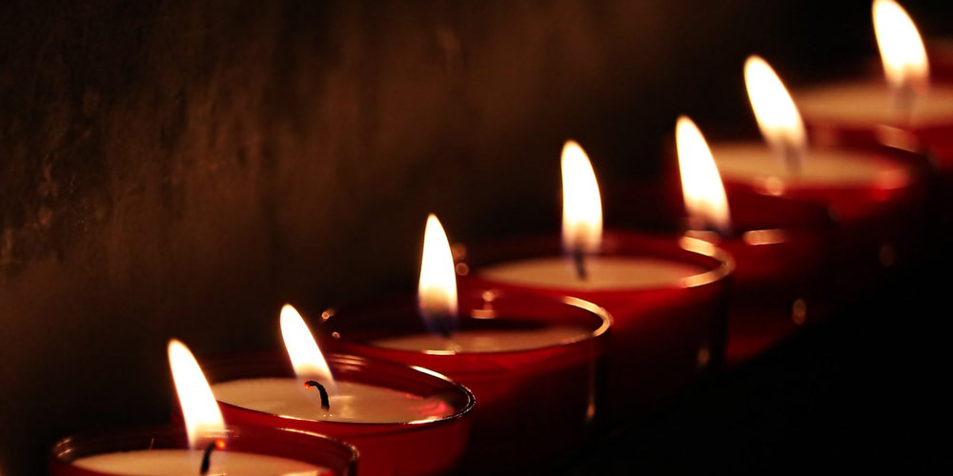
The Seven-Fold Spirit of God

Slide 2
LOVE
HUMILITY WISDOM TRUTH
REVIEW
FOUR LIGHTS

Slide 3
REVIEW
God is LIGHT
TRUTH:
Naked & Unashamed

Slide 4
The choice that Adam and Eve made was truth vs evil…
Light vs Darkness
REVIEW
TRUTH:
Naked & Unashamed

Slide 5
Lucifer offers us:
S PIN
T ORTURED LOGIC
A SSERTED FALSEHOODS
R EPARSING LANGUAGE
REVIEW
TRUTH:
Naked & Unashamed

Slide 6
TRUTH is essential aspect of the LIGHT OF JESUS.
REVIEW
TRUTH:
Naked & Unashamed

Slide 7
Jesus identified the problem with humanity…”They prefer darkness to light because their deeds are evil.”
REVIEW
TRUTH:
Naked & Unashamed

Slide 8
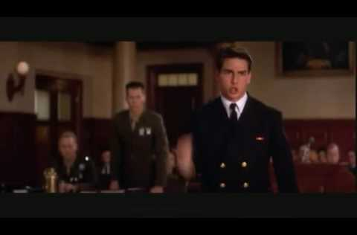
INTRODUCTION
TEN INCONVENIENTTRUTHS
Col. Jessup: You want answers?
Kaffee: I think I'm entitled to…
Col. Jessup: You want answers?
Kaffee: I WANT THE TRUTH!
Col. Jessup: YOU CAN'T HANDLE THE TRUTH!

Slide 9
CAN WE HANDLE THE TRUTH?
INTRODUCTION
TEN INCONVENIENTTRUTHS

Slide 10
Human nature tends to treat the One True God as last resort not FIRST resort.
POINT #1
TEN INCONVENIENTTRUTHS

Slide 11
Human nature tends to exalt created things into places of worship that belong only to God.
POINT #2
TEN INCONVENIENTTRUTHS

Slide 12
Human nature tends to devalue God’s nature and reputation and attribute to Him acts that He is not involved in.
POINT #3
TEN INCONVENIENTTRUTHS

Slide 13
Human nature tends to over-indulge and overdo in the physical to the point of forgetting God (spiritual)
POINT #4
TEN INCONVENIENTTRUTHS

Slide 14
Human nature tends to dis-honor and resent those who are not useful for the future.
POINT #5
TEN INCONVENIENTTRUTHS

Slide 15
Human nature tends to devalue people and see their life as an obstacle or a problem to be solved only by death.
POINT #6
TEN INCONVENIENTTRUTHS

Slide 16
Human nature tends to view marriage as a contract of the earth rather than a covenant before heaven.
POINT #7
TEN INCONVENIENTTRUTHS

Slide 17
Human nature tends to view material imbalance as only solvable through some sort of theft.
POINT #8
TEN INCONVENIENTTRUTHS

Slide 18
Human nature tends to betray those closest to them with a noble rationale.
POINT #9
TEN INCONVENIENTTRUTHS

Slide 19
Human nature tends to embrace jealousy and envy as helpful energy propelling them towards their goals.
POINT #10
TEN INCONVENIENTTRUTHS

Slide 20
The Ten Commandments do not grant life – they condemn the human nature to eternal capital punishment
CONCLUSION
TEN INCONVENIENTTRUTHS

Slide 21
The Law of God condemns the wickedness, iniquity, and sin of human nature…
CONCLUSION
TEN INCONVENIENTTRUTHS

Slide 22
BUT Jesus came to take the punishment due that human nature in order to give us a new nature!
CONCLUSION
TEN INCONVENIENTTRUTHS

