Slide 1
RESURRECTION

Slide 2
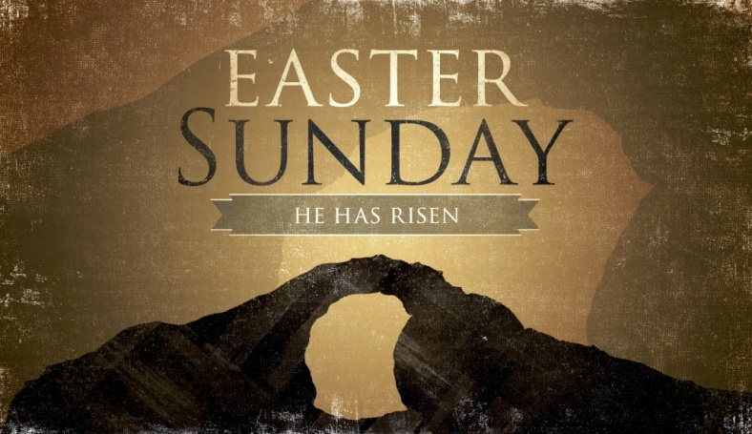
Why Resurrection?
INTRODUCTION

Slide 3
“Body stolen” “He swooned” “The Christ spirit”
INTRODUCTION

Slide 4
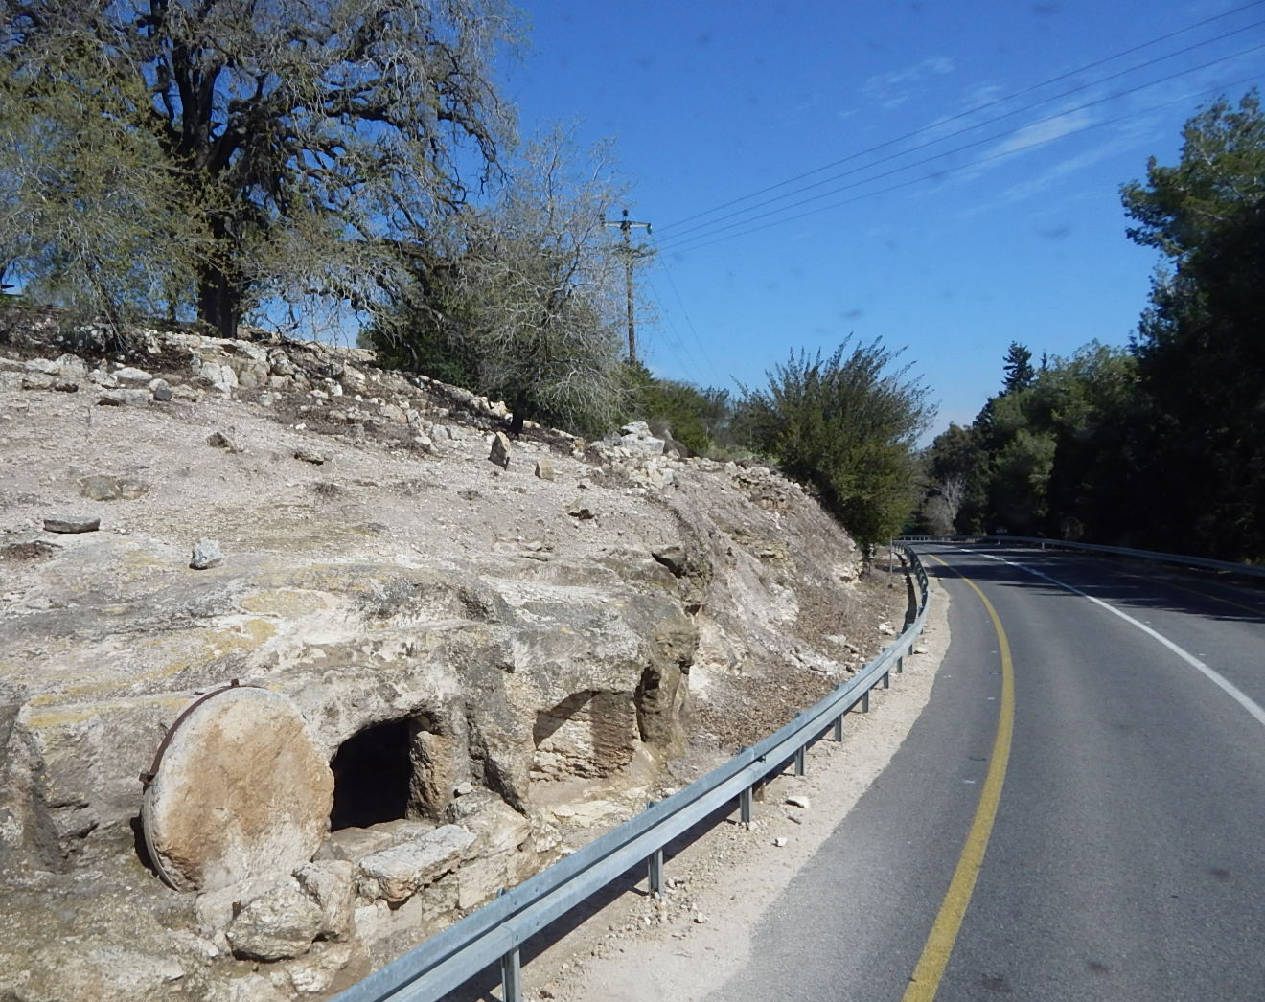
ILLUSTRATION

Slide 5
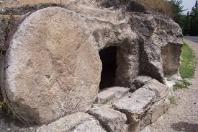
ILLUSTRATION

Slide 6
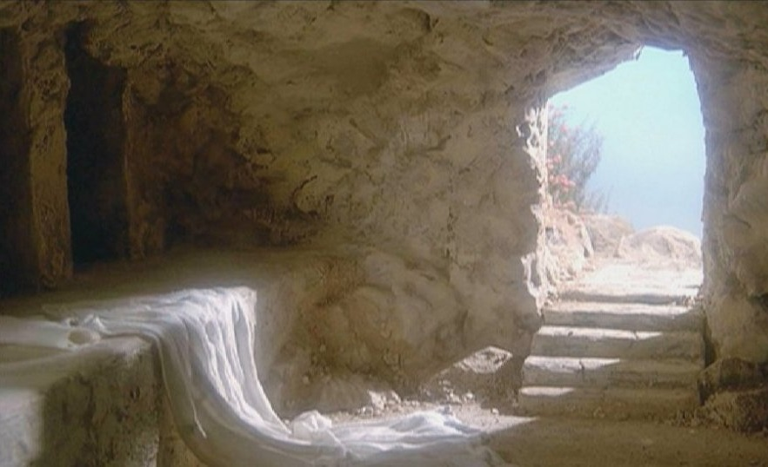
ILLUSTRATION

Slide 7
²⁵ He was delivered over to death for our sins and was raised to life for our justification.
Romans 4:25

Slide 8
He is Risen… because payment is accepted in full
Point #1

Slide 9
²⁴ But God raised him from the dead, freeing him from the agony of death, because it was impossible for death to keep its hold on him.
Acts 2:24

Slide 10
He is Risen… LIFE always beats DEATH LIGHT always shatters DARKNESS
Point #2

Slide 11
³⁴ God raised him from the dead so that he will never be subject to decay. As God has said, “‘I will give you the holy and sure blessings promised to David.’
Acts 13:34

Slide 12
He is Risen… to prove that God keeps His promises
Point #3

Slide 13
⁴ We were therefore buried with him through baptism into death in order that, just as Christ was raised from the dead through the glory of the Father, we too may live a new life.
Romans 6:4

Slide 14
He is Risen… because God gives us new LIFE
Point #4

Slide 15
¹⁰ then know this, you and all the people of Israel: It is by the name of Jesus Christ of Nazareth, whom you crucified but whom God raised from the dead, that this man stands before you healed.
Acts
4:10

Slide 16
He is Risen… so that His grace may be flow from His people
Point #5

Slide 17
¹⁴ because we know that the one who raised the Lord Jesus from the dead will also raise us with Jesus and present us with you to himself.
Second Corinthians4:14

Slide 18
He is Risen… because He is an example to us of our physical resurrection
Point #6

Slide 19
³¹ For he has set a day when he will judge the world with justice by the man he has appointed. He has given proof of this to everyone by raising him from the dead.”
Acts 17:31

Slide 20
He is Risen… because God will have a MAN judge all of mankind
Point #7

Slide 21
God is not in the condemnation and killing business but in the life and resurrection business
CONCLUSION

Slide 22
Where in your life do you need a RESURRECTION?
CONCLUSION

