Slide 1
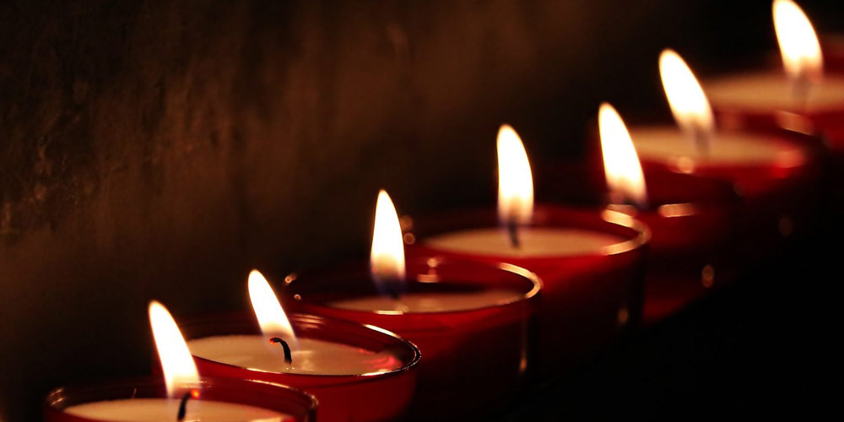
The Seven-Fold
Spirit of God

Slide 2
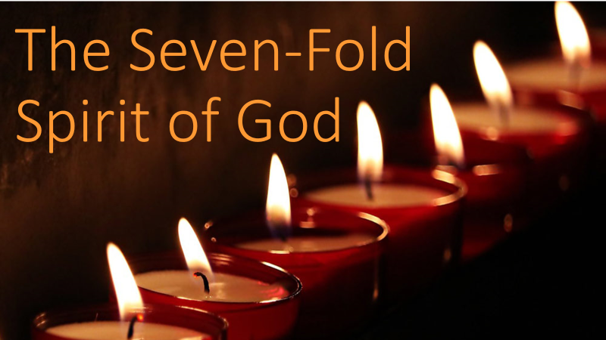
wis·dom
/ˈwizdəm/ noun
the body of knowledge and principles that develops within a specified society or period.
“the way things are done in God’s culture"
synonyms: knowledge of the Lord, learning God’s ways, study to shew yourself approved, love of what is true;
"the wisdom of God"
REVIEW
WISDOM:
FROM BELOW TO ABOVE

Slide 3
WISDOM puts us in the right frame of mind to walk in the culture of Heaven and handle God’s resources.
REVIEW
WISDOM:
OFF TO A GOOD START

Slide 4
WISDOMfrom below
A song of TWO notes
Bitter Envy
Selfish Ambition
WISDOM
WISDOM: FROM BELOW TO ABOVE

Slide 5
WISDOMfrom below
Three Characteristics
Earthly
Unspiritual
Demonic
REVIEW
WISDOM: FROM BELOW TO ABOVE

Slide 6
WISDOMfrom above
SEVEN Characteristics
Pure
Peace-Loving
Considerate
Submissive
Full of mercy & good fruit
Impartial
Sincere
REVIEW
WISDOM: FROM BELOW TO ABOVE

Slide 7
WISDOM
The Way GOD
goes about doing
what He does
INTRODUCTION
WISDOM: THE AMAZING WAYS OF GOD

Slide 8
“For my thoughts are not your thoughts, neither are your ways my ways,” declares the Lord.
“As the heavens are higher than the earth, so are my ways higher than your ways and my thoughts than your thoughts. Isaiah 55:8-9
SCRIPTURE
WISDOM:
THE AMAZING WAYS OF GOD

Slide 9
Oh, the depth of the riches of the wisdom and knowledge of God! How unsearchable his judgments, and his paths beyond tracing out! “Who has known the mind of the Lord? Or who has been his counselor?” “Who has ever given to God, that God should repay them?” For from him and through him and for him are all things. To him be the glory forever! Amen. Romans 11:33-36
SCRIPTURE
WISDOM:
THE AMAZING WAYS OF GOD

Slide 10
THE WISDOM OF GOD CANNOT BE FOUND FROM THE HUMAN POSITION
POINT #1
WISDOM: THE AMAZING WAYS OF GOD

Slide 11
He made known his ways to Moses, his deeds to the people of Israel:
The Lord is compassionate and gracious, slow to anger, abounding in love.
Psalm 103:7,8
SCRIPTURE
WISDOM:
THE AMAZING WAYS OF GOD

Slide 12
FEW HAVE DISCOVERED WISDOM
MULTITUDES HAVE ENJOYED ITS BENEFITS
POINT #2
WISDOM: THE AMAZING WAYS OF GOD

Slide 13
Enoch – walked w God
Noah-received instruction
Abraham-went to a land
Moses – face to face friend
David – knew His presence
Solomon – asked for it
Jesus – received fullness
POINT #2
WISDOM: THE AMAZING WAYS OF GOD

Slide 14
For God has bound everyone over to disobedience so that he may have mercy on them all.
Romans 11:32
SCRIPTURE
WISDOM:
THE AMAZING WAYS OF GOD

Slide 15
For the message of the cross is foolishness to those who are perishing, but to us who are being saved it is the power of God. For it is written: "I will destroy the wisdom of the wise; the intelligence of the intelligent I will frustrate." Where is the wise man? Where is the scholar? Where is the philosopher of this age? Has not God made foolish the wisdom of the world? For since in the wisdom of God the world through its wisdom did not know him, God was pleased through the foolishness of what was preached to save those who believe.
1 Cor 1:18-21
SCRIPTURE
WISDOM:
THE AMAZING WAYS OF GOD

Slide 16
GOD’S WISDOM APPEARS TO BE UPSIDE-DOWN AND BACKWARD
POINT #3
WISDOM: THE AMAZING WAYS OF GOD

Slide 17
Empty to become full
Decrease to increase
Less becomes more
Ruler of little then much
Small beginnings
Younger leads the elder
Foolish instructs the wise
POINT #3
WISDOM: THE AMAZING WAYS OF GOD

Slide 18
The problem is that God does appear upside-down!
But HE HAS NEVER MOVED WE HAVE!
POINT #3
WISDOM: THE AMAZING WAYS OF GOD

Slide 19
God’s entire plan for man was to thoroughly expose him as guilty so that he could thoroughly redeem him and exalt him back to his intended place.
POINT #3
WISDOM: THE AMAZING WAYS OF GOD

Slide 20
“Do not let your hearts be troubled. You believe in God; believe also in me. My Father’s house has many rooms; if that were not so, would I have told you that I am going there to prepare a place for you? And if I go and prepare a place for you, I will come back and take you to be with me that you also may be where I am. You know the way to the place where I am going.” Thomas said to him, “Lord, we don’t know where you are going, so how can we know the way?” Jesus answered, “I am the way and the truth and the life. No one comes to the Father except through me. John 14:1-6
SCRIPTURE
WISDOM:
THE AMAZING WAYS OF GOD

Slide 21
GOD’S WAYS WERE PACKED INTO A HUMAN BEING
POINT #4
WISDOM: THE AMAZING WAYS OF GOD

Slide 22
Jesus is the wisdom of God in a form we can handle, understand, and receive
POINT #4
WISDOM: THE AMAZING WAYS OF GOD

Slide 23
We still need some help getting there…
POINT #4
WISDOM: THE AMAZING WAYS OF GOD

Slide 24
I keep asking that the God of our Lord Jesus Christ, the glorious Father, may give you the Spirit of wisdom and revelation, so that you may know him better. Ephesians 1:17
SCRIPTURE
WISDOM:
THE AMAZING WAYS OF GOD

Slide 25
THE SPIRIT OF WISDOM REVEALS JESUS :
TO
IN &
THROUGH
US
POINT #5
WISDOM: THE AMAZING WAYS OF GOD

Slide 26
… beyond our resources & ways
… come from receiving
…seem upside down and backward
…have been made flesh
…require revelation by the Spirit
CONCLUSION
WISDOM:
THE AMAZING WAYS OF GOD

