Slide 1
What is your default setting?

Slide 2
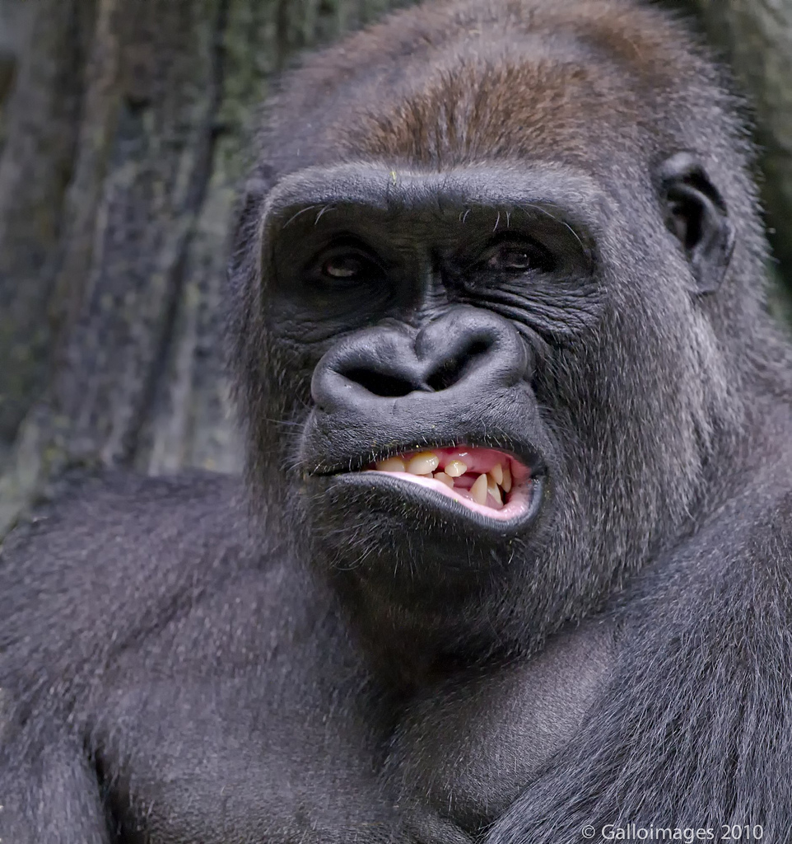

Slide 3
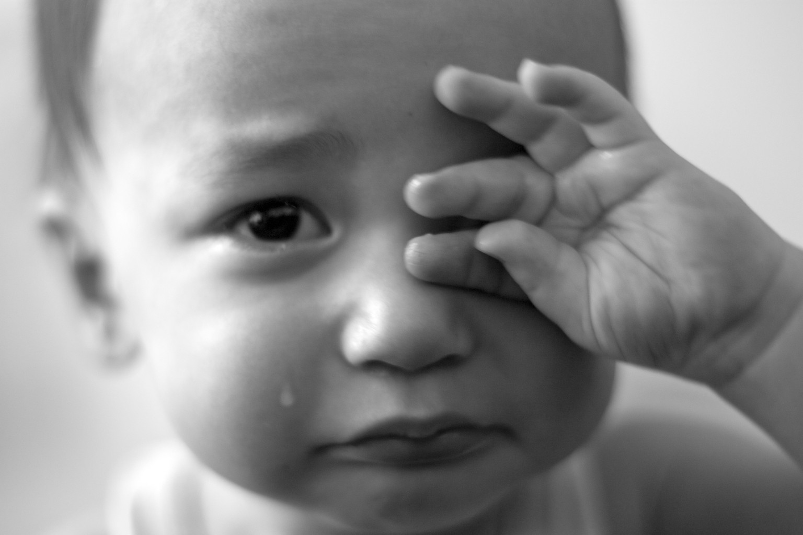

Slide 4
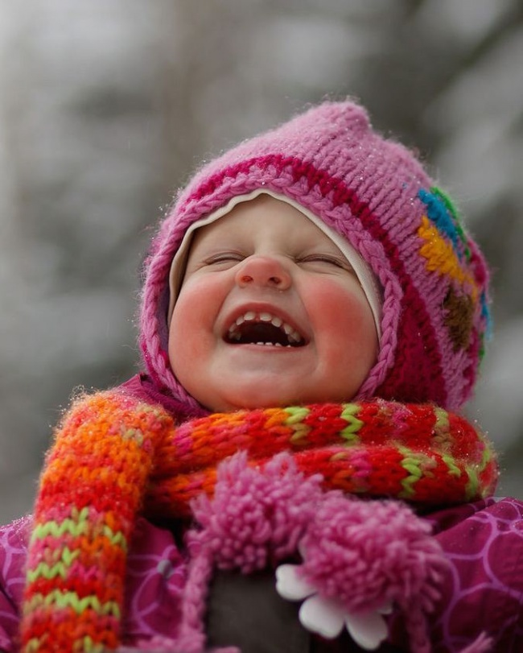

Slide 5
Humans are emotional beings and can be ruled by their emotions.

Slide 6
GRUMBLING

Slide 7
to murmur, mutter, grumble, say anything against in a low tone
  of the cooing of doves
  of those who confer secretly together
of those who discontentedly complain

Slide 8
Philippians 2:12-13
Therefore, my dear friends, as you have always obeyed—not only in my presence, but now much more in my absence—continue to work out your salvation with fear and trembling,
for it is God who works in you to will and to act in order to fulfill his good purpose.

Slide 9
Philippians 2:14-16
Do everything without grumbling or arguing,
so that you may become blameless and pure, “children of God without fault in a warped and crooked generation.” Then you will shine among them like stars in the sky
as you hold firmly to the word of life. And then I will be able to boast on the day of Christ that I did not run or labor in vain.

Slide 10
Exodus 14:11-13
They said to Moses, “Was it because there were no graves in Egypt that you brought us to the desert to die? What have you done to us by bringing us out of Egypt?
Didn’t we say to you in Egypt, ‘Leave us alone; let us serve the Egyptians’? It would have been better for us to serve the Egyptians than to die in the desert!”
Moses answered the people, “Do not be afraid. Stand firm and you will see the deliverance the LORD will bring you today. The Egyptians you see today you will never see again.

Slide 11
ARGUING

Slide 12
the thinking of a man deliberating with himself
  a. a thought, inward reasoning
  b. purpose, design
a deliberating, questioning about what is true
  a. hesitation, doubting
3. disputing, arguing

Slide 13
ANGER

Slide 14
James 1:19-20
My dear brothers and sisters, take note of this: Everyone should be quick to listen, slow to speak and slow to become angry,
because human anger does not produce the righteousness that God desires.

Slide 15
anger, the natural disposition, temper, character
movement or agitation of the soul, impulse, desire, any violent emotion, but esp. anger
3. anger, wrath, indignation
anger exhibited in punishment, hence used for punishment itself
a. of punishments inflicted by magistrates

Slide 16
OBEDIENCE

Slide 17
to listen, to harken of one who on the knock at the door comes to listen who it is, (the duty of a porter) to harken to a command to obey, be obedient to, submit to

Slide 18
HOLD ON!

Slide 19
2 Thessalonians 2:15
So then, brothers and sisters, stand firm and hold fast to the teachings we passed on to you, whether by word of mouth or by letter.

Slide 20
THANKFULNESS

Slide 21
Mindful of favors, grateful, thankful
Pleasing, agreeable.
Acceptable to others

Slide 22
Colossians 3:15
Let the peace of Christ rule in your hearts, since as members of one body you were called to peace. And be thankful.

Slide 23
What is your default setting?

Slide 24
Is your default setting:
Grumbling?
Arguing?
Anger?
Obedience?
Holding on to God?
Thankfulness?

Slide 25
Is your default setting pleasing to God?

