Slide 1
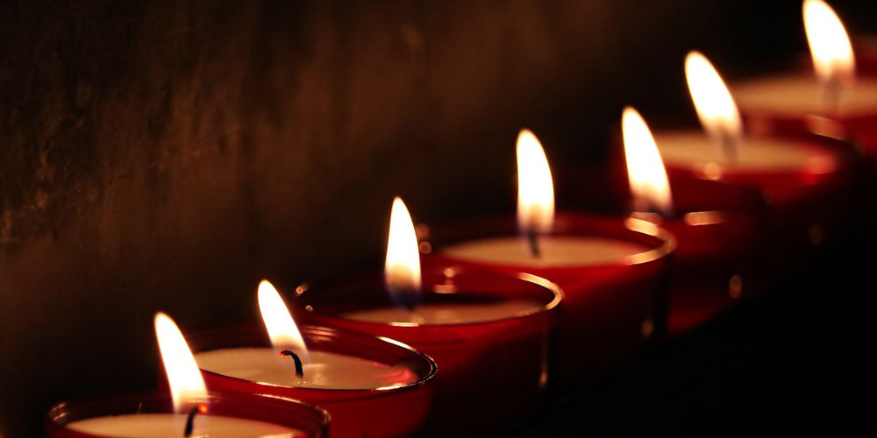
The Seven-Fold Spirit of God

Slide 2
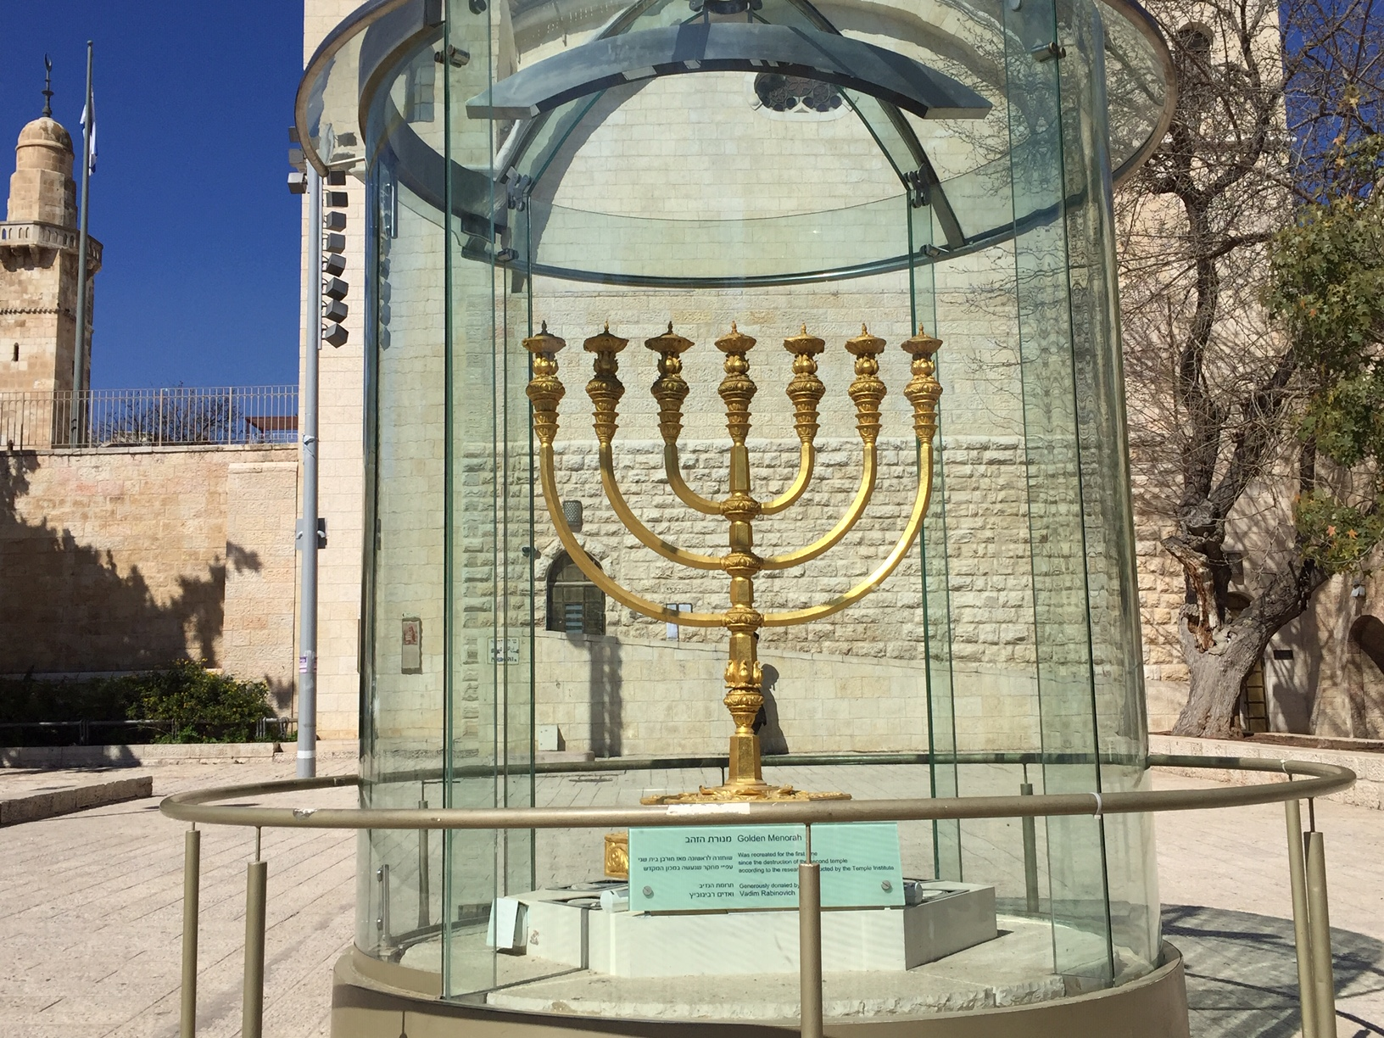

Slide 3
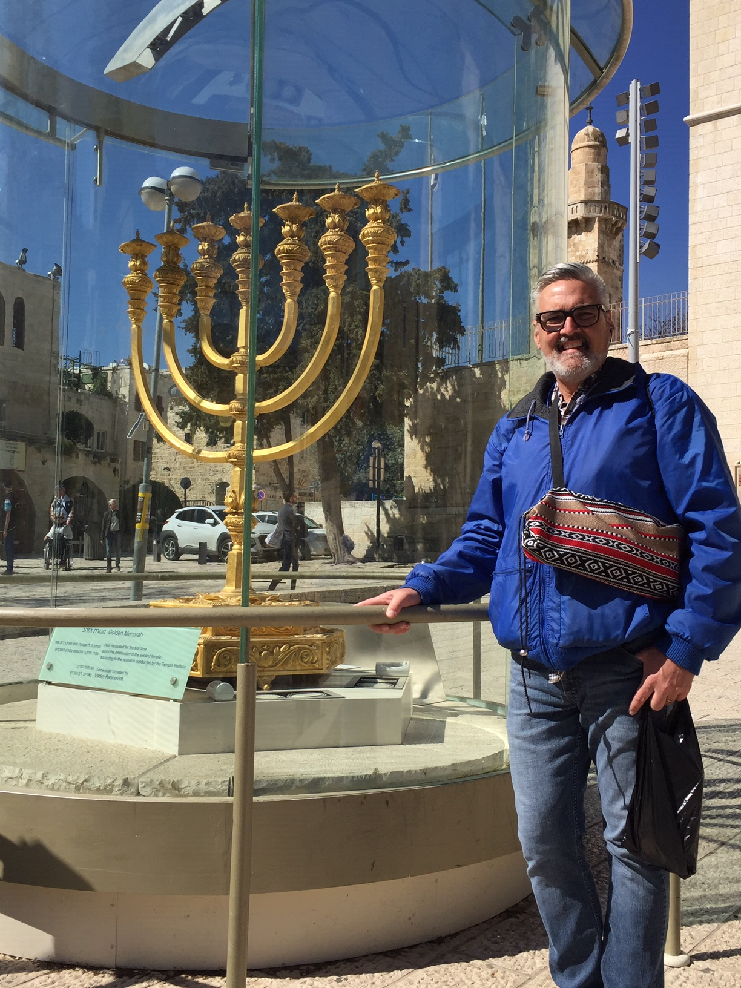

Slide 4
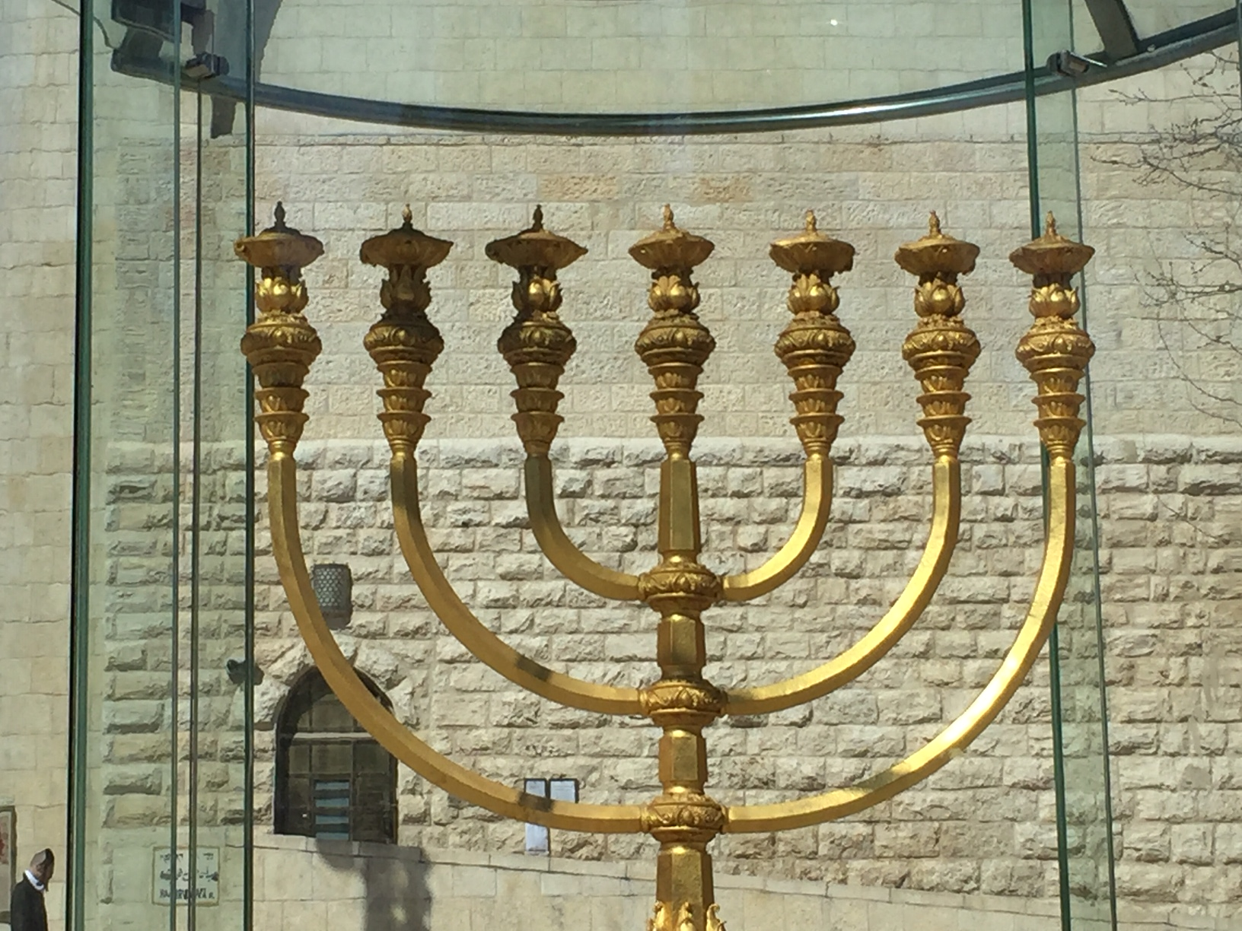

Slide 5
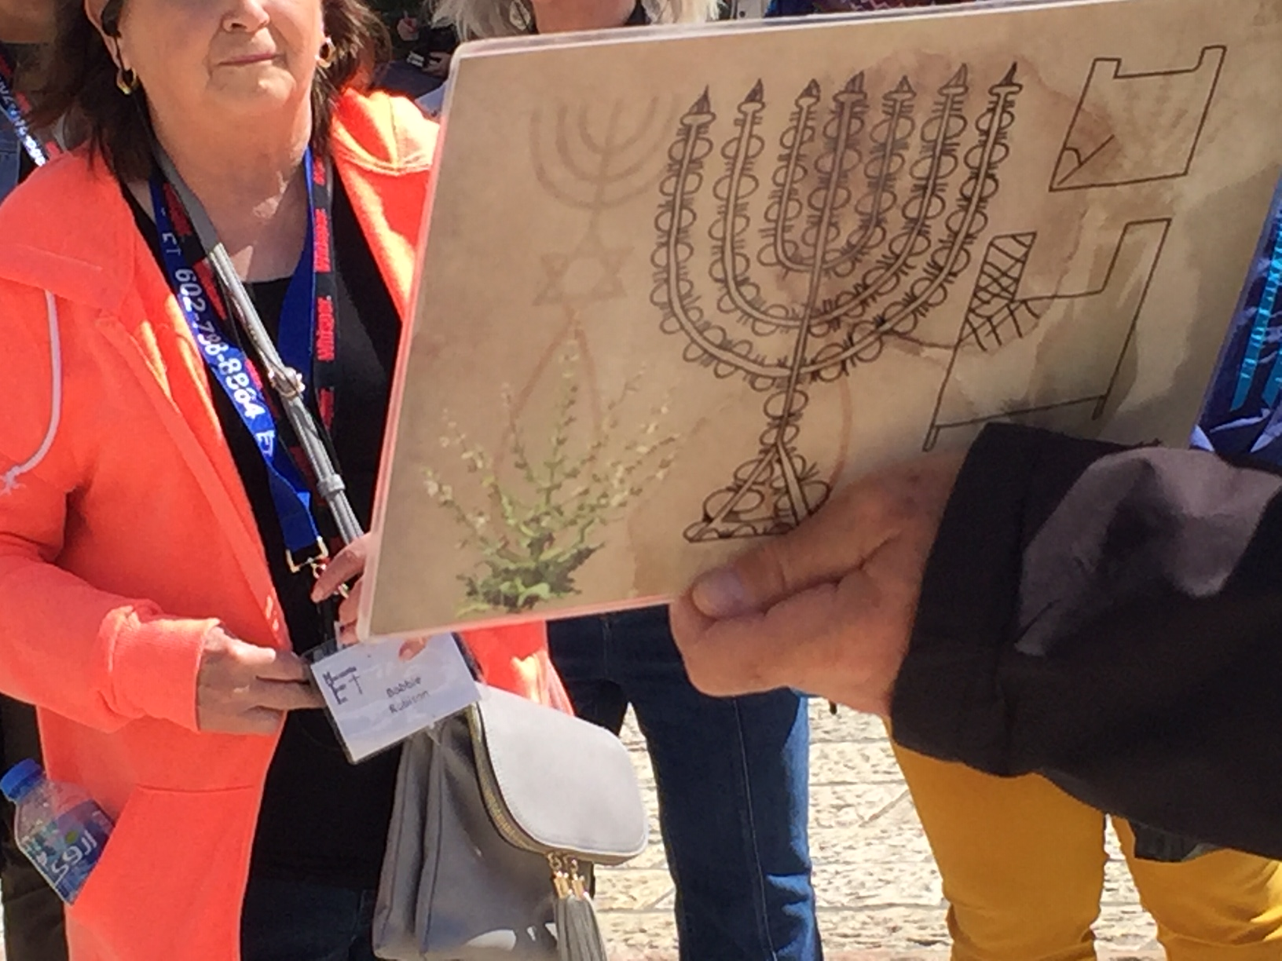

Slide 6
Personal
Recongition:
“I
Deserve
Everything”
REVIEW
A LESSON FROM DARKNESS

Slide 7
LIFE IS MORE THAN:
Provision
Power
Prestige
REVIEW
A LESSON FROM DARKNESS

Slide 8
HUMILITY
REVIEW
Jesus is the Light of the World and he blazes with humility –
What a contrast!
A LESSON FROM DARKNESS

Slide 9
It is not about ability it is about availability
It is not about position but proximity
It is not about ovations but about obedience
REVIEW
THE INCREDIBLE POWER OF SERVANTHOOD

Slide 10
HUMILITY puts us in the right posture in the right place to handle the provision of Heaven.
REVIEW
THE INCREDIBLE POWER OF SERVANTHOOD

Slide 11
JESUS
The highest ONE became the LEAST of all
REVIEW
DEFINITELY WORTH IMITATING

Slide 12
Wisdom – a definition
INTRODUCTION
WISDOM:
OFF TO A GOOD START

Slide 13
wis·dom
/ˈwizdəm/ noun
the quality of having experience, knowledge, and good judgment; the quality of being wise.
synonyms: sagacity, sageness, intelligence, understanding, insight, perception, perceptiveness, percipience, penetration, perspicuity, acuity, discernment, sense, good sense, common sense, shrewdness, astuteness, acumen, smartness, judiciousness, judgment, foresight, clear-sightedness, prudence, circumspection;
INTRODUCTION
WISDOM:
OFF TO A GOOD START

Slide 14
wis·dom
/ˈwizdəm/ noun
the soundness of an action or decision with regard to the application of experience, knowledge, and good judgment.
"some questioned the wisdom of building the dam so close to an active volcano“
INTRODUCTION
WISDOM:
OFF TO A GOOD START

Slide 15
wis·dom
/ˈwizdəm/ noun
the body of knowledge and principles that develops within a specified society or period.
"the traditional farming wisdom of India"
synonyms: knowledge, learning, erudition, scholarship, philosophy; lore
"the wisdom of the ancients"
INTRODUCTION
WISDOM:
OFF TO A GOOD START

Slide 16
For the director of music. Of David. The fool says in his heart, "There is no God." They are corrupt, their deeds are vile; there is no one who does good.
Psalm 14:1
SCRIPTURE
WISDOM:
OFF TO A GOOD START

Slide 17
WISDOM
Atheism and Agnosticism have a lot to teach us
POINT #1
WISDOM: OFF TO A GOOD START

Slide 18
ATHEISM – there is NO God/gods
AGNOSTICISM- if there is a God/gods we probably cannot know him/them
POINT #1
WISDOM: OFF TO A GOOD START

Slide 19
ATHEISM – foolishness with NO hope.
AGNOSTICISM- foolishness with SOME hope
POINT #1
WISDOM: OFF TO A GOOD START

Slide 20
The life lived this way is one filled with self-wisdom and self-light.
AVOID LIVING THIS WAY
POINT #1
WISDOM: OFF TO A GOOD START

Slide 21
The fear of the Lord is the beginning of wisdom, and knowledge of the Holy One is understanding.
Proverbs 9:10
SCRIPTURE
WISDOM:
OFF TO A GOOD START

Slide 22
WISDOM
The right kind of fear
The right kind of understanding
POINT #2
WISDOM: OFF TO A GOOD START

Slide 23
Awe, reverence, and respect is the right kind of fear
NOT PARANOIA
POINT #2
WISDOM: OFF TO A GOOD START

Slide 24
The Word of God, lives lived according to the Word of God, and self-evident quality life
RIGHT UNDERSTANDING
POINT #2
WISDOM: OFF TO A GOOD START

Slide 25
Get wisdom, get understanding;
do not forget my words or turn away from them.
Do not forsake wisdom, and she will protect you; love her, and she will watch over you.
Proverbs 4:5-9
SCRIPTURE
WISDOM:
OFF TO A GOOD START

Slide 26
The beginning of wisdom is this: Get wisdom. Though it cost all you have, get understanding. Cherish her, and she will exalt you; embrace her, and she will honor you. She will give you a garland to grace your head and present you with a glorious crown.
Proverbs 4:5-9
SCRIPTURE
WISDOM:
OFF TO A GOOD START

Slide 27
WISDOM
“ She’s got a way about her”
POINT #3
WISDOM: OFF TO A GOOD START

Slide 28
WISDOM
Cling to her – she will protect you
POINT #3
WISDOM: OFF TO A GOOD START

Slide 29
WISDOM
Cling to her – she will protect you
POINT #3
WISDOM: OFF TO A GOOD START

Slide 30
WISDOM
Love her – she will watch over you
POINT #3
WISDOM: OFF TO A GOOD START

Slide 31
WISDOM
Be Desperate
Invest Everything
POINT #3
WISDOM: OFF TO A GOOD START

Slide 32
WISDOM
Cherish wisdom
Become exalted
POINT #3
WISDOM: OFF TO A GOOD START

Slide 33
WISDOM
Embrace wisdom
Become honorable
POINT #3
WISDOM: OFF TO A GOOD START

Slide 34
WISDOM
Becomes a crown
(white hair is often described this way – Jesus has white hair)
POINT #3
WISDOM: OFF TO A GOOD START

Slide 35
WISDOM puts us in the right frame of mind to walk in the culture of Heaven and handle God’s resources.
CONCLUSION
THE INCREDIBLE POWER OF SERVANTHOOD

Slide 36
Turn away from unbelief and disbelief – the Atheist and the Agnostic are not your friend. ASK FOR HELP FROM THE SPIRIT OF WISDOM AND SEE WHAT HAPPENS!
CONCLUSION
WISDOM: OFF TO A GOOD START

Slide 37
2. Let go of PARANOIA and empty tradition and ASK FOR A NEW RESPECT, AWE and REVERENCE AND SEE HOW THE SPIRIT OF WISDOM RESPONDS.
CONCLUSION
WISDOM: OFF TO A GOOD START

Slide 38
3. Become a PURSUER of the Spirit of Wisdom. Go after the Word and the Spirit like never before. ASK THE SPIRIT OF WISDOM TO DO SOMETHING WITH YOUR HEART, SEE WHAT HAPPENS!
CONCLUSION
WISDOM: OFF TO A GOOD START

