Slide 1
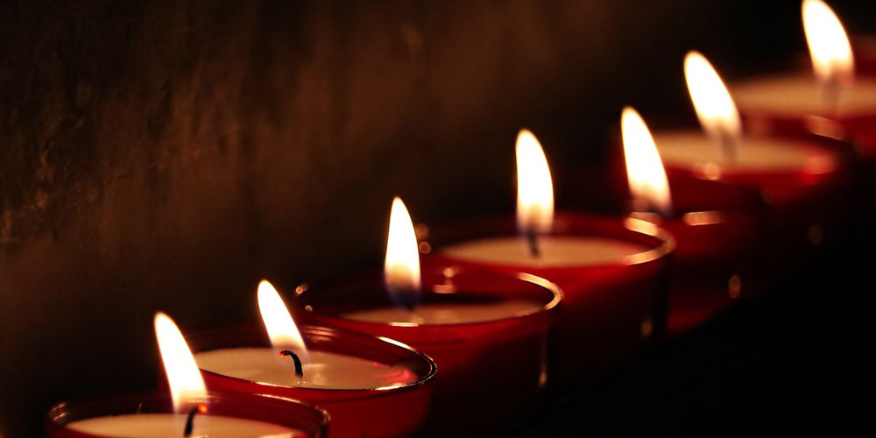
The Seven-Fold Spirit of God

Slide 2
We should learn from servants since we are surrounded by them.
REVIEW
THE INCREDIBLE POWER OF SERVANTHOOD

Slide 3
SERVANTS
Servants do not get the Glory.
Servants make all the difference.
REVIEW
THE INCREDIBLE POWER OF SERVANTHOOD

Slide 4
They are everywhere
They are involved
The are in the know
REVIEW
DEFINITELY WORTH IMITATING

Slide 5
HUMILITY
REVIEW
Jesus is the Light of the World and he blazes with humility!
THE INCREDIBLE POWER OF SERVANTHOOD

Slide 6
Therefore if you have any encouragement from being united with Christ, if any comfort from his love, if any common sharing in the Spirit, if any tenderness and compassion, then make my joy complete by being like-minded, having the same love, being one in spirit and of one mind.
Do nothing out of selfish ambition or vain conceit. Rather, in humility value others above yourselves, not looking to your own interests but each of you to the interests of the others. Philippians 2:1-4
SCRIPTURE
DEFINITELY WORTH IMITATING

Slide 7
In your relationships with one another, have the same mindset as Christ Jesus: Who, being in very nature God, did not consider equality with God something to be used to his own advantage; rather, he made himself nothing by taking the very nature of a servant, being made in human likeness.
Philippians 2:5-7
SCRIPTURE
DEFINITELY WORTH IMITATING

Slide 8
And being found in appearance as a man, he humbled himself by becoming obedient to death— even death on a cross! Therefore God exalted him to the highest place and gave him the name that is above every name, that at the name of Jesus every knee should bow, in heaven and on earth and under the earth, and every tongue acknowledge that Jesus Christ is Lord, to the glory of God the Father. Philippians 2: 8-11
SCRIPTURE
DEFINITELY WORTH IMITATING

Slide 9
Love God
Love People
Point One
DEFINITELY WORTH IMITATING

Slide 10
Teacher, which is the greatest commandment in the Law?”
Jesus replied: “ ‘Love the Lord your God with all your heart and with all your soul and with all your mind.’ This is the first and greatest commandment.
And the second is like it: ‘Love your neighbor as yourself.’ Matthew 22:36-39
Scripture
DEFINITELY WORTH IMITATING

Slide 11
Make my joy complete by being of the same mind, having the same love (toward one another), knit together in spirit, intent on one purpose (and living a life that reflects your faith and spreads the gospel—the good news regarding salvation through faith in Christ). Philippians 2:2 AMP
Scripture
DEFINITELY WORTH IMITATING

Slide 12
Live your faith!
Point Two
DEFINITELY WORTH IMITATING

Slide 13
Don’t be selfish!
We were born that way but we don’t have to stay that way.
Point Three
DEFINITELY WORTH IMITATING

Slide 14
ATTITUDE IS EVERYTHING!
Point Four
DEFINITELY WORTH IMITATING

Slide 15
Attitude is like a flat tire. If you don’t change it you will never go anywhere.
Point Four
DEFINITELY WORTH IMITATING

Slide 16
Do everything without grumbling or arguing, so that you may become blameless and pure, “children of God without fault in a warped and crooked generation.” Then you will shine among them like stars in the sky.
Philippians 2:14-15
SCRIPTURE
DEFINITELY WORTH IMITATING

Slide 17
We must be obedient!
Point Five
DEFINITELY WORTH IMITATING

Slide 18
The proof of our love for God is our obedience to the commands of God.
Point Five
DEFINITELY WORTH IMITATING

Slide 19
Love is essential.
Live out loud.
Live Second.
Lose the bad attitude.
Listen and Obey.
CONCLUSION
DEFINITELY WORTH IMITATING

Slide 20
If being like Christ is our goal then humility is essential and definitely worth imitating.
CONCLUSION
DEFINITELY WORTH IMITATING

Slide 21
Behavioral Change – Heart Change = Temporary Change
Heart Change + Behavioral Change = Permanent Change
CONCLUSION
DEFINITELY WORTH IMITATING

Slide 22
Have you fallen short in:
Loving God and others?
Living out loud?
Living second?
Losing the bad attitude?
Listening and obeying?
CONCLUSION
DEFINITELY WORTH IMITATING

