Slide 1
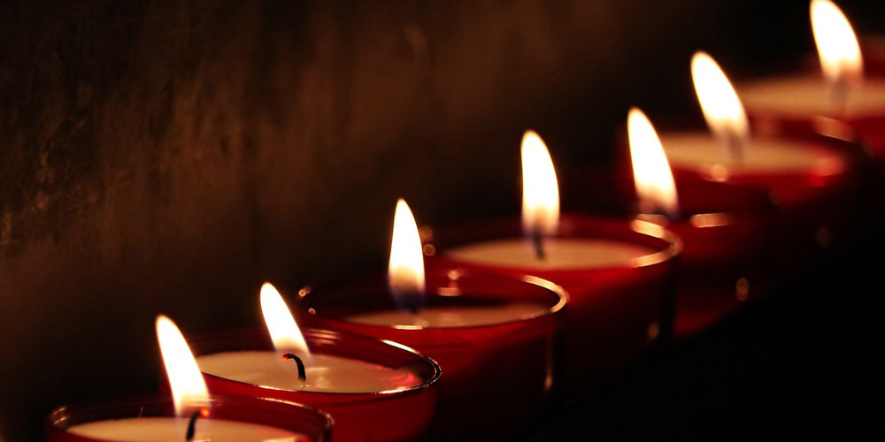
The Seven-Fold Spirit of God

Slide 2
Personal
Recongition:
“I
Deserve
Everything”
REVIEW
A LESSON FROM DARKNESS

Slide 3
PRIDE
Infected the heavenly creation and caused a fall”
REVIEW
A LESSON FROM DARKNESS

Slide 4
PRIDE
Infected the earthly creation and caused a fall”
POINT #1
A LESSON FROM DARKNESS

Slide 5
HUMILITY
REVIEW
Jesus is the Light of the World and he blazes with humility –
What a contrast!
A LESSON FROM DARKNESS

Slide 6
LIFE IS MORE THAN:
Provision
Power
Prestige
REVIEW
A LESSON FROM DARKNESS

Slide 7
They are everywhere
They are involved
The are in the know
INTRODUCTION
THE INCREDIBLE POWER OF SERVANTHOOD

Slide 8
We should learn from servants since we are surrounded by them.
INTRODUCTION
THE INCREDIBLE POWER OF SERVANTHOOD

Slide 9
THREE POWERFUL STORIES ABOUT SERVANTS
INTRODUCTION
THE INCREDIBLE POWER OF SERVANTHOOD

Slide 10
5 Now Naaman was commander of the army of the king of Aram. He was a great man in the sight of his master and highly regarded, because through him the Lord had given victory to Aram. He was a valiant soldier, but he had leprosy.^{[a]}
² Now bands of raiders from Aram had gone out and had taken captive a young girl from Israel, and she served Naaman’s wife. ³ She said to her mistress, “If only my master would see the prophet who is in Samaria! He would cure him of his leprosy.” 2 Kings 5:1-19
SCRIPTURE
THE INCREDIBLE POWER OF SERVANTHOOD

Slide 11
⁴ Naaman went to his master and told him what the girl from Israel had said. ⁵ “By all means, go,” the king of Aram replied. “I will send a letter to the king of Israel.” So Naaman left, taking with him ten talents^{[b]} of silver, six thousand shekels^{[c]} of gold and ten sets of clothing. ⁶ The letter that he took to the king of Israel read: “With this letter I am sending my servant Naaman to you so that you may cure him of his leprosy.” 2 Kings 5:1-19
SCRIPTURE
THE INCREDIBLE POWER OF SERVANTHOOD

Slide 12
⁷ As soon as the king of Israel read the letter, he tore his robes and said, “Am I God? Can I kill and bring back to life? Why does this fellow send someone to me to be cured of his leprosy? See how he is trying to pick a quarrel with me!”
⁸ When Elisha the man of God heard that the king of Israel had torn his robes, he sent him this message: “Why have you torn your robes? Have the man come to me and he will know that there is a prophet in Israel.” 2 Kings 5:1-19
SCRIPTURE
THE INCREDIBLE POWER OF SERVANTHOOD

Slide 13
⁹ So Naaman went with his horses and chariots and stopped at the door of Elisha’s house. ¹⁰ Elisha sent a messenger to say to him, “Go, wash yourself seven times in the Jordan, and your flesh will be restored and you will be cleansed.”
¹¹ But Naaman went away angry and said, “I thought that he would surely come out to me and stand and call on the name of the Lord his God, wave his hand over the spot and cure me of my leprosy. ¹² Are not Abana and Pharpar, the rivers of Damascus, better than all the waters of Israel? Couldn’t I wash in them and be cleansed?” So he turned and went off in a rage. 2 Kings 5:1-19
SCRIPTURE
THE INCREDIBLE POWER OF SERVANTHOOD

Slide 14
¹³ Naaman’s servants went to him and said, “My father, if the prophet had told you to do some great thing, would you not have done it? How much more, then, when he tells you, ‘Wash and be cleansed’!” ¹⁴ So he went down and dipped himself in the Jordan seven times, as the man of God had told him, and his flesh was restored and became clean like that of a young boy.
¹⁵ Then Naaman and all his attendants went back to the man of God. He stood before him and said, “Now I know that there is no God in all the world except in Israel. So please accept a gift from your servant.” 2 Kings 5:1-19
SCRIPTURE
THE INCREDIBLE POWER OF SERVANTHOOD

Slide 15
¹⁶ The prophet answered, “As surely as the Lord lives, whom I serve, I will not accept a thing.” And even though Naaman urged him, he refused.
¹⁷ “If you will not,” said Naaman, “please let me, your servant, be given as much earth as a pair of mules can carry, for your servant will never again make burnt offerings and sacrifices to any other god but the Lord.¹⁸ But may the Lord forgive your servant for this one thing: When my master enters the temple of Rimmon to bow down and he is leaning on my arm and I have to bow there also—when I bow down in the temple of Rimmon, may the Lord forgive your servant for this.”
¹⁹ “Go in peace,” Elisha said. 2 Kings 5:1-19
SCRIPTURE
THE INCREDIBLE POWER OF SERVANTHOOD

Slide 16
The Kidnapped Hand-Maiden
The Leading General – Naaman
The King of Aram
The King of Israel
The Man of God - Elisha
The Servants of the General
The Servant of the Man of God - Gehazi
POINT #1
THE INCREDIBLE POWER OF SERVANTHOOD

Slide 17
And there were shepherds living out in the fields nearby, keeping watch over their flocks at night. An angel of the Lord appeared to them, and the glory of the Lord shone around them, and they were terrified.
Luke 2:8-18
SCRIPTURE
THE INCREDIBLE POWER OF SERVANTHOOD

Slide 18
But the angel said to them, “Do not be afraid. I bring you good news that will cause great joy for all the people. Today in the town of David a Savior has been born to you; he is the Messiah, the Lord. This will be a sign to you: You will find a baby wrapped in cloths and lying in a manger.”
Luke 2:8-18
SCRIPTURE
THE INCREDIBLE POWER OF SERVANTHOOD

Slide 19
Suddenly a great company of the heavenly host appeared with the angel, praising God and saying,
“Glory to God in the highest heaven,
and on earth peace to those on whom his favor rests.”
When the angels had left them and gone into heaven, the shepherds said to one another, “Let’s go to Bethlehem and see this thing that has happened, which the Lord has told us about.”
Luke 2:8-18
SCRIPTURE
THE INCREDIBLE POWER OF SERVANTHOOD

Slide 20
So they hurried off and found Mary and Joseph, and the baby, who was lying in the manger. When they had seen him, they spread the word concerning what had been told them about this child, and all who heard it were amazed at what the shepherds said to them.
Luke 2:8-18
SCRIPTURE
THE INCREDIBLE POWER OF SERVANTHOOD

Slide 21
Servants of the Priesthood - Shepherds
Servants of Heaven - Angels
Servant of the Lord - Mary
Servant of the Lord - Joseph
POINT #2
THE INCREDIBLE POWER OF SERVANTHOOD

Slide 22
On the third day a wedding took place at Cana in Galilee. Jesus’ mother was there, ² and Jesus and his disciples had also been invited to the wedding. ³ When the wine was gone, Jesus’ mother said to him, “They have no more wine.”
⁴ “Woman,^{[a]} why do you involve me?” Jesus replied. “My hour has not yet come.”
John 2:1-11
SCRIPTURE
THE INCREDIBLE POWER OF SERVANTHOOD

Slide 23
⁵ His mother said to the servants, “Do whatever he tells you.”
⁶ Nearby stood six stone water jars, the kind used by the Jews for ceremonial washing, each holding from twenty to thirty gallons.
⁷ Jesus said to the servants, “Fill the jars with water”; so they filled them to the brim.
John 2:1-11
SCRIPTURE
THE INCREDIBLE POWER OF SERVANTHOOD

Slide 24
⁸ Then he told them, “Now draw some out and take it to the master of the banquet.”
They did so, ⁹ and the master of the banquet tasted the water that had been turned into wine. He did not realize where it had come from, though the servants who had drawn the water knew.
John 2:1-11
SCRIPTURE
THE INCREDIBLE POWER OF SERVANTHOOD

Slide 25
Then he called the bridegroom aside ¹⁰ and said, “Everyone brings out the choice wine first and then the cheaper wine after the guests have had too much to drink; but you have saved the best till now.”
¹¹ What Jesus did here in Cana of Galilee was the first of the signs through which he revealed his glory; and his disciples believed in him.
John 2:1-11
SCRIPTURE
THE INCREDIBLE POWER OF SERVANTHOOD

Slide 26
Crowd
Guests of Honor
Servant of the Family - Mary
The Lord - Jesus
Servants of the Feast
Master of the Banquet
Disciples – servants of Jesus
POINT #3
THE INCREDIBLE POWER OF SERVANTHOOD

Slide 27
It is not about ability it is about availability
It is not about position but proximity
It is not about ovations but about obedience
CONCLUSION
THE INCREDIBLE POWER OF SERVANTHOOD

Slide 28
HUMILITY puts us in the right posture in the right place to handle the provision of Heaven.
CONCLUSION
THE INCREDIBLE POWER OF SERVANTHOOD

