Slide 1
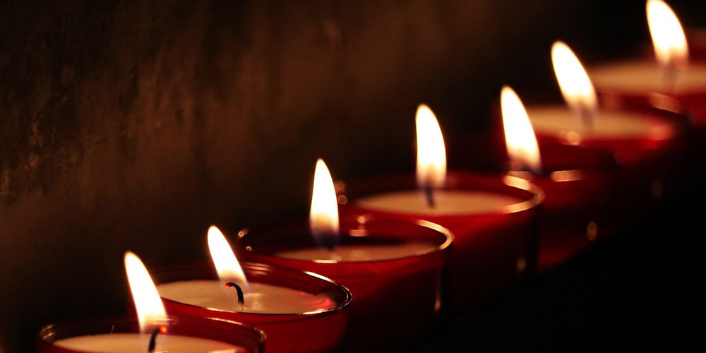
The Seven-Fold Spirit of God

Slide 2
⁴ Surrounding the throne were twenty-four other thrones, and seated on them were twenty-four elders. They were dressed in white and had crowns of gold on their heads. ⁵ From the throne came flashes of lightning, rumblings and peals of thunder. In front of the throne, seven lamps were blazing. These are the seven spirits^{[a]} of God
Rev 5:1-5
REVIEW
A Vision For The HEART

Slide 3
⁶ Then I saw a Lamb, looking as if it had been slain, standing at the center of the throne, encircled by the four living creatures and the elders. The Lamb had seven horns and seven eyes, which are the seven spirits^{[a]} of God sent out into all the earth.
Rev 6:5-6
REVIEW
A Vision For The HEART

Slide 4
³¹ “Make a lampstand of pure gold. Hammer out its base and shaft, and make its flowerlike cups, buds and blossoms of one piece with them.³² Six branches are to extend from the sides of the lampstand—three on one side and three on the other.
Exodus 25:31-37
REVIEW
A Vision For The HEART

Slide 5
³⁷ “Then make its seven lamps and set them up on it so that they light the space in front of it.
Exodus 25:31-37
REVIEW
A Vision For The HEART

Slide 6
“ You will serve as an example of something to someone – make it good!”
INTRODUCTION
A LESSON FROM DARKNESS

Slide 7
We should learn from mistakes since we are surrounded by so many of them!
INTRODUCTION
A LESSON FROM DARKNESS

Slide 8
Darkness provides the contrast against which LIGHT stands out and is appreciated
INTRODUCTION
A LESSON FROM DARKNESS

Slide 9
How you have fallen from heaven, morning star, son of the dawn! You have been cast down to the earth, you who once laid low the nations! You said in your heart,
Isaiah 12:12-15
SCRIPTURE
A LESSON FROM DARKNESS

Slide 10
“I will ascend to the heavens; I will raise my throne above the stars of God; I will sit enthroned on the mount of assembly, on the utmost heights of Mount Zaphon.^{[b]} I will ascend above the tops of the clouds; I will make myself like the Most High.”
Isaiah 12:12-15
SCRIPTURE
A LESSON FROM DARKNESS

Slide 11
“I will ascend to the heavens; I will raise my throne above the stars of God; I will sit enthroned on the mount of assembly, on the utmost heights of Mount Zaphon.^{[b]} I will ascend above the tops of the clouds; I will make myself like the Most High.” But you are brought down to the realm of the dead, to the depths of the pit.
Isaiah 12:12-15
SCRIPTURE
A LESSON FROM DARKNESS

Slide 12
“‘You were the seal of perfection, full of wisdom and perfect in beauty. You were in Eden, the garden of God; every precious stone adorned you: carnelian, chrysolite and emerald, topaz, onyx and jasper, lapis lazuli, turquoise and beryl.^{[b]} Your settings and mountings^{[c]} were made of gold; on the day you were created they were prepared.
Ezekiel 28:12-19
SCRIPTURE
A LESSON FROM DARKNESS

Slide 13
You were anointed as a guardian cherub, for so I ordained you. You were on the holy mount of God; you walked among the fiery stones. You were blameless in your ways from the day you were created
till wickedness was found in you.
Ezekiel 28:12-19
SCRIPTURE
A LESSON FROM DARKNESS

Slide 14
Through your widespread trade you were filled with violence, and you sinned. So I drove you in disgrace from the mount of God, and I expelled you, guardian cherub, from among the fiery stones.
Ezekiel 28:12-19
SCRIPTURE
A LESSON FROM DARKNESS

Slide 15
Your heart became proud on account of your beauty, and you corrupted your wisdom because of your splendor. So I threw you to the earth; I made a spectacle of you before kings.
By your many sins and dishonest trade you have desecrated your sanctuaries.
Ezekiel 28:12-19
SCRIPTURE
A LESSON FROM DARKNESS

Slide 16
By your many sins and dishonest trade you have desecrated your sanctuaries. So I made a fire come out from you, and it consumed you, and I reduced you to ashes on the ground in the sight of all who were watching.
Ezekiel 28:12-19
SCRIPTURE
A LESSON FROM DARKNESS

Slide 17
All the nations who knew you are appalled at you; you have come to a horrible end and will be no more.’”
Ezekiel 28:12-19
SCRIPTURE
A LESSON FROM DARKNESS

Slide 18
PRIDE
Infected the heavenly creation and caused a fall”
POINT #1
A LESSON FROM DARKNESS

Slide 19
Personal
Recongition:
“I
Deserve
Everything”
POINT #1
A LESSON FROM DARKNESS

Slide 20
Pride stirs up feelings of discontent within a perfect situation.
POINT #1
A LESSON FROM DARKNESS

Slide 21
Now the serpent was more crafty than any of the wild animals the Lord God had made. He said to the woman, “Did God really say, ‘You must not eat from any tree in the garden’?”
² The woman said to the serpent, “We may eat fruit from the trees in the garden, ³ but God did say, ‘You must not eat fruit from the tree that is in the middle of the garden, and you must not touch it, or you will die.’”
Genesis 2:1-7
POINT #2
A LESSON FROM DARKNESS

Slide 22
⁴ “You will not certainly die,” the serpent said to the woman. ⁵ “For God knows that when you eat from it your eyes will be opened, and you will be like God, knowing good and evil.”
⁶ When the woman saw that the fruit of the tree was good for food and pleasing to the eye, and also desirable for gaining wisdom, she took some and ate it.
Genesis 2:1-7
POINT #2
A LESSON FROM DARKNESS

Slide 23
She also gave some to her husband, who was with her, and he ate it. ⁷ Then the eyes of both of them were opened, and they realized they were naked; so they sewed fig leaves together and made coverings for themselves.
Genesis 2:1-7
POINT #2
A LESSON FROM DARKNESS

Slide 24
PRIDE
Infected the earthly creation and caused a fall”
POINT #1
A LESSON FROM DARKNESS

Slide 25
Personal
Recongition:
“I
Deserve
Everything”
POINT #2
A LESSON FROM DARKNESS

Slide 26
PRIDE
Stirs up feelings that I am getting less that what I deserve
POINT #1
A LESSON FROM DARKNESS

Slide 27
PRIDE
Questions the motives of those who are instructing
POINT #1
A LESSON FROM DARKNESS

Slide 28
PRIDE
Relies on internal resources and personal experience
POINT #1
A LESSON FROM DARKNESS

Slide 29
Jesus, full of the Holy Spirit, left the Jordan and was led by the Spirit into the wilderness, where for forty days he was tempted[a] by the devil. He ate nothing during those days, and at the end of them he was hungry.
Luke 4:1-13
SCRIPTURE
A LESSON FROM DARKNESS

Slide 30
The devil said to him, “If you are the Son of God, tell this stone to become bread.” Jesus answered, “It is written: ‘Man shall not live on bread alone.’[b]”
Luke 4:1-13
SCRIPTURE
A LESSON FROM DARKNESS

Slide 31
The devil led him up to a high place and showed him in an instant all the kingdoms of the world. And he said to him, “I will give you all their authority and splendor; it has been given to me, and I can give it to anyone I want to. If you worship me, it will all be yours.” Jesus answered, “It is written: ‘Worship the Lord your God and serve him only.’[c]”
Luke 4:1-13
SCRIPTURE
A LESSON FROM DARKNESS

Slide 32
The devil led him to Jerusalem and had him stand on the highest point of the temple. “If you are the Son of God,” he said, “throw yourself down from here. For it is written:
“‘He will command his angels concerning you to guard you carefully; they will lift you up in their hands, so that you will not strike your foot against a stone.’[d]”
Luke 4:1-13
SCRIPTURE
A LESSON FROM DARKNESS

Slide 33
Jesus answered, “It is said: ‘Do not put the Lord your God to the test.’[e]” When the devil had finished all this tempting, he left him until an opportune time.
Luke 4:1-13
SCRIPTURE
A LESSON FROM DARKNESS

Slide 34
JESUS IS A STARK CONTRAST TO DARKNESS
POINT #3
A LESSON FROM DARKNESS

Slide 35
JESUS
IS
LIGHT
POINT #3
A LESSON FROM DARKNESS

Slide 36
JESUS DEALS WITH THREE POINTS OF TEMPTATION
POINT #3
A LESSON FROM DARKNESS

Slide 37
JESUS IS TESTED REGARDING PRIDE
POINT #3
A LESSON FROM DARKNESS

Slide 38
Provision
Power
Prestige
POINT #3
A LESSON FROM DARKNESS

Slide 39
HUMILITY IS WHAT GOD IS LOOKING FOR
THIS IS AN IMPORTANT PART OF HIS NATURE
CONCLUSION
A LESSON FROM DARKNESS

