Slide 1
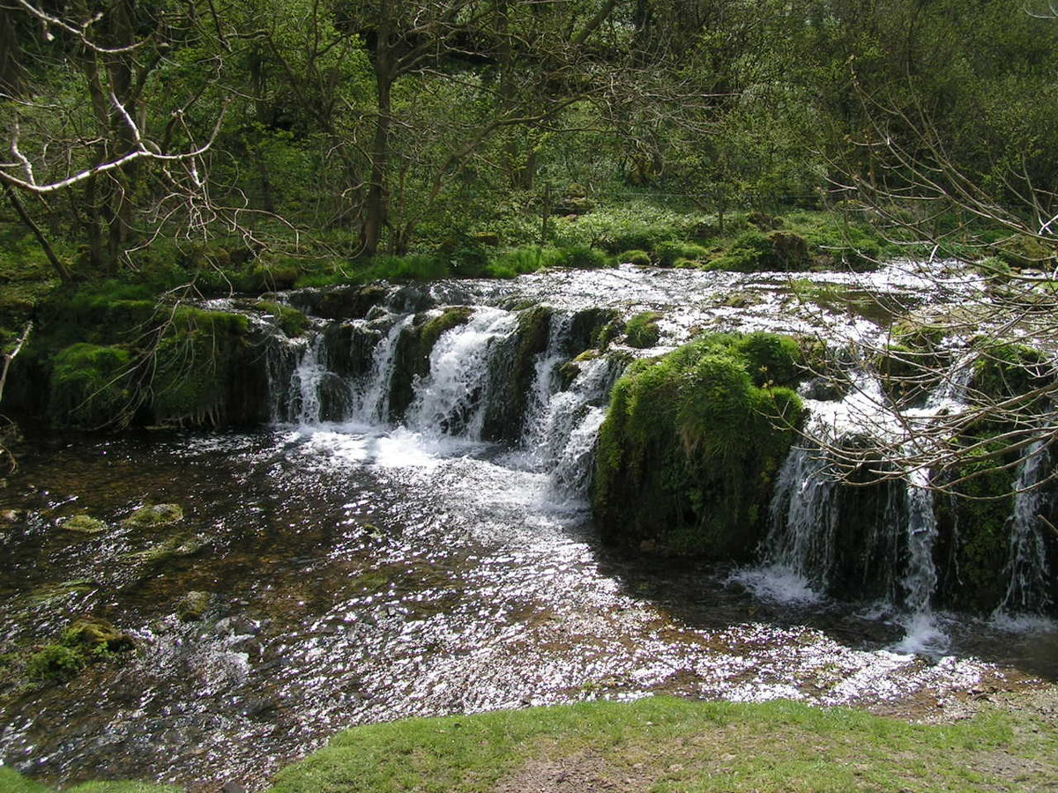
Let the River Flow

Slide 2
John 4:10
(To the woman at the well)
Jesus answered her, "If you knew the gift of God, and who it is that is saying to you, 'Give me a drink,' you would have asked him, and he would have given you living water.“ ESV

Slide 3
The woman was thirsty. If she wasn’t, what Jesus said would not have interested her.
LIVING WATER? CONTINUALLY? ON THE INSIDE OF ME?

Slide 4
Luke 4:18-19
18 "The Spirit of the Lord is upon me,
because he has anointed me
to proclaim good news to the poor.
He has sent me to proclaim liberty to the captives and recovering of sight to the blind,
to set at liberty those who are oppressed,
19 to proclaim the year of the Lord's favor.“ ESV

Slide 5
Jesus followed the anointing. He followed the love’s divine flow.

Slide 6
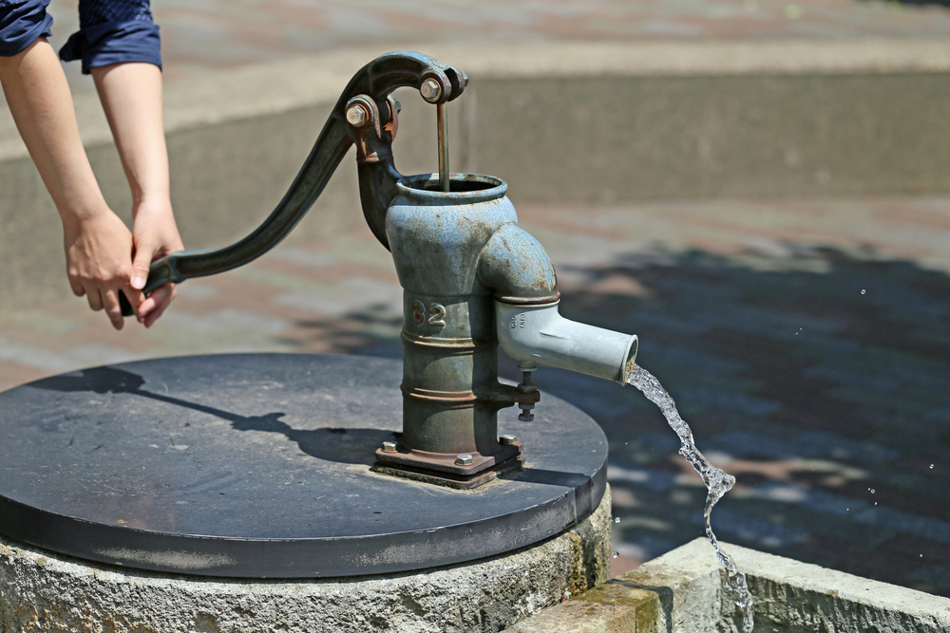
The well producing living water is inside you.
It is a well of anointing, the same that was in Jesus.

Slide 7
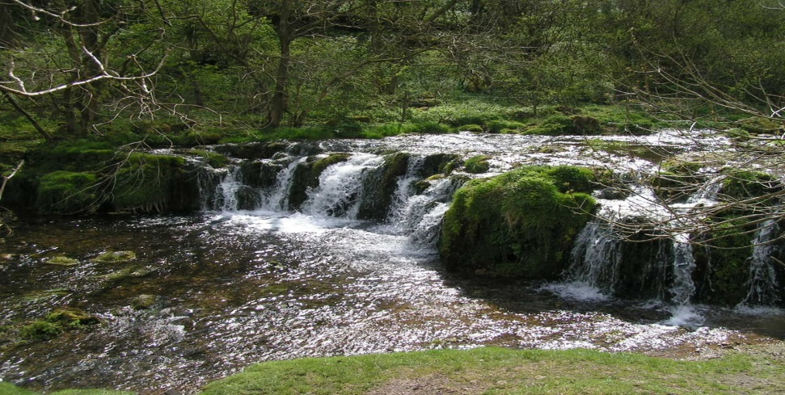
It’s pure water, peaceful, happy, resourceful, productive, creative and continual. Don’t let anything divert it or contaminate it.

Slide 8
When you wake up, don’t just pray a generic prayer, “Lord be with me.” Pray an anointed prayer,
“Lord, be in me a well of living water that overflows today. Let my words be anointed, pure, happy, and reflective of your love and purpose.”

Slide 9
Ephesians 4:29
“Don’t let any unwholesome talk come out of your mouth.”
That keeps the water pure.

Slide 10
Ephesians 4:31
Let all bitterness and wrath and anger and clamor and slander be put away from you, along with all malice.

Slide 11
Ephesians 4:32
Be ye kind to one another, tender hearted forgiving one another, Just as Christ also has forgiven you.

Slide 12
River blockers
Negativity
Complaining
Gossip
Criticism
Judgmentalism
Arrogance
Pride
Apathy
Sarcasm

Slide 13
1 Peter 3:7
7 Likewise, husbands, live with your wives in an understanding way, showing honor to the woman as the weaker vessel, since they are heirs with you of the grace of life, so that your prayers may not be hindered.
ESV

Slide 14
There are anointing blockers.
Strife, stress, offense, self pity, anger, unforgiveness, poor self image, thinking you are unqualified or incompetent.

Slide 15
A recommended prayer
“Lord, today I refuse to dam up the anointing on the inside of me. I’m going to walk in love, joy, and peace, patience, kindness, etc. so that the anointing can flow through me. Lead me to thirsty people who want living water.”

Slide 16

We have a water purifier at home. There is also a water purifier in your heart.

Slide 17
Remember this little song?
“There’s a river of life flowing out through me,
It makes the lame to walk, and the blind to see.
Opens prison doors, sets the captives free,
There’s a river of life flowing out through me.”

Slide 18

Just like a well… you have to prime the pump. Be happy, positive, friendly, faith-filled, smile, gracious.

Slide 19
Grace not only flows to you but through you….will you let it?

