Slide 1
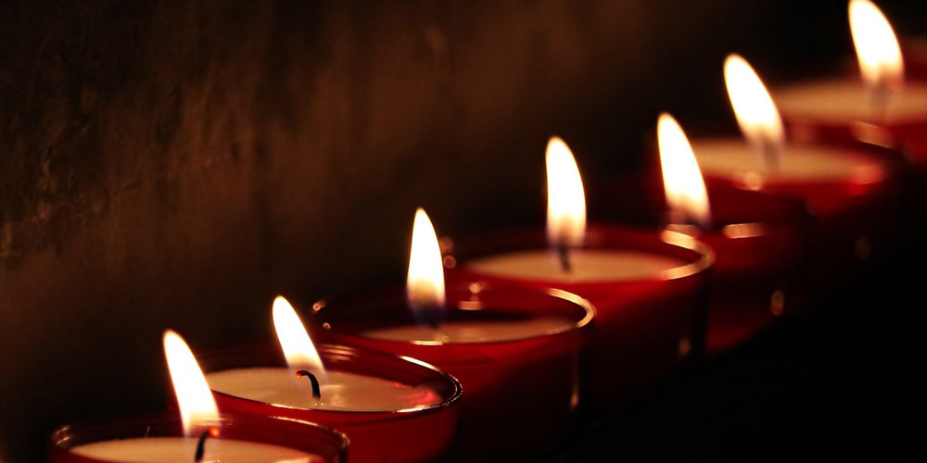
The Seven-Fold Spirit of God

Slide 2
Embrace the Invitation
Embrace the Terms of Adoption
Embrace the Call into His Presence
Embrace the Call to the Cross
REVIEW
The Response of the SONS

Slide 3
Western Church tradition and theological thought has trapped us outside of a category
INTRODUCTION
The Revelation of JESUS

Slide 4
There is a small percentage of people who enjoy the Book of Revelation – most people fear it!
INTRODUCTION
The Revelation of JESUS

Slide 5
The same disciple referred to as “the beloved disciple” was released to write down this revelation of the end of the world.
INTRODUCTION
The Revelation of JESUS

Slide 6
The same one who captured these words, “For God so loved…” also captured these words “not found in the Lamb’s book of life was cast in the lake of fire.”
INTRODUCTION
The Revelation of JESUS

Slide 7
“To the angel ª of the church in Ephesus write:
These are the words of him who holds the seven stars in his right hand and walks among the seven golden lampstands.
Revelation 2:1-7
The Revelation of JESUS

Slide 8
I know your deeds, your hard work and your perseverance. I know that you cannot tolerate wicked people, that you have tested those who claim to be apostles but are not, and have found them false. You have persevered and have endured hardships for my name, and have not grown weary.
Revelation 2:1-7
The Revelation of JESUS

Slide 9
Yet I hold this against you: You have forsaken the love you had at first. Consider how far you have fallen! Repent and do the things you did at first. If you do not repent, I will come to you and remove your lampstand from its place. But you have this in your favor: You hate the practices of the Nicolaitans, which I also hate.
Revelation 2:1-7
The Revelation of JESUS

Slide 10
Whoever has ears, let them hear what the Spirit says to the churches. To the one who is victorious, I will give the right to eat from the tree of life, which is in the paradise of God.
Revelation 2:1-7
The Revelation of JESUS

Slide 11
JESUS is OUR MELCHIZEDEK
POINT #1
The Revelation of JESUS

Slide 12
“To the angel ª of the church in Ephesus write:
These are the words of him who holds the seven stars in his right hand and walks among the seven golden lampstands.
Revelation 2:1-7
The Revelation of JESUS

Slide 13
As our priest Jesus not only intervenes and intercedes he INSPECTS
POINT #1
The Revelation of JESUS

Slide 14
JESUS
INSPECTS FOR WHAT IS RIGHT
POINT #2
The Revelation of JESUS

Slide 15
I know your deeds, your hard work and your perseverance. I know that you cannot tolerate wicked people, that you have tested those who claim to be apostles but are not, and have found them false. You have persevered and have endured hardships for my name, and have not grown weary.
Revelation 2:1-7
The Revelation of JESUS

Slide 16
We could learn a thing or two from Jesus about being a parent or a boss
POINT #2
The Revelation of JESUS

Slide 17
Hard work
Perseverance
Intolerance towards mixture
Test poor leaders
Endure hardships
Stayed strong
POINT #2
The Revelation of JESUS

Slide 18
PROBLEM:
You can do all of those good things to be a champion golfer or excel in anything on the earth
POINT #2
The Revelation of JESUS

Slide 19
The characteristics of the church of Ephesus could be on a motivational poster to sell vitamins or snake oil or encyclopedias
NOT ENOUGH
POINT #2
The Revelation of JESUS

Slide 20
JESUS INSPECTS FOR WHAT IS FIRST
POINT #3
The Revelation of JESUS

Slide 21
Yet I hold this against you: You have forsaken the love you had at first. Consider how far you have fallen! Repent and do the things you did at first. If you do not repent, I will come to you and remove your lampstand from its place. But you have this in your favor: You hate the practices of the Nicolaitans, which I also hate.
Revelation 2:1-7
The Revelation of JESUS

Slide 22
FIRST LOVE – forsaken
FALLEN – A long way
REPENTANCE – passe’
REMOVAL – imminent
PASSION – only negative
POINT #3
The Revelation of JESUS

Slide 23
PASSION
FIRE IN THE BELLY
INTENSITY
GONE
POINT #3
The Revelation of JESUS

Slide 24
The LOVE OF GOD is a flickering ember on a lampstand and it has been relegated to IRRELEVANCE
POINT #3
The Revelation of JESUS

Slide 25
The LOVE OF GOD in Ephesus has been replaced with the zeal of being RIGHT and a dark wisdom and a dark truth
POINT #3
The Revelation of JESUS

Slide 26
Paul talked to them about a spirit of Wisdom and Revelation but they evidently disregarded him
POINT #3
The Revelation of JESUS

Slide 27
JESUS OFFERS HOPE
POINT #4
The Revelation of JESUS

Slide 28
Whoever has ears, let them hear what the Spirit says to the churches. To the one who is victorious, I will give the right to eat from the tree of life, which is in the paradise of God.
Revelation 2:1-7
The Revelation of JESUS

Slide 29
JESUS calls us to the hope offered through life offered as a result of repentance
POINT #4
The Revelation of JESUS

Slide 30
The repentance that he mentions invites the spirit of restoration to take us back to FIRST LOVE, FIRST THINGS, and FIRST VISION
POINT #4
The Revelation of JESUS

Slide 31
Jesus came to give us life and that abundantly…what moved us from the tree of life? What nudged us from the garden of God?
CONCLUSION
The Revelation of JESUS

Slide 32
What is the first work that Jesus is asking you to do over again?
CONCLUSION
The Revelation of JESUS

Slide 33
Are you willing to invite the Holy Spirit to refresh, renew, and rekindle something in your spirit?
CONCLUSION
The Revelation of JESUS

Slide 34
Are you willing to spend more time in the garden of His Presence?
CONCLUSION
The Revelation of JESUS

Slide 35
What would happen in your life if you lived dead to yourself but alive to God everyday?
CONCLUSION
The Revelation of JESUS

Slide 36
What sort of response can you offer to God today?
CONCLUSION
The Revelation of JESUS

