Slide 1
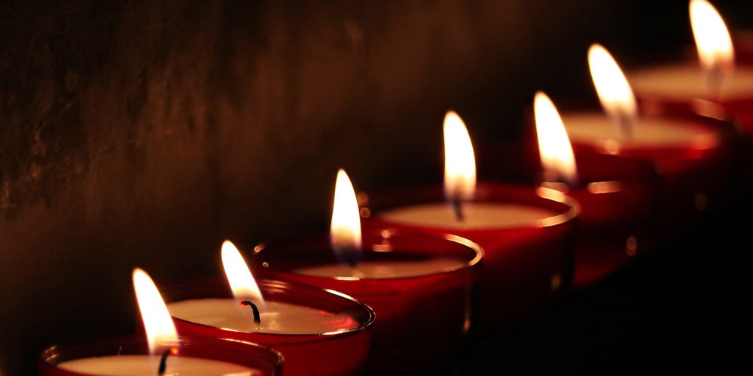
The Seven-Fold Spirit of God

Slide 2
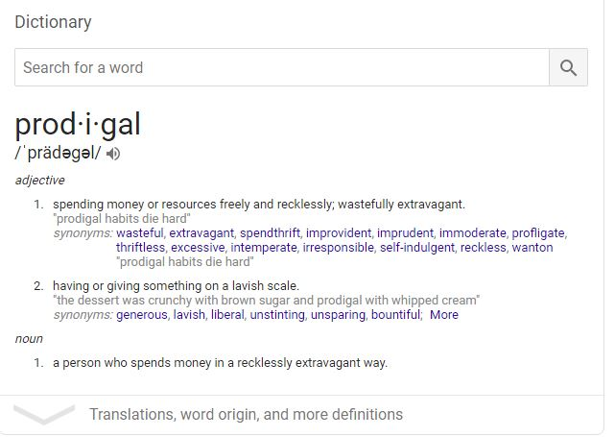
REVIEW
The Heart of the FATHER

Slide 3
The Father has FACED defiance
The Father’s FIRE burns long & steady
The Father has FACTORED humility
The Father is FOCUSED on return
The Father FLOODS with forgiveness
The Father is FANATIC about celebration
The Father FINDS triumph in mercy
REVIEW
The Heart of the FATHER

Slide 4
Western Church tradition and theological thought has trapped us outside of a category
INTRODUCTION
The Response of the SONS

Slide 5
We are typically taught and have proclaimed that Jesus is the Son of God and we are something in between that and lost humanity.
INTRODUCTION
The Response of the SONS

Slide 6
⁴⁴ But I say to you, love your enemy and pray for those who persecute you, ⁴⁵ so that you may be like your Father in heaven, since he causes the sun to rise on the evil and the good, and sends rain on the righteous and the unrighteous.
Matthew 5:44-45
The Response of the SONS

Slide 7
⁹ “This, then, is how you should pray:
“‘Our Father in heaven, hallowed be your name, ¹⁰ your kingdom come, your will be done, on earth as it is in heaven. ¹¹ Give us today our daily bread. ¹² And forgive us our debts, as we also have forgiven our debtors. ¹³ And lead us not into temptation,^{[a]} but deliver us from the evil one.^{[b]}’
Matthew 6:9-13
The Response of the SONS

Slide 8
¹¹ He came to that which was his own, but his own did not receive him.¹² Yet to all who did receive him, to those who believed in his name, he gave the right to become children of God—
John 1:11-12
The Response of the SONS

Slide 9
¹⁷ Jesus said, “Do not hold on to me, for I have not yet ascended to the Father. Go instead to my brothers and tell them, ‘I am ascending to my Father and your Father, to my God and your God.’”
John 20:17
The Response of the SONS

Slide 10
See what great love the Father has lavished on us, that we should be called children of God! And that is what we are! The reason the world does not know us is that it did not know him
1 John 3:1
The Response of the SONS

Slide 11
POINT #1
EMBRACE THE “INVITATION”
The Response of the SONS

Slide 12
EMBRACE THE TERMS OF FULL “ADOPTION”
POINT #2
The Response of the SONS

Slide 13
EMBRACE THE CALL INTO HIS PRESENCE
POINT #3
The Response of the SONS

Slide 14
EMBRACE THE CALL TO YOUR CROSS
POINT #4
The Response of the SONS

Slide 15
What would happen in your life if you dared to accept the Father’s invitation to forgiveness of your sins?
CONCLUSION
The Response of the SONS

Slide 16
What would happen in your life if you dared to believe God is offering to fully-adopt you with all rights and privileges?
CONCLUSION
The Response of the SONS

Slide 17
What would happen in your life if you spent quality time everyday in His presence just like Jesus did?
CONCLUSION
The Response of the SONS

Slide 18
What would happen in your life if you lived dead to yourself but alive to God everyday?
CONCLUSION
The Response of the SONS

Slide 19
What sort of response can you offer to God today?
CONCLUSION
The Response of the SONS

