Slide 1
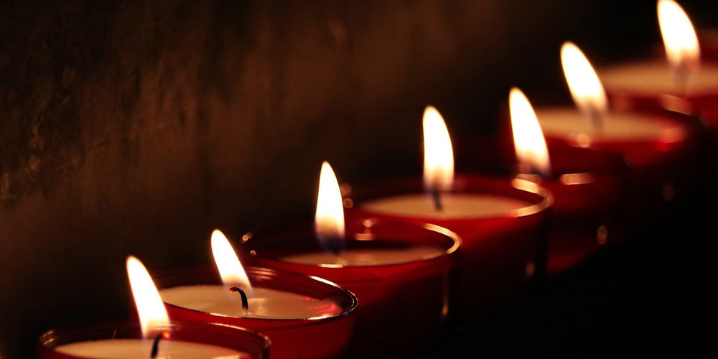
The Seven-Fold Spirit of God

Slide 2
In front of the throne, seven lamps were blazing. These are the seven spirits^{[a]} of God
Rev 5:5b
REVIEW
The Heart of the FATHER

Slide 3
…The Lamb had seven horns and seven eyes, which are the seven spirits^{[a]} of God sent out into all the earth.
Rev 6:6b
REVIEW
The Heart of the FATHER

Slide 4
³⁷ “Then make its seven lamps and set them up on it so that they light the space in front of it.
Exodus 25:37
REVIEW
The Heart of the FATHER

Slide 5
¹⁹ Do you not know that your bodies are temples of the Holy Spirit, who is in you, whom you have received from God? You are not your own;
1 Cor 6:19
REVIEW
The Heart of the FATHER

Slide 6
⁵ Look, I will send you Elijah the prophet before the great and terrible day of the Lord arrives. ⁶ He will encourage fathers and their children to return to me, so that I will not come and strike the earth with judgment.”
Malachi 4:5,6
The Heart of the FATHER

Slide 7
And he will go on before the Lord, in the spirit and power of Elijah, to turn the hearts of the parents to their children and the disobedient to the wisdom of the righteous--to make ready a people prepared for the Lord."
Luke 1:17
The Heart of the FATHER

Slide 8
Around the globe people are suffering from FATHER issues.
INTRODUCTION
The Heart of the FATHER

Slide 9
Social ills
Poverty
Injustice
Lack of Defense
INTRODUCTION
The Heart of the FATHER

Slide 10
The Enemy has placed his targeting systems and all of his resources against the role of man and the influence of a Father because it is ultimately about THE FATHER
INTRODUCTION
The Heart of the FATHER

Slide 11
¹¹ Jesus continued: “There was a man who had two sons. ¹² The younger one said to his father, ‘Father, give me my share of the estate.’ So he divided his property between them.
¹³ “Not long after that, the younger son got together all he had, set off for a distant country and there squandered his wealth in wild living.
Luke 14:11-32
The Heart of the FATHER

Slide 12
The Father has FACED prodigals before.
POINT #1
The Heart of the FATHER

Slide 13
The Prodigal Son considered his father as good as dead to him.
POINT #1
The Heart of the FATHER

Slide 14
This process happened before Adam with Lucifer
POINT #1
The Heart of the FATHER

Slide 15
This process happened with Adam
POINT #1
The Heart of the FATHER

Slide 16
¹⁴ After he had spent everything, there was a severe famine in that whole country, and he began to be in need. ¹⁵ So he went and hired himself out to a citizen of that country, who sent him to his fields to feed pigs. ¹⁶ He longed to fill his stomach with the pods that the pigs were eating, but no one gave him anything.
Luke 14:11-32
The Heart of the FATHER

Slide 17
The Fathers FIRE burns long and steady – Selfish fire burns hot and quick.
POINT #2
The Heart of the FATHER

Slide 18
“Sin takes us further than we want to go. Costs us more than what we wanted to pay. Keeps us longer than we wanted to stay.”
POINT #2
The Heart of the FATHER

Slide 19
¹⁷ “When he came to his senses, he said, ‘How many of my father’s hired servants have food to spare, and here I am starving to death! ¹⁸ I will set out and go back to my father and say to him: Father, I have sinned against heaven and against you. ¹⁹ I am no longer worthy to be called your son; make me like one of your hired servants.’ ²⁰ So he got up and went to his father.
Luke 14:11-32
The Heart of the FATHER

Slide 20
The Father has FACTORED humility into his creation.
POINT #3
The Heart of the FATHER

Slide 21
Life has a way of humiliating you. Take advantage of the clear thinking it can bring you to!
POINT #3
The Heart of the FATHER

Slide 22
Pride will reject humility but wisdom starts when you embrace it.
POINT #3
The Heart of the FATHER

Slide 23
“But while he was still a long way off, his father saw him and was filled with compassion for him; he ran to his son, threw his arms around him and kissed him.
²¹ “The son said to him, ‘Father, I have sinned against heaven and against you. I am no longer worthy to be called your son.’
²² “But the father said to his servants, ‘Quick! Bring the best robe and put it on him. Put a ring on his finger and sandals on his feet. ²³ Bring the fattened calf and kill it. Let’s have a feast and celebrate. ²⁴ For this son of mine was dead and is alive again; he was lost and is found.’ So they began to celebrate.
Luke 14:11-32
The Heart of the FATHER

Slide 24
The Father is FOCUSED on the edge of his presence eagerly looking for us to show up.
POINT #4
The Heart of the FATHER

Slide 25
The Father is FILLED with compassion.
POINT #5
The Heart of the FATHER

Slide 26
The Father FLOODS the repentant one with FORGIVENESS.
POINT #5
The Heart of the FATHER

Slide 27
The Father is a FANATIC for restoration and celebration.
POINT #6
The Heart of the FATHER

Slide 28
²⁵ “Meanwhile, the older son was in the field. When he came near the house, he heard music and dancing. ²⁶ So he called one of the servants and asked him what was going on. ²⁷ ‘Your brother has come,’ he replied, ‘and your father has killed the fattened calf because he has him back safe and sound.’
²⁸ “The older brother became angry and refused to go in
Luke 14:11-32
The Heart of the FATHER

Slide 29
So his father went out and pleaded with him. ²⁹ But he answered his father, ‘Look! All these years I’ve been slaving for you and never disobeyed your orders. Yet you never gave me even a young goat so I could celebrate with my friends. ³⁰ But when this son of yours who has squandered your property with prostitutes comes home, you kill the fattened calf for him!’
³¹ “‘My son,’ the father said, ‘you are always with me, and everything I have is yours. ³² But we had to celebrate and be glad, because this brother of yours was dead and is alive again; he was lost and is found.’”
Luke 14:11-32
The Heart of the FATHER

Slide 30
The FATHER FINDS triumph in mercy more than in justice.
POINT #7
The Heart of the FATHER

Slide 31
Where are you today?
Who do you most identify with?
CONCLUSION
The Heart of the FATHER

Slide 32
Would you dare to believe that this is exactly how the Father feels about you?
CONCLUSION
The Heart of the FATHER

Slide 33
Run toward the Father and lose yourself in His embrace.
CONCLUSION
The Heart of the FATHER

