Slide 1
LISTEN

Slide 2
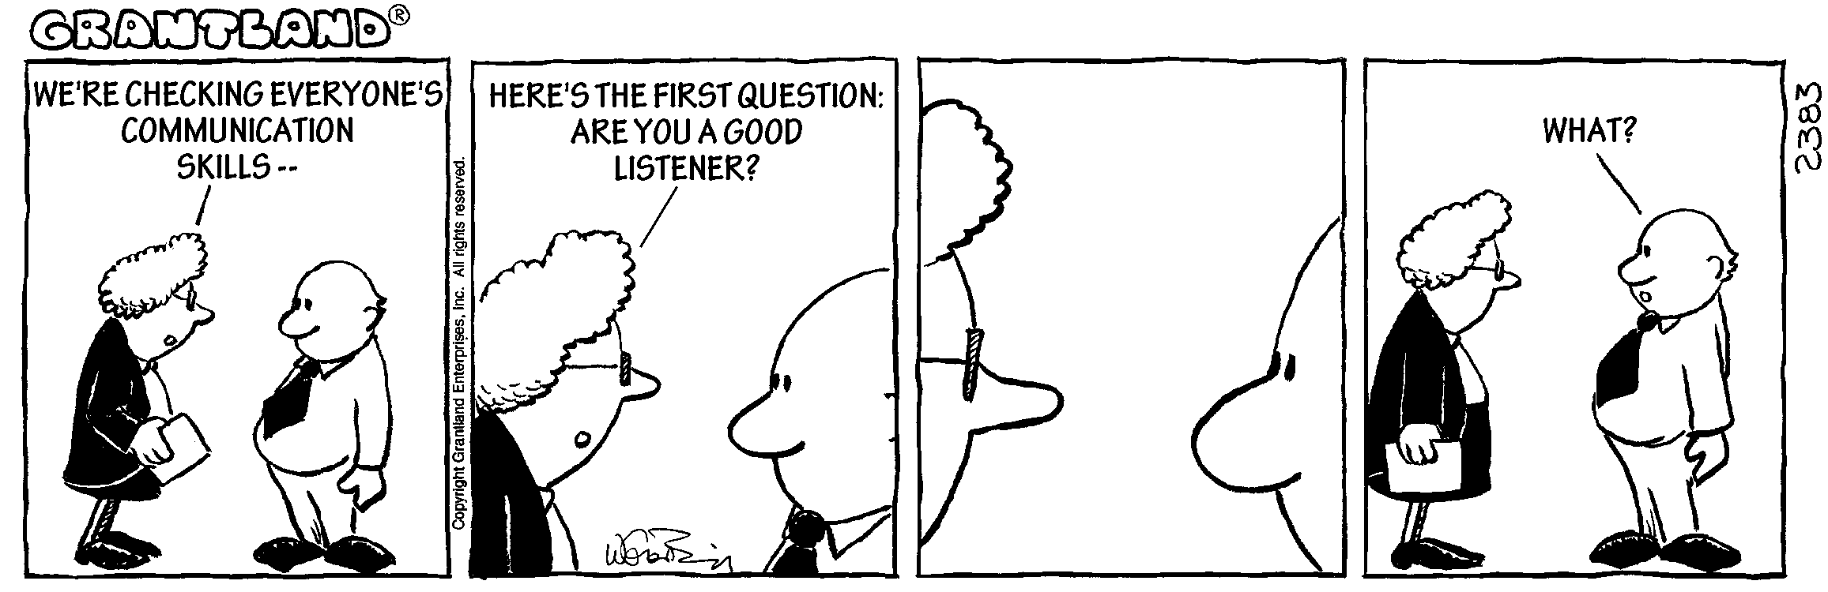

Slide 3
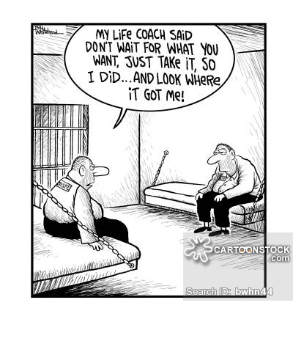

Slide 4
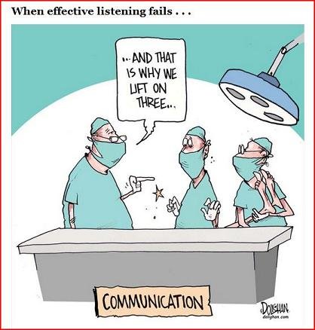

Slide 5
LISTEN
Akouo – Verb
To attend to – consider what has been said
To understand.

Slide 6
Definition of Listen
1 : to pay attention to sound listen to music
2 : to hear something with thoughtful attention : give consideration listen to a plea
Verb

Slide 7
SCRIPTURE
You, LORD, hear the desire of the afflicted; you encourage them, and you listen to their cry,
Psalm 10:17

Slide 8
SCRIPTURE
Go near and listen to all that the LORD our God says. Then tell us whatever the LORD our God tells you. We will listen and obey.” Deuteronomy 5:27

Slide 9
SCRIPTURE
Listen and hear my voice; pay attention and hear what I say. Isaiah 28:23

Slide 10
SCRIPTURE
Come near, you nations, and listen; pay attention, you peoples! Let the earth hear, and all that is in it, the world, and all that comes out of it! Isaiah 34:1

Slide 11
SCRIPTURE
Jesus called the crowd to him and said, “Listen and understand. Matthew 15:10

Slide 12
SCRIPTURE
While he was still speaking, a bright cloud covered them, and a voice from the cloud said, “This is my Son, whom I love; with him I am well pleased. Listen to him!”
Matthew 17:5

Slide 13
SCRIPTURE
My sheep listen to my voice; I know them, and they follow me.
John 10:27

Slide 14
SCRIPTURE
19 My dear brothers and sisters, take note of this: Everyone should be quick to listen, slow to speak and slow to become angry,
20 because human anger does not produce the righteousness that God desires.
21 Therefore, get rid of all moral filth and the evil that is so prevalent and humbly accept the word planted in you, which can save you.
22 Do not merely listen to the word, and so deceive yourselves. Do what it says.

Slide 15
SCRIPTURE
23 Anyone who listens to the word but does not do what it says is like someone who looks at his face in a mirror
24 and, after looking at himself, goes away and immediately forgets what he looks like.
25 But whoever looks intently into the perfect law that gives freedom, and continues in it—not forgetting what they have heard, but doing it—they will be blessed in what they do. James 1:19-25

Slide 16
LISTEN
Lean close and be attentive to every word.
I
S
T
E
N

Slide 17
LISTEN
Lean close and be attentive to every word.
Invite others—including God—to speak by asking questions and waiting for their answers.
S
T
E
N

Slide 18
LISTEN
Lean close and be attentive to every word.
Invite others—including God—to speak by asking questions and waiting for their answers.
Silence distractions.
T
E
N

Slide 19
LISTEN
Lean close and be attentive to every word.
Invite others—including God—to speak by asking questions and waiting for their answers.
Silence distractions.
Think about what I’ve heard, processing it and letting it sink in.
E
N

Slide 20
Lean close and be attentive to every word.
Invite others—including God—to speak by asking questions and waiting for their answers.
Silence distractions.
Think about what I’ve heard, processing it and letting it sink in.
Empathize with concerns shared with me.
N

Slide 21
Lean close and be attentive to every word.
Invite others—including God—to speak by asking questions and waiting for their answers.
Silence distractions.
Think about what I’ve heard, processing it and letting it sink in.
Empathize with concerns shared with me.
Note action I need to take in response to what I’ve heard.

Slide 22
5 TIPS ON HOW TO LISTEN EFFECTIVELY
1) Close your mouth!
2) Listen through the eyes and ears of kindness and compassion.
3) Listen as if you might never have the opportunity to hear that person speak again.
4) Be present- take your judgment glasses off.
5) Be mindful of nonverbal communications- yours and theirs.

Slide 23
LISTEN
Are you a good listener?
If not, how can you improve?
Ask the Holy Spirit for help.

