Slide 1
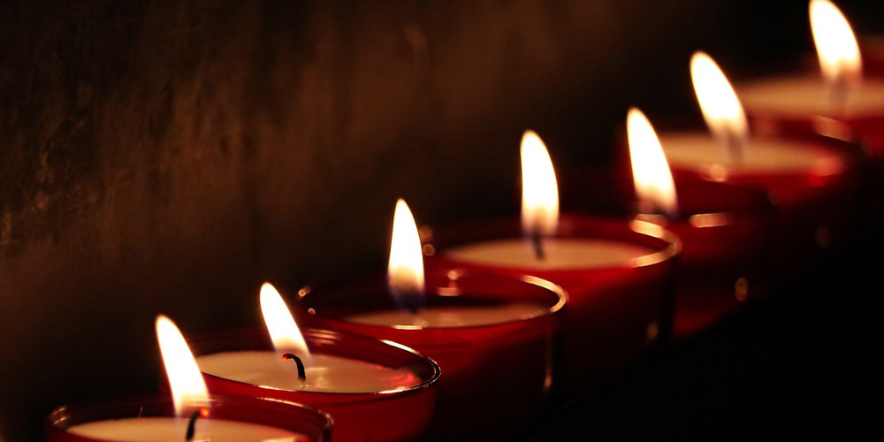
The Seven-Fold Spirit of God

Slide 2
After this I looked, and there before me was a door standing open in heaven. And the voice I had first heard speaking to me like a trumpet said, “Come up here, and I will show you what must take place after this.” ² At once I was in the Spirit, and there before me was a throne in heaven with someone sitting on it. ³ And the one who sat there had the appearance of jasper and ruby. A rainbow that shone like an emerald encircled the throne.
Rev 5:1-5
INTRODUCTION
A Vision For The HEART

Slide 3
⁴ Surrounding the throne were twenty-four other thrones, and seated on them were twenty-four elders. They were dressed in white and had crowns of gold on their heads. ⁵ From the throne came flashes of lightning, rumblings and peals of thunder. In front of the throne, seven lamps were blazing. These are the seven spirits^{[a]} of God
Rev 5:1-5
INTRODUCTION
A Vision For The HEART

Slide 4
⁶ Then I saw a Lamb, looking as if it had been slain, standing at the center of the throne, encircled by the four living creatures and the elders. The Lamb had seven horns and seven eyes, which are the seven spirits^{[a]} of God sent out into all the earth.
Rev 6:5-6
INTRODUCTION
A Vision For The HEART

Slide 5
³¹ “Make a lampstand of pure gold. Hammer out its base and shaft, and make its flowerlike cups, buds and blossoms of one piece with them.³² Six branches are to extend from the sides of the lampstand—three on one side and three on the other.
Exodus 25:31-37
INTRODUCTION
A Vision For The HEART

Slide 6
³³ Three cups shaped like almond flowers with buds and blossoms are to be on one branch, three on the next branch, and the same for all six branches extending from the lampstand. ³⁴ And on the lampstand there are to be four cups shaped like almond flowers with buds and blossoms.
Exodus 25:31-37
INTRODUCTION
A Vision For The HEART

Slide 7
³⁵ One bud shall be under the first pair of branches extending from the lampstand, a second bud under the second pair, and a third bud under the third pair—six branches in all. ³⁶ The buds and branches shall all be of one piece with the lampstand, hammered out of pure gold.
³⁷ “Then make its seven lamps and set them up on it so that they light the space in front of it.
Exodus 25:31-37
INTRODUCTION
A Vision For The HEART

Slide 8
¹⁹ Do you not know that your bodies are temples of the Holy Spirit, who is in you, whom you have received from God? You are not your own;
1 Cor 6:19
INTRODUCTION
A Vision For The HEART

Slide 9
GOD IS LOVE
POINT #1
A Vision For The HEART

Slide 10
⁷ Dear friends, let us love one another, for love comes from God. Everyone who loves has been born of God and knows God. ⁸ Whoever does not love does not know God, because God is love.
1 John 4:7,8
POINT #1
A Vision For The HEART

Slide 11
LOVE GOD
LOVE OTHERS
POINT #2
A Vision For The HEART

Slide 12
³⁶ “Teacher, which is the greatest commandment in the Law?”
³⁷ Jesus replied: “‘Love the Lord your God with all your heart and with all your soul and with all your mind.’^{[a]} ³⁸ This is the first and greatest commandment. ³⁹ And the second is like it: ‘Love your neighbor as yourself.’^{[b]} ⁴⁰ All the Law and the Prophets hang on these two commandments.”
Matthew 22:36-40
POINT #2
A Vision For The HEART

Slide 13
The Quality of Love that God requests of us is merely a return on His Investment…it is a maximum.
POINT #2
A Vision For The HEART

Slide 14
The Quality of Love that God requests of us towards others is what we naturally have for ourselves…it is a bare minimum.
POINT #2
A Vision For The HEART

Slide 15
LOVE THOSE IN THE BODY WITH THE LOVE OF GOD
POINT #3
A Vision For The HEART

Slide 16
³⁴ “A new command I give you: Love one another. As I have loved you, so you must love one another. ³⁵ By this everyone will know that you are my disciples, if you love one another.”
John 13:34-35
POINT #3
A Vision For The HEART

Slide 17
The Quality of Love that Jesus requests towards members of His family is the same as God’s investment in us – divine maximum!!
POINT #3
A Vision For The HEART

Slide 18
The Holy Spirit is here to light a fire in each of us, to re-kindle a fire, or to bring our fire to a greater intensity.
CONCLUSION
A Vision For The HEART

