Slide 1
The Triple Combination
Fire Engines and Christians

Slide 2
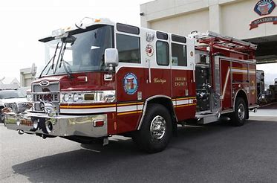
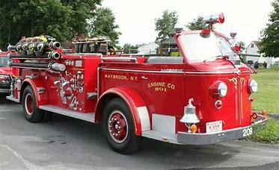
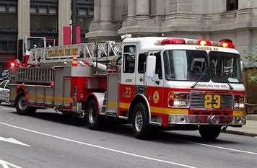
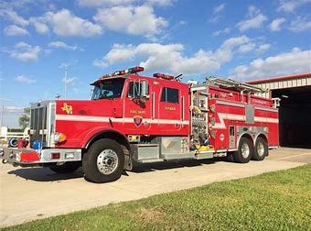
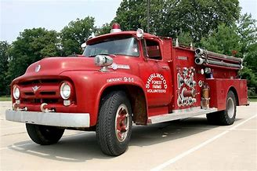
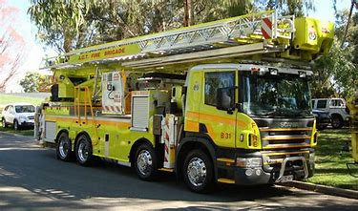
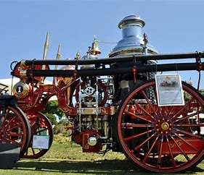
The Triple Combination

Slide 3
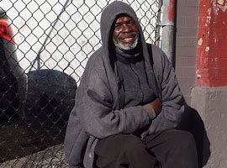
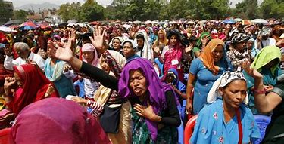
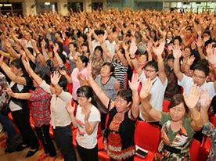
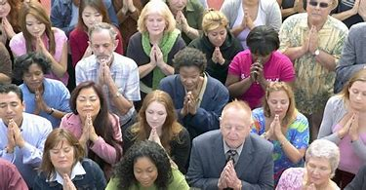
The Triple Combination

Slide 4
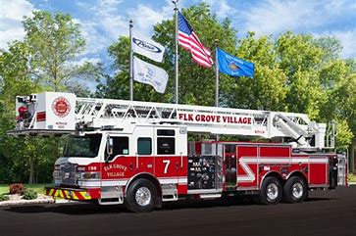
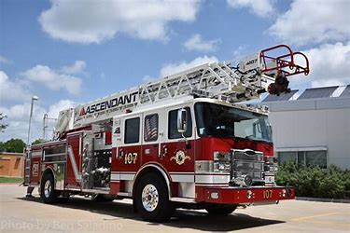
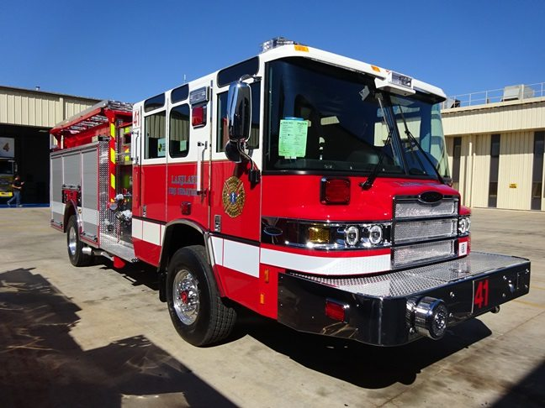
The Triple Combination

Slide 5
The Triple Combination
The Triple Combination Fire Engine
To be considered a tripe combination fire engine it must have three components:
Fire Pump
Water Tank
Fire Hose

Slide 6
The Triple Combination
The Triple Combination Fire Engine
The National Fire Protection Association sets the standards for fire apparatus.
NFPA 1901 Standard Automotive Fire Apparatus.

Slide 7
The Triple Combination
The Triple Combination Fire Engine
The fire pump must have a minimum capacity of 750gpm’s
Have water tank with a minimum capacity of 300 gallons.
Carry a minimum of 800’ of LDH and 400’ of handlines.

Slide 8
The Triple Combination
The Triple Combination Christian
To be considered a tripe combination Christian one must have three components:
Good Words
Good Works
Good Prayer Life

Slide 9
The Triple Combination
The Triple Combination Christian
The Bible sets forth the standards for Christians

Slide 10
The Triple Combination
The Triple Combination Christian
Good Words:
Proverbs 18:21 (NIV)
“The tongue has the power of life and death, and those who love it will eat its fruit.

Slide 11
The Triple Combination
The Triple Combination Christian
Good Words:
Proverbs 15:1 (NIV)
“A gentle answer turns away wrath, but harsh words stir up anger.”

Slide 12
The Triple Combination
The Triple Combination Christian
Good Words:
Luke 6:45 (NIV)
“A good man brings good things out of the good stored up in his heart, and an evil man brings evil things out of the evil stored up in his heart. For the mouth speaks what the heart is full of.

Slide 13
The Triple Combination
The Triple Combination Christian
Good Works:
Titus 3:14 (NIV)
“Our people must learn to devote themselves to doing what is good, in order to provide for urgent needs and not live unproductive lives.”

Slide 14
The Triple Combination
The Triple Combination Christian
Good Works:
1 Peter 2:12 (NIV)
“Live such good lives among the pagans that, though they accuse you of doing wrong, they may see your good deeds and glorify God on the day he visits us.”

Slide 15
The Triple Combination
The Triple Combination Christian
Good Works:
John 13:34-35 (NIV)
“A new command I give you: Love one another. As I have loved you, so you must love one another. ³⁵ By this everyone will know that you are my disciples, if you love one another.”

Slide 16
The Triple Combination
The Triple Combination Christian
Good Prayer Life:
James 5:16 (NIV)
“Therefore confess your sins to each other and pray for each other so that you may be healed. The prayer of a righteous person is powerful and effective.

Slide 17
The Triple Combination
The Triple Combination Christian
Good Prayer Life:
Romans 12:12 (NIV)
“Be joyful in hope, patient in affliction, faithful in prayer.

Slide 18
The Triple Combination
The Triple Combination Christian
Good Prayer Life:
Ephesians 6:18 (NIV)
“And pray in the Spirit on all occasions with all kinds of prayers and requests. With this in mind, be alert and always keep on praying for all the Lord’s people.

Slide 19
The Triple Combination
The Triple Combination Christian
Conclusion:
Remove any portion of the three components of the fire engine and you only have a apparatus.
Remove any portion of the Christian and you only have a person.

Slide 20
The Triple Combination
The Triple Combination Christian
Conclusion:
Don’t settle for just being, live the full productive Christian life.

