Slide 1
Every Tribe / Every Nation
“YOU HAD ONE JOB”

Slide 2
“YOU HAD ONE JOB”

Slide 3
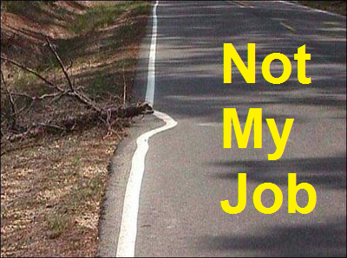
“YOU HAD ONE JOB”

Slide 4
“YOU HAD ONE JOB”

Slide 5
¹⁶ Then the eleven disciples went to Galilee, to the mountain where Jesus had told them to go. ¹⁷ When they saw him, they worshiped him; but some doubted. (Matthew 28:16-20)
YOU HAD ONE JOB

Slide 6
¹⁸ Then Jesus came to them and said, “All authority in heaven and on earth has been given to me. (Matthew 28:19-20)
YOU HAD ONE JOB

Slide 7
¹⁹ Therefore go and make disciples of all nations, baptizing them in the name of the Father and of the Son and of the Holy Spirit, ²⁰ and teaching them to obey everything I have commanded you. And surely I am with you always, to the very end of the age.
(Matthew 28:19-20)
YOU HAD ONE JOB

Slide 8
One Job –
Several Aspects
YOU HAD ONE JOB

Slide 9
#1 The Target is THE NATIONS
YOU HAD ONE JOB

Slide 10
¹⁶ Then the eleven disciples went to Galilee, to the mountain where Jesus had told them to go.
YOU HAD ONE JOB

Slide 11
Why Galilee?
Why a mountain?
YOU HAD ONE JOB

Slide 12
#2 Those who are called to the task are imperfect
YOU HAD ONE JOB

Slide 13
¹⁷ When they saw him, they worshiped him; but some doubted.
YOU HAD ONE JOB

Slide 14
Not only did they struggle with doubt but they were intimidated by mountains of culture and the giants on those mountains.
YOU HAD ONE JOB

Slide 15
#3 Our confidence is in the one sending us,
YOU HAD ONE JOB

Slide 16
¹⁸ Then Jesus came to them and said, “All authority in heaven and on earth has been given to me.
YOU HAD ONE JOB

Slide 17
ALL Power and Authority are his. We are on his assignment.
YOU HAD ONE JOB

Slide 18
“ On this rock I will build my church and the gates of hell will not prevail against it.”
YOU HAD ONE JOB

Slide 19
#4 Conversion, Baptism, and Discipleship
YOU HAD ONE JOB

Slide 20
¹⁹ Therefore go and make disciples of all nations, baptizing them in the name of the Father and of the Son and of the Holy Spirit, ²⁰ and teaching them to obey everything I have commanded you. And surely I am with you always, to the very end of the age.
(Matthew 28:19-20)
YOU HAD ONE JOB

Slide 21
CONVERSION
Share the Good News
Holy Spirit Convicts
Reap the Harvest
YOU HAD ONE JOB

Slide 22
EMPOWERMENT
Receive into the Church
Introduce to the Holy Spirit
YOU HAD ONE JOB

Slide 23
DISCIPLESHIP
1. Love God
Love others
Love those in the family
YOU HAD ONE JOB

Slide 24
WE HAVE ONE JOB!!
YOU HAD ONE JOB

Slide 25
Target the nations
Go, though we are imperfect
Rely on Jesus power & authority
Born again, received, and conforming to His image.
YOU HAD ONE JOB

