Slide 1
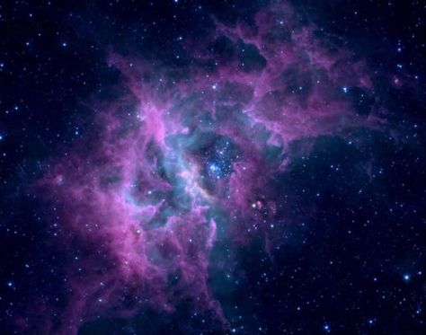
Cosmic
Christianity

Slide 2
A PRAYER OF COSMIC PROPORTIONS
INTRODUCTION

Slide 3
The Ephesian church
Planted by Paul (AD 52) – 2 years (Acts 19)
Warned by Paul – 3 years (Acts 20)
Rebuked by Jesus (AD 81-96) (Rev 2:1-7)
INTRODUCTION

Slide 4
For this reason I kneel before the Father, from whom his whole family in heaven and earth derives its name.
Ephesians 3:14-21 NIV

Slide 5
I pray that out of his glorious riches he may strengthen you with power through his Spirit in your inner being so that Christ may dwell in your hearts through faith.
Ephesians 3:14-21 NIV

Slide 6
And I pray that you, being rooted and established in love, may have power together with all the saints, to grasp how wide and long and high and deep is the love of Christ.
Ephesians 3:14-21 NIV

Slide 7
And to know this love that surpasses knowledge – that you may be filled to the measure of all the fullness of God.
Ephesians 3:14-21 NIV

Slide 8
Now to him who is able to do immeasurably more than all we ask or imagine, according to his power that is at work within us, to Him be glory in the church and in Christ Jesus throughout all generations, forever and ever! AMEN.
Ephesians 3:14-21 NIV

