Slide 1
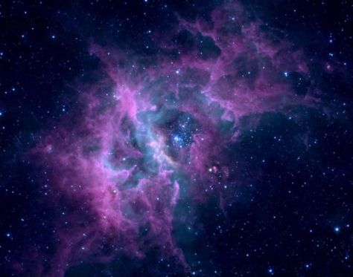
Cosmic
Christianity

Slide 2
THE GREATEST MYSTERY EVER!
INTRODUCTION

Slide 3
Everyone loves a good mystery!
SUSPENSE, MIS-DIRECTION, UNEXPECTED TWISTS & TURNS, FORCED-CONCLUSIONS THAT ARE INCORRECT, FINAL REVEAL
INTRODUCTION

Slide 4
God’s mystery began before creation and all the evidence is lying right out in the open for everyone to see. (Gen 3, Rom 1)
INTRODUCTION

Slide 5
For this reason I, Paul, the prisoner of Christ Jesus for the sake of you Gentiles – Surely you have heard about the administration of God’s grace that was given to me for you,
Ephesians 3:1-13 NIV

Slide 6
that is, the mystery made known to me by revelation, as I have already written briefly.
Ephesians 3:1-13 NIV

Slide 7
In reading this, then, you will be able to understand my insight into the mystery of Christ, which was not made known to men in other generations as it has now been revealed by the Spirit to God’s holy apostles and prophets.
Ephesians 3:1-13 NIV

Slide 8
This mystery is that through the gospel the Gentiles are heirs together with Israel, members together of one body, and sharers together in the promise in Christ Jesus.
Ephesians 3:1-13 NIV

Slide 9
I became a servant of this gospel by the gift of God’s grace given me through the working of his power. Although I am less than the least of all God’s people, this grace was given me to preach to the Gentiles the unsearchable riches of Christ,
Ephesians 3:1-13 NIV

Slide 10
And to make plain to everyone the administration of this mystery, which for ages past was kept hidden in God, who created all things.
Ephesians 3:1-13 NIV

Slide 11
His intent was that now, through the church, the manifold wisdom of God should be made known to the rulers and authorities in the heavenly realms, according to his eternal purpose which he accomplished in Christ Jesus our Lord.
Ephesians 3:1-13 NIV

Slide 12
In him and through faith in him we may approach God with freedom and confidence. I ask you, therefore, not to be discouraged because of my sufferings for you, which are your glory.
Ephesians 3:1-13 NIV

