Slide 1
Cosmic Christianity The Letter to Ephesus
A MATTER OF PERSPECTIVE

Slide 2
10 For we are God's workmanship, created in Christ Jesus to do good works, which God prepared in advance for us to do.
A MATTER OF PERSPECTIVE
EPHESIANS 2:10-22

Slide 3
God’s WORD brings PERSPECTIVE from OUT of this world INTO this world.
A MATTER OF PERSPECTIVE
Introduction

Slide 4
A MATTER OF PERSPECTIVE
PER·SPEC·TIVE /pərˈspektiv/
1. The art of drawing solid objects on a two-dimensional surface so as to give the right impression of their height, width, depth, and position in relation to each other when viewed from a particular point. "a perspective drawing“
A particular attitude toward or way of regarding something; a point of view.
synonyms: outlook, view, viewpoint, point of view, POV, standpoint, position, stand, stance, angle, slant, attitude, frame of mind, frame of reference, approach, way of looking, interpretation, “spin”
Introduction

Slide 5
PERSPECTIVE is important in ART
A MATTER OF PERSPECTIVE
ILLUSTRATION

Slide 6
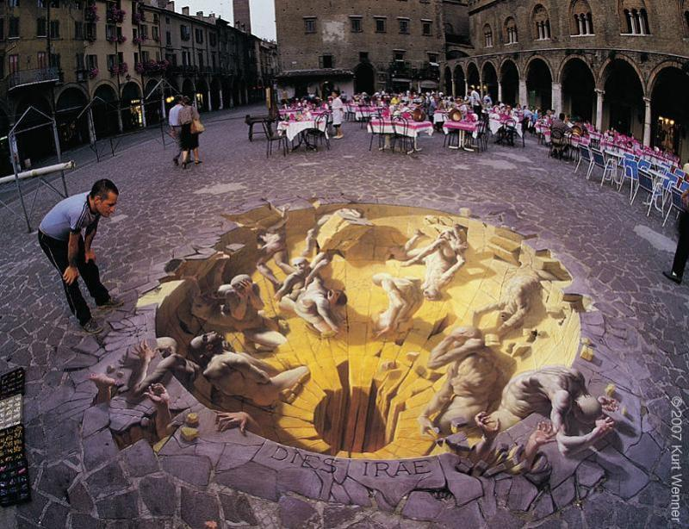

Slide 7
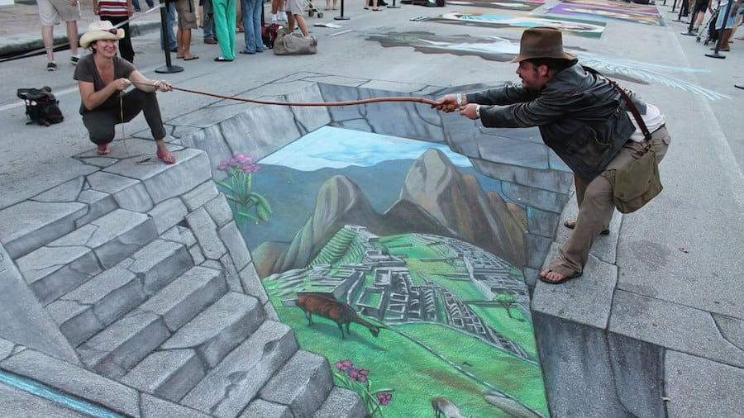

Slide 8
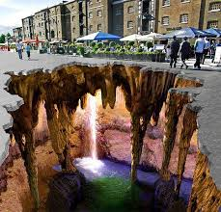

Slide 9
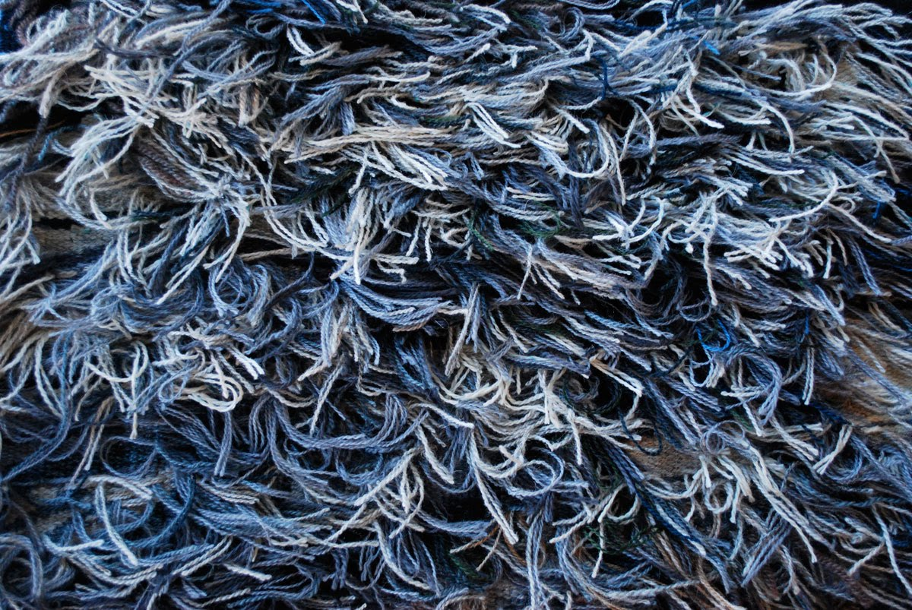
THE BACKSIDE OF THE TAPESTYRY

Slide 11
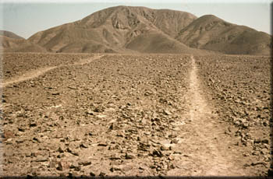
A MATTER OF PERSPECTIVE
ILLUSTRATION

Slide 12
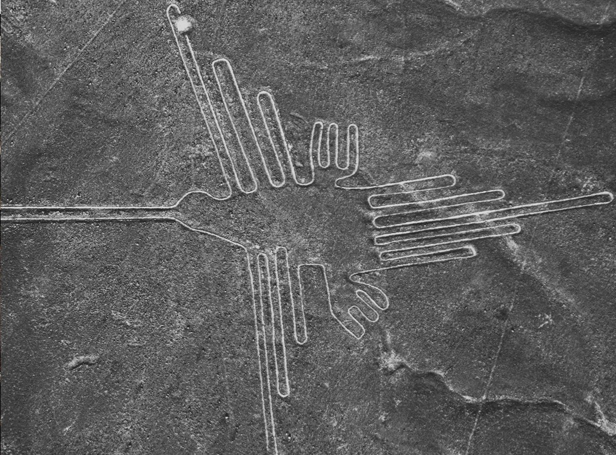
A MATTER OF PERSPECTIVE
ILLUSTRATION

Slide 13
10 For we are God's workmanship, created in Christ Jesus to do good works, which God prepared in advance for us to do. 11 Therefore, remember that formerly you who are Gentiles by birth and called "uncircumcised" by those who call themselves "the circumcision" (that done in the body by the hands of men)-- 12 remember that at that time you were separate from Christ, excluded from citizenship in Israel and foreigners to the covenants of the promise, without hope and without God in the world. 13 But now in Christ Jesus you who once were far away have been brought near through the blood of Christ.
A MATTER OF PERSPECTIVE
EPHESIANS 2:10-22

Slide 14
14 For he himself is our peace, who has made the two one and has destroyed the barrier, the dividing wall of hostility, 15 by abolishing in his flesh the law with its commandments and regulations. His purpose was to create in himself one new man out of the two, thus making peace, 16 and in this one body to reconcile both of them to God through the cross, by which he put to death their hostility.
A MATTER OF PERSPECTIVE
EPHESIANS 2:10-22

Slide 15
17 He came and preached peace to you who were far away and peace to those who were near. 18 For through him we both have access to the Father by one Spirit. 19 Consequently, you are no longer foreigners and aliens, but fellow citizens with God's people and members of God's household,
A MATTER OF PERSPECTIVE
EPHESIANS 2:10-22

Slide 16
20 built on the foundation of the apostles and prophets, with Christ Jesus himself as the chief cornerstone. 21 In him the whole building is joined together and rises to become a holy temple in the Lord. 22 And in him you too are being built together to become a dwelling in which God lives by his Spirit.
A MATTER OF PERSPECTIVE
EPHESIANS 2:10-22

Slide 17
The Masterpiece is about the Artist but the Artist is apparently missing
A MATTER OF PERSPECTIVE
NUMBER ONE

Slide 18
10 For we are God's workmanship, created in Christ Jesus to do good works, which God prepared in advance for us to do. 11 Therefore, remember that formerly you who are Gentiles by birth and called "uncircumcised" by those who call themselves "the circumcision" (that done in the body by the hands of men)-- 12 remember that at that time you were separate from Christ, excluded from citizenship in Israel and foreigners to the covenants of the promise, without hope and without God in the world. 13 But now in Christ Jesus you who once were far away have been brought near through the blood of Christ.
A MATTER OF PERSPECTIVE
EPHESIANS 2:10-22

Slide 19
Humility is critically important to the masterpiece.
A MATTER OF PERSPECTIVE
NUMBER ONE

Slide 20
Moses & prophets warned Israel Paul warned the Gentile churches James warned us all
A MATTER OF PERSPECTIVE
NUMBER ONE

Slide 21
REMEMBER the remedy and the power of the BLOOD OF JESUS THE CHRIST
A MATTER OF PERSPECTIVE
NUMBER ONE

Slide 22
PEACE & UNITY are keys to God’s workmanship
A MATTER OF PERSPECTIVE
NUMBER TWO

Slide 23
17 He came and preached peace to you who were far away and peace to those who were near. 18 For through him we both have access to the Father by one Spirit. 19 Consequently, you are no longer foreigners and aliens, but fellow citizens with God's people and members of God's household,
A MATTER OF PERSPECTIVE
EPHESIANS 2:10-22

Slide 24
God is working in the medium of people, relationships, and synergy
A MATTER OF PERSPECTIVE
NUMBER TWO

Slide 25
Satan is working to reduce people to things, disrupt categories and relationships, and focus everything upon EGO and INDIVIDUAL
A MATTER OF PERSPECTIVE
NUMBER TWO

Slide 26
PEACE comes from God and exists in our spirit UNITY comes from God and extends from our spirit into our SOUL and connects us to OTHERS
A MATTER OF PERSPECTIVE
NUMBER TWO

Slide 27
CHRIST is our peace CHRIST has broken down walls of division CHRIST brings UNITY
A MATTER OF PERSPECTIVE
NUMBER TWO

Slide 28
The Masterpiece is to be viewed by God, the unseen realm and the seen realm – it is a TEMPLE
A MATTER OF PERSPECTIVE
NUMBER THREE

Slide 29
20 built on the foundation of the apostles and prophets, with Christ Jesus himself as the chief cornerstone. 21 In him the whole building is joined together and rises to become a holy temple in the Lord. 22 And in him you too are being built together to become a dwelling in which God lives by his Spirit.
A MATTER OF PERSPECTIVE
EPHESIANS 2:10-22

Slide 30
INDIVIDUALLY we connect with his desired and inspired plan for who we are supposed to be – a temple of the Holy Spirit. With a gift or two and a calling.
A MATTER OF PERSPECTIVE
NUMBER THREE

Slide 31
Lucifer rejected God’s inspired and desired plan for him despite his amazing provision.
A MATTER OF PERSPECTIVE
NUMBER THREE

Slide 32
Humanity is allowed the same option.
A MATTER OF PERSPECTIVE
NUMBER THREE

Slide 33
CORPORATELY a church is to connect with his desired and inspired plan for who they are supposed to be – a temple of the Holy Spirit.
A MATTER OF PERSPECTIVE
NUMBER THREE

Slide 34
The church can be fully called and equipped because there are more people and Christ can be reflected more fully and more powerfully as a TEMPLE of GOD.
A MATTER OF PERSPECTIVE
NUMBER THREE

Slide 35
There is A MATTER OF PERSPECTIVE…How God sees us, how Unfallen and Fallen heavenly creations see us, and how our world sees us.
A MATTER OF PERSPECTIVE
CONCLUSION

Slide 36
God has a plan to make you INDIVIDUALLY a masterpiece God has a plan to make us as a church a masterpiece Are you/we willing to accept the touch of the Master’s hand?
A MATTER OF PERSPECTIVE
CONCLUSION

