Slide 1
Yes, you can!!
Or, Who’s your Daddy!!

Slide 2
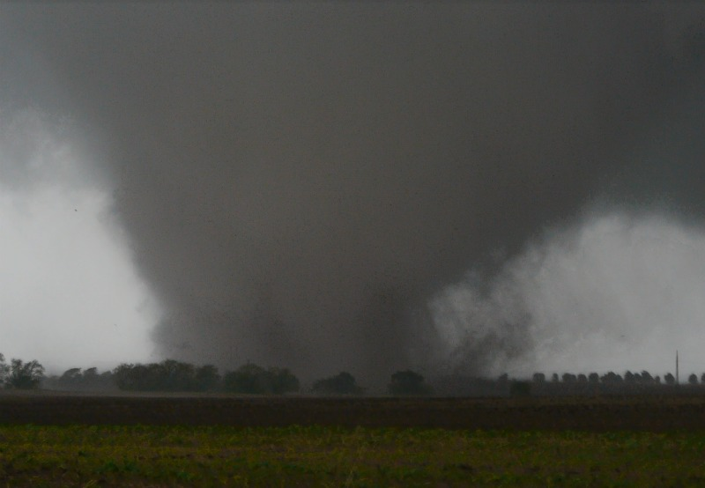
tornado

Slide 3
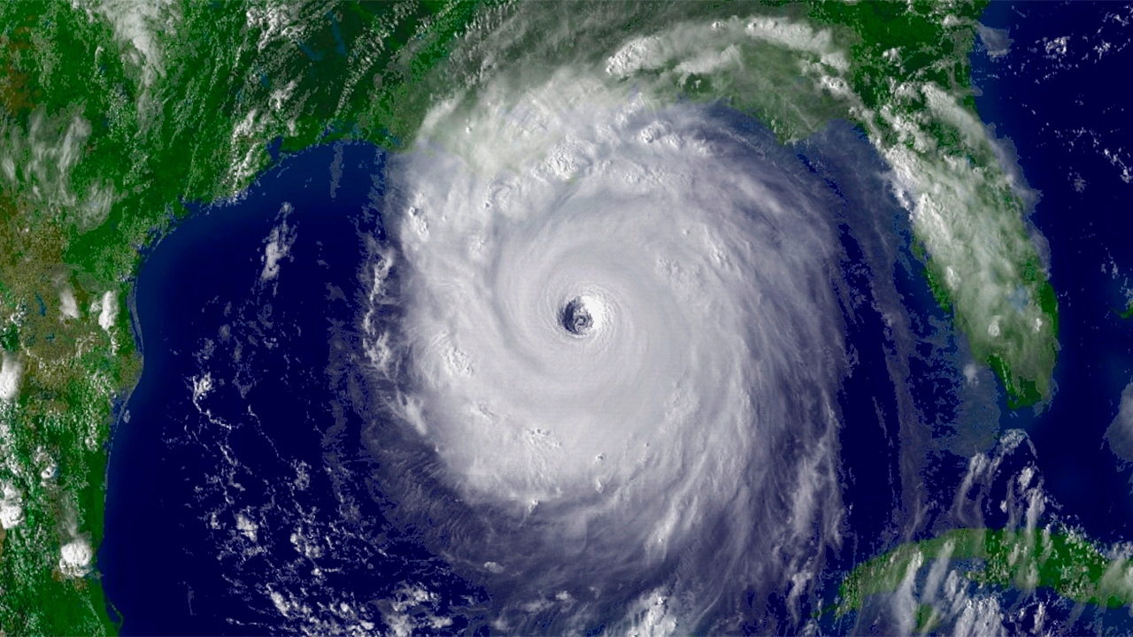
hurricane

Slide 4
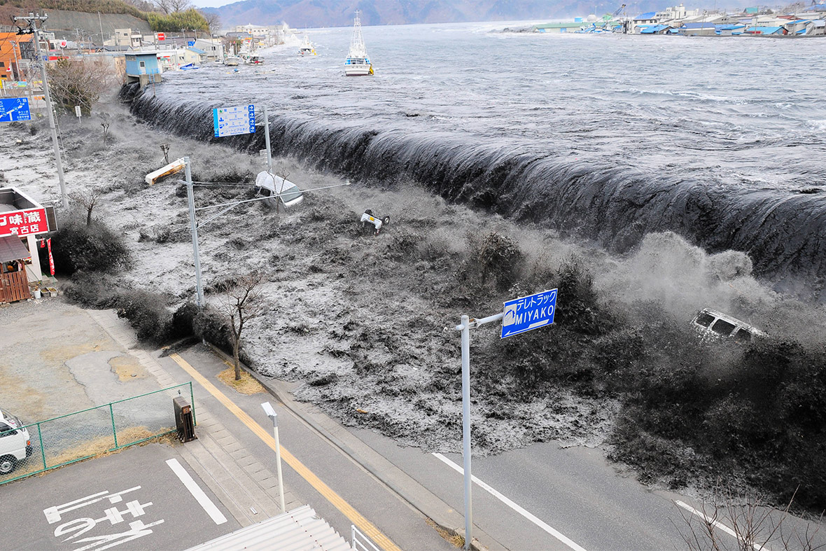
Tsunami

Slide 5
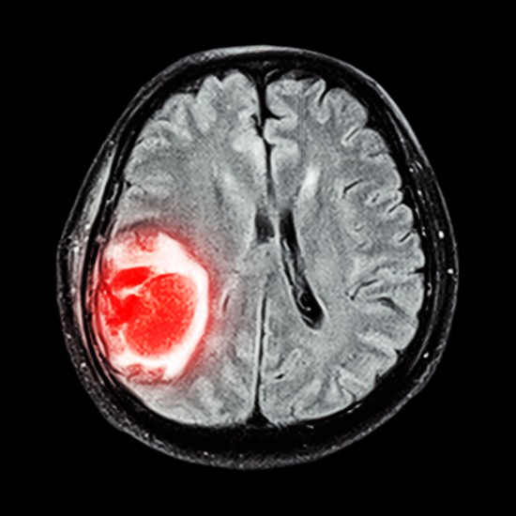
illness

Slide 6
Jeremiah 38:1-2 NLT
Now Shephatiah son of Mattan, Gedaliah son of Pashhur, Jehucal son of Shelemiah, and Pashhur son of Malkijah heard what Jeremiah had been telling the people. He had been saying,
2 “This is what the LORD says: ‘Everyone who stays in Jerusalem will die from war, famine, or disease, but those who surrender to the Babylonians will live. Their reward will be life. They will live!’

Slide 7
Jeremiah 38:3-4 NLT
The LORD also says: ‘The city of Jerusalem will certainly be handed over to the army of the king of Babylon, who will capture it.’”
4 So these officials went to the king and said, “Sir, this man must die! That kind of talk will undermine the morale of the few fighting men we have left, as well as that of all the people. This man is a traitor!”

Slide 8
Jeremiah 38:5
King Zedekiah agreed. “All right,” he said. “Do as you like. I can’t stop you.”

Slide 9
introduction
We act in this same way every day. We don’t believe we have any authority to stop the enemy’s plans for our lives.

Slide 10
question
How many times have the words “there is nothing I can do about it” come out of your mouth?

Slide 11
Point one
Realize we have power.

Slide 12
Acts 1:8 nlt
But you will receive power when the Holy Spirit comes upon you. And you will be my witnesses, telling people about me everywhere—in Jerusalem, throughout Judea, in Samaria, and to the ends of the earth.”

Slide 13
Point two
Learn what that authority is.

Slide 14
Matthew 10:1 NLT
Jesus called his twelve disciples together and gave them authority to cast out evil spirits and to heal every kind of disease and illness.

Slide 15
Point three
Start exercising your authority.

Slide 16
Point three
Pray in the power and authority of Jesus name.

Slide 17
Point three
It’s about time that we told Satan how it is going to be instead of listening to how he says it is going to be.

Slide 18
Point four
Expect results.

Slide 19
Mark 11:24
I tell you, you can pray for anything, and if you believe that you’ve received it, it will be yours.

Slide 20
conclusion
Are you tired of feeling helpless?
Do you let Satan push you around?

Slide 21
conclusion
Realize you have power and authority.
Learn what that authority is.
Start exercising that authority.
Expect results.

