Slide 1
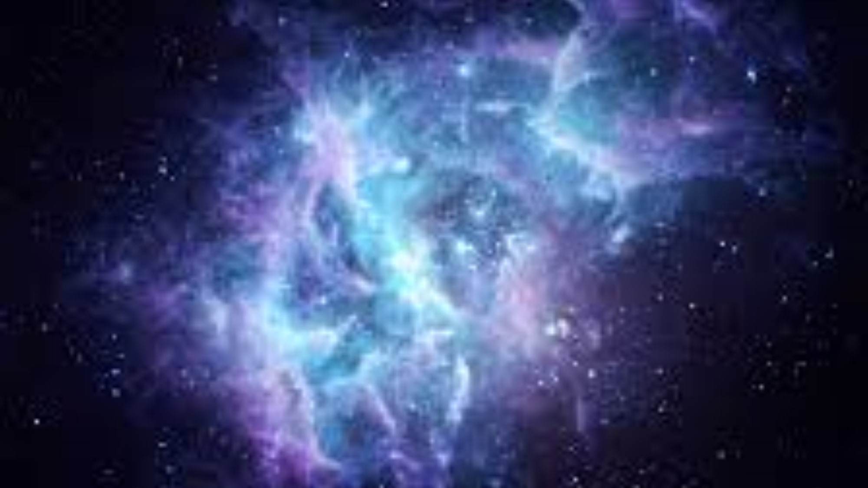
Cosmic Christianity
The Letter to Ephesus
GRACE THROUGH FAITH

Slide 2

Salvation: Works or grace?

Slide 3
Ephesians 2:8-10
8 By grace you have been saved through faith. And this is not your own doing; it is the gift of God, 9 not a result of works, so that no one may boast. 10 For we are his workmanship, created in Christ Jesus for good works. ESV

Slide 4
We often use the phrase “Saved by grace,” but that’s not what the Bible teaches.
Paul said, “We’re saved by grace though faith.”
Faith is not a virtue you possess, but your connector to God’s grace. When you heard about the free gift, you said, “I accept.” That’s faith.

Slide 5
Ah, so we’re saved by faith.
No, “grace through faith… otherwise we make faith a kind of virtue that God rewards.

Slide 6
Works and good works
I’m confused about works. Paul said works do not cause salvation, but then he said we are saved unto good works.

Slide 7
We are to do the works of God. The first work is to believe upon God’s son. The next is to do the good works that God is producing in us.

Slide 8
James 2:18
18 But someone will say, "You have faith and I have works." Show me your faith apart from your works, and I will show you my faith by my works. ESV
Works are not the cause of salvation, but the result. If there’s not results, James says, “You don’t have faith.”

Slide 9
Works according to the Pharisees was a kind of merit system that gave them brownie points with God.
To tell a Pharisee that his righteousness is as filthy rags to God would be devastating.

Slide 10
Paul wanted to make it clear… We’re not working for our salvation….Jesus worked it all out for us, so there’s nothing left to do to get the approval of God. He didn’t do most of it, and we do the rest. No, He did it all. That’s hard to accept because we are in such an “I’ll do it” mode and “I need to earn it” mentality. If I can’t help, how did it get done?

Slide 11
Grace means we get an “A” at the beginning of the class, not at the end.
Jesus took the test, and the result when into your file.

Slide 12
That is the scandal of grace, that someone else did for me what I could not do for myself.

Slide 13
Acts 20:24
24 I consider my life worth nothing to me, if only I may finish the race and complete the task the Lord Jesus has given me--the task of testifying to the gospel of God's grace. ESV

Slide 14
Grace…hard or easy?
Some say grace is too easy…as if to say God is letting people off the hook, as if some should pay for their own sins, while others have theirs forgiven.
Here’s what’s hard about grace…

Slide 15
What’s hard about grace?
It’s free.
There’s no self-satisfaction.
There’s no work.
There’s no sacrifice.
There’s nothing to earn.
There’s no 12 step program.
The prize is at the beginning instead of the end.
It negates religious effort.
Somebody else does it for me.

Slide 16
Grace all so arbitrary: “I will be gracious to whom I will be gracious, and merciful to whom I will be merciful.”
No sacrifice, ceremony, rite, or prayer can earn grace, precisely because it is purely and totally gracious. Am I happy about this? Not at all. My best effort is punctured by gratuitous, prevenient, sanctifying grace.
--Jacques Ellul

Slide 17
As human beings we don’t want grace. We want self-justification. It’s fine for Jesus to help us, but for someone outside of ourselves to declare us not guilty or pay our debt is out of the question.

Slide 18
John 6:28-29
28 Then they said to him (Jesus), "What must we do, to be doing the works of God?" 29 Jesus answered them, "This is the work of God, that you believe in him whom he has sent." ESV

Slide 19
Mark 10:26-27
When Jesus said it was easier for a camel to go through the eye of a needle than a rich person to enter the kingdom of heaven….
26 And they were exceedingly astonished, and said to him, "Then who can be saved?" 27 Jesus looked at them and said, "With man it is impossible, but not with God. For all things are possible with God." ESV

Slide 20
Biblical faith is not in our ability, but His ability to do what He promised.
Faith is an action in response to God’s promises.
You are not saved by works, but by a faith that works.

Slide 21
Grace goes beyond…
Mercy gave Ruth some food. Grace gave her a husband and a home.
Mercy gave the prodigal son a second chance, but grace threw him a party.
Mercy prompted the Samaritan to bandage the wounds of a victim, but grace prompted him to leave his credit card as a payment for the victim’s care.
Mercy forgave the thief on the cross but grace escorted him into paradise.

Slide 22
There are 9,000 religions in the world. We are told that we’re suppose to hug everyone and say, “Your religion is just as true and valid as mine.”
Actually there are only two religions in the world—the true and the false.
Those two religions have two manifestions—they are either works or grace. The only one that is grace is the gospel of our Lord Jesus Christ.
Every religion can tell you what you must do in order to please God. The gospel of grace is the only one that tells what God did for you, being unable to save yourself. Grace provides what God requires.

Slide 23
Philippians 1:6
6 I am sure of this, that he who began a good work in you will bring it to completion at (until) the day of Jesus Christ. ESV
There’s a sense in which it’s all done when you said “yes” to Jesus, and another sense in which salvation has just begun. We are his “workmanship” created for good works.
Works are not what I do for God, but what God does through me.

Slide 24
In what way am I God’s workmanship? It means we are the product of the work of God.
The product is not individual masterpieces, but fitting us beautifully together into the body of Christ, in order that we might corporately fully represent his love, his power, and his grace upon the earth.

Slide 25
Prayer
God we thank you for mercy, but we especially thank your for grace, by which all that you have done for us through Christ is accessible through faith. Paul called it the gospel of grace, by which Christ’s righteousness was not just imputed, but imparted to us who believe. Everything we could not do for ourselves, God did through Christ’s death and resurrection. Thank you in Jesus name.

