Slide 1
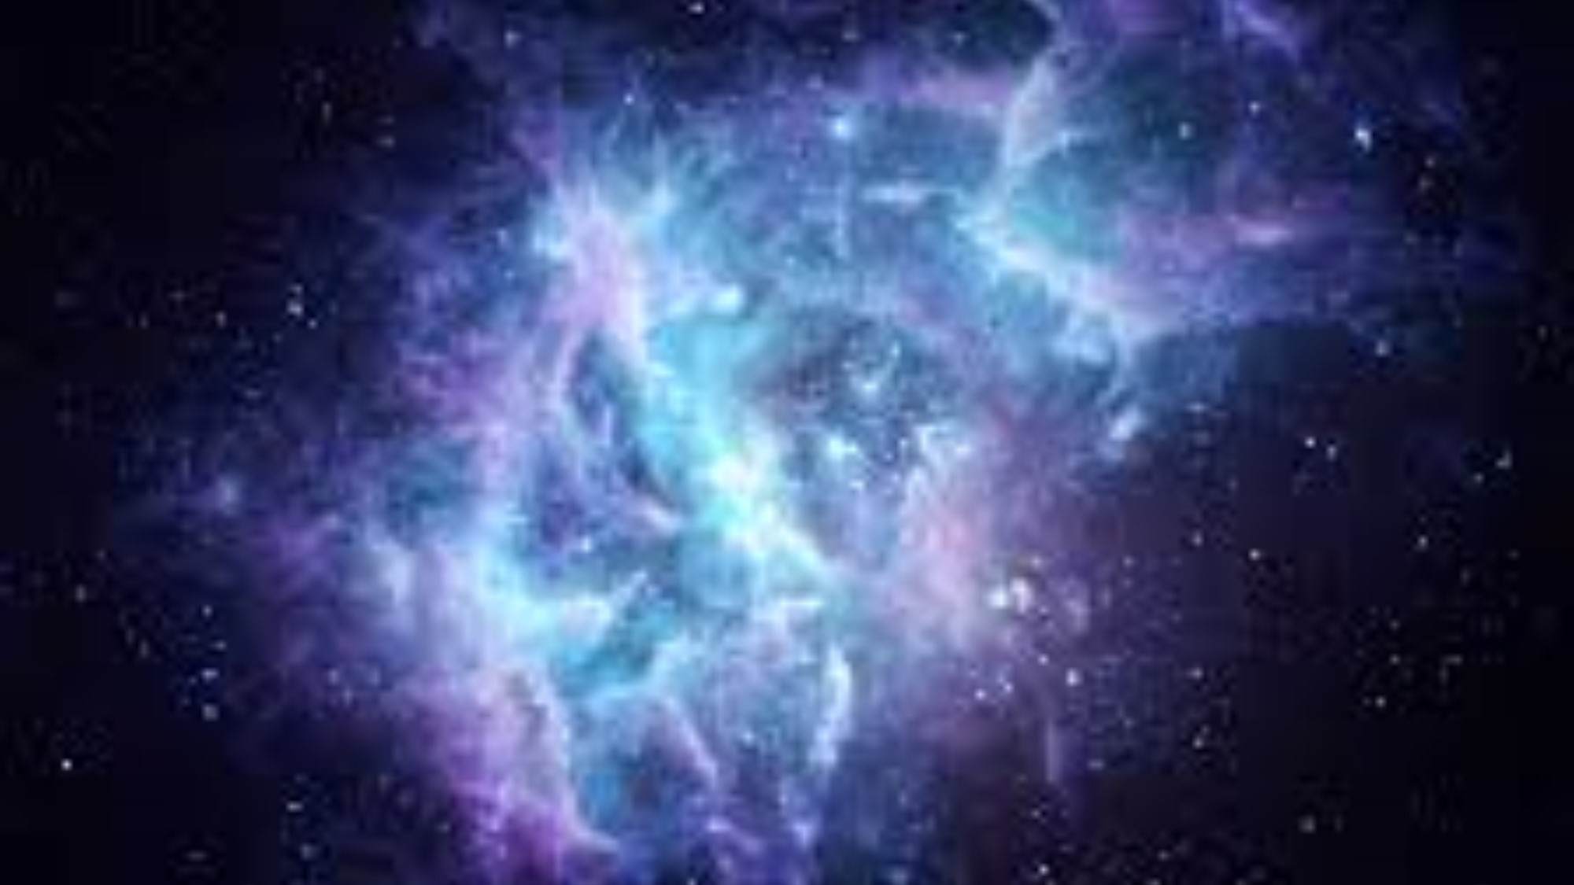
Cosmic Christianity
The Letter to Ephesus
MORE THAN MEETS THE EYE

Slide 2
REMEMBER THE THREE PIVOTAL PRAYERS
COSMIC CHRISTIANITY
Introduction

Slide 3
1. Thanksgiving
2. Wisdom & Revelation to know HIM
3. Enlighten the eyes of the heart with the Word.
COSMIC CHRISTIANITY
Introduction

Slide 4
¹ As for you, you were dead in your transgressions and sins,
² in which you used to live when you followed the ways of this world and of the ruler of the kingdom of the air, the spirit who is now at work in those who are disobedient.
³ All of us also lived among them at one time, gratifying the cravings of our sinful nature and following its desires and thoughts. Like the rest, we were by nature objects of wrath.
⁴ But because of his great love for us, God, who is rich in mercy,
COSMIC CHRISTIANITY
EPHESIANS 2:1-7

Slide 5
⁵ made us alive with Christ even when we were dead in transgressions--it is by grace you have been saved.
⁶ And God raised us up with Christ and seated us with him in the heavenly realms in Christ Jesus,
⁷ in order that in the coming ages he might show the incomparable riches of his grace, expressed in his kindness to us in Christ Jesus.
COSMIC CHRISTIANITY
EPHESIANS 2:1-7

Slide 6
From Genesis 1:1 we are introduced to ANOTHER whole world out there!
COSMIC CHRISTIANITY
Introduction

Slide 7
“In the beginning God created the heavens & the earth…” Genesis 1:1
More Than Meets The Eye
Introduction

Slide 8
Because we have such detail about us in Scripture we tend to think we are all there is to this creation. Materialists think that only the material world – the ERETZ is all there is.
More Than Meets The Eye
Introduction

Slide 9
¹ As for you, you were dead in your transgressions and sins,
² in which you used to live when you followed the ways of this world and of the ruler of the kingdom of the air, the spirit who is now at work in those who are disobedient.
More Than Meets The Eye
EPHESIANS 2:1-2

Slide 10
TRANSGRESSION & DEATH IS A UNIVERSAL PROBLEM
More Than Meets The Eye
NUMBER ONE

Slide 11
THE SOUL THAT SINS - DIES
More Than Meets The Eye
NUMBER ONE

Slide 12
¹ As for you, you were dead in your transgressions and sins,
² in which you used to live when you followed the ways of this world and of the ruler of the kingdom of the air, the spirit who is now at work in those who are disobedient.
More Than Meets The Eye
EPHESIANS 2:1-2

Slide 13
LIFE ON EARTH IS DOMINATED BY DISOBEDIENCE
A SPIRITUAL PROBLEM with a SPIRITUAL SOURCE
THREE APOSTOLIC PRAYERS
NUMBER TWO

Slide 14
THERE NEEDS TO BE A “USED TO”!
More Than Meets The Eye
NUMBER TWO

Slide 15
1. Followed the ways (wisdom) of this world
2. Followed the ways of the ruler of kingdom of the air
3. There is a spirit of disobedience
More Than Meets The Eye
NUMBER TWO

Slide 16
³ All of us also lived among them at one time, gratifying the cravings of our sinful nature and following its desires and thoughts. Like the rest, we were by nature objects of wrath.
More Than Meets The Eye
EPHESIANS 2:1-7

Slide 17
1. Jew & Gentile alike shared in this problem
2. The appetite of self-fulfilling thoughts and actions
3. The consequences is wrath
More Than Meets The Eye
NUMBER THREE

Slide 18
⁴ But because of his great love for us, God, who is rich in mercy, ⁵ made us alive with Christ even when we were dead in transgressions--it is by grace you have been saved.
More Than Meets The Eye
EPHESIANS 2:1-7

Slide 19
1. LOVE trumps JUSTICE & WRATH
2. MERCY acts to spare us our just desserts
3. GRACE gives us an alternative of SALVATION
More Than Meets The Eye
NUMBER FOUR

Slide 20
⁶ And God raised us up with Christ and seated us with him in the heavenly realms in Christ Jesus,
⁷ in order that in the coming ages he might show the incomparable riches of his grace, expressed in his kindness to us in Christ Jesus.
COSMIC CHRISTIANITY
EPHESIANS 2:1-7

Slide 21
1. The church is raised and seated with Christ.
2. Our seat is in the heavenly realms.
3. We are the eternal object lesson of kindness.
More Than Meets The Eye
NUMBER FIVE

Slide 22
There is more than meets the eye…
THIS is not all there is!
More Than Meets The Eye
CONCLUSION

Slide 23
A new life is available right now and it is offered from another realm and is lived by the ways of another wisdom to the ends of another purposes.
More Than Meets The Eye
CONCLUSION

Slide 24
God’s purposes are realized in THIS world and in the HEAVENLY realms – if we are willing.
More Than Meets The Eye
CONCLUSION

