Slide 1
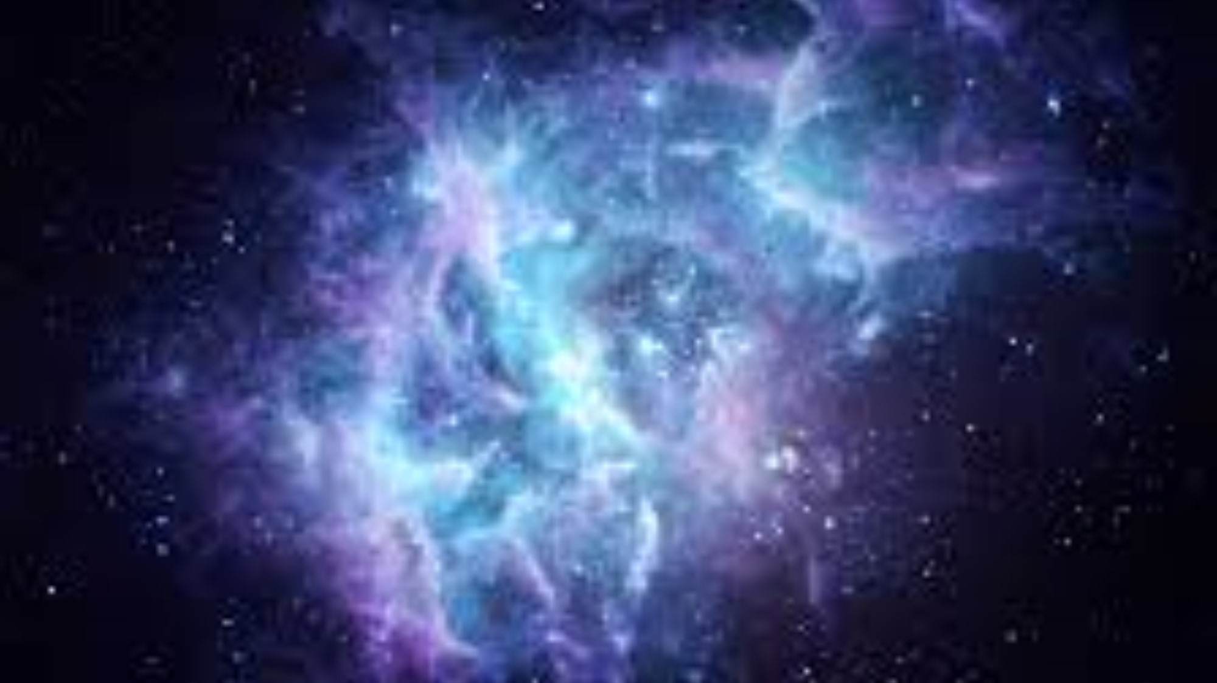
Cosmic Christianity
The Letter to Ephesus
EIGHT BLESSINGS OF THE CHURCH

Slide 2
The great mystery of THE CHURCH and the plan of God concerning HER and ISRAEL is revealed by PAUL to the church at Ephesus.
COSMIC CHRISTIANITY
Introduction

Slide 3
Paul lists EIGHT distinct aspects of this MYSTERY – He is talking about FULLNESS and NEWNESS OF CREATION!!
COSMIC CHRISTIANITY
Introduction

Slide 4
Praise be the God and Father of our Lord Jesus Christ, who has blessed us in the heavenly realms with every spiritual blessing in Christ
Ephesians 1:3-14
NUMBER ONE

Slide 5
THE FATHER / US – RELATIONSHIP
“BLESSED” - TIME
HIGHEST REALM – LOCATION
IN CHRIST - RELATIONSHIP
Ephesians 1:3-14
NUMBER ONE

Slide 6
The church is where people learn to live in a higher realm instead of a lower realm.
Ephesians 1:3-14
NUMBER ONE

Slide 7
For He chose us in Him before the creation of the world to be holy and blameless in his sight in love.
Ephesians 1:3-14
NUMBER TWO

Slide 8
HE CHOSE US IN HIM – POSITION
BEFORE CREATION - TIME
HOLY & BLAMELESS – STATE/CONDITION
IN HIS SIGHT/IN LOVE - RELATIONSHIP
Ephesians 1:3-14
NUMBER TWO

Slide 9
The church is where BROKEN & GUILTY learn how to live HOLY & BLAMELESS in LOVE RELATIONSHIP with God and US.
Ephesians 1:3-14
NUMBER TWO

Slide 10
He predestined us to be adopted as His sons through Jesus Christ in accordance with his pleasure and will – to the praise of his glorious grace, which he has freely given us in the One he loves.
Ephesians 1:3-14
NUMBER THREE

Slide 11
ADOPTED AS SONS – POSITION
PREDESTINED - TIME
GLORIOUS GRACE GIVEN – STATE/CONDITION
THROUGH CHRIST - RELATIONSHIP
Ephesians 1:3-14
NUMBER THREE

Slide 12
The church is where people learn how to be SONS OF GOD and ALLOW GRACE TO FLOW THROUGH THEM.
Ephesians 1:3-14
NUMBER THREE

Slide 13
In him we have redemption through his blood, the forgiveness of sins, in accordance with the riches of God’s grace that he lavished on us with all wisdom and understanding.
Ephesians 1:3-14
NUMBER FOUR

Slide 14
REDEMPTION – POSITION
LAVISHED GRACE & WISDOM TIME
SINS FORGIVEN – STATE/CONDITION
IN HIM - RELATIONSHIP
Ephesians 1:3-14
NUMBER FOUR

Slide 15
The CHURCH proclaims a message of forgiveness and RESTORED POSITION through lavish divine wisdom and grace.
Ephesians 1:3-14
NUMBER FOUR

Slide 16
And he made known to us the mystery of his will according to his good pleasure, which he purposed in Christ to be put into effect when the times will have reached their fulfillment to bring all things in heaven and on earth together under one head, even Christ.
Ephesians 1:3-14
NUMBER FIVE

Slide 17
INSIDE CONFIDANTE – POSITION
PURPOSED - TIME
GOOD PLEASURE/UNITY – STATE/CONDITION
IN CHRIST - RELATIONSHIP
Ephesians 1:3-14
NUMBER FIVE

Slide 18
The CHURCH knows GOD’s mind and plans for the desired future –FULFILLMENT and UNITY living the future NOW.
Ephesians 1:3-14
NUMBER FIVE

Slide 19
In him we were also chosen, having been predestined according to the plan of him who works out everything in conformity with the purpose of his will, in order that we who were the first to hope in Christ might be for the praise of his glory.
Ephesians 1:3-14
NUMBER SIX

Slide 20
CHOSEN (Israel) – POSITION
PREDESTINED - TIME
1st in hope/1st in Praise – STATE/CONDITION
IN CHRIST - RELATIONSHIP
Ephesians 1:3-14
NUMBER SIX

Slide 21
The CHURCH calls ISRAEL to FAITH and looks for and prays for HER FULFILLMENT
Ephesians 1:3-14
NUMBER SIX

Slide 22
And you also were included in Christ when you heard the word of truth, the gospel of your salvation.
Ephesians 1:3-14
NUMBER SEVEN

Slide 23
INCLUDED – POSITION
HEARD/BELIEVED - TIME
BEING SAVED – STATE/CONDITION
IN CHRIST - RELATIONSHIP
Ephesians 1:3-14
NUMBER SEVEN

Slide 24
The CHURCH is for all but the SUPER-MAJORITY is GENTILE / ALL-NATIONS and must remain humble – we are INCLUDED!!
Ephesians 1:3-14
NUMBER SEVEN

Slide 25
Having believed you were marked in him with a seal the promised Holy Spirit who is a deposit guaranteeing our inheritance until the redemption of those who are God’s possession-to the praise of His Glory.
Ephesians 1:3-14
NUMBER EIGHT

Slide 26
INHERITOR – POSITION
MARKED /SEALED - TIME
AWAITING ISRAEL – STATE/CONDITION
IN CHRIST - RELATIONSHIP
Ephesians 1:3-14
NUMBER EIGHT

Slide 27
The church is born-again Jewish and Gentile believers working with a mark of God upon them, (a down-payment) and looking forward to the redemption of a whole physical nation of Israel.
Ephesians 1:3-14
NUMBER EIGHT

Slide 28
GREAT NEWS – The invitation has been given to ALL, Christ died for ALL, and God is willing for ALL to come to Him and become a part of the MYSTERY!!
COSMIC CHRISTIANITY
CONCLUSION

