Slide 1
JOY

Slide 2
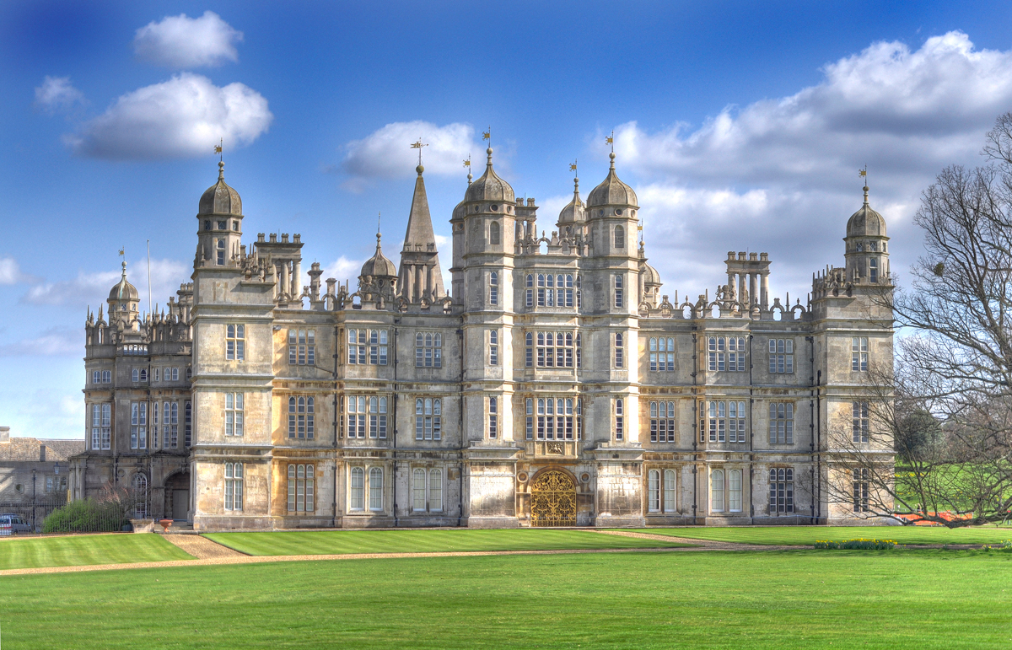

Slide 3


Slide 4
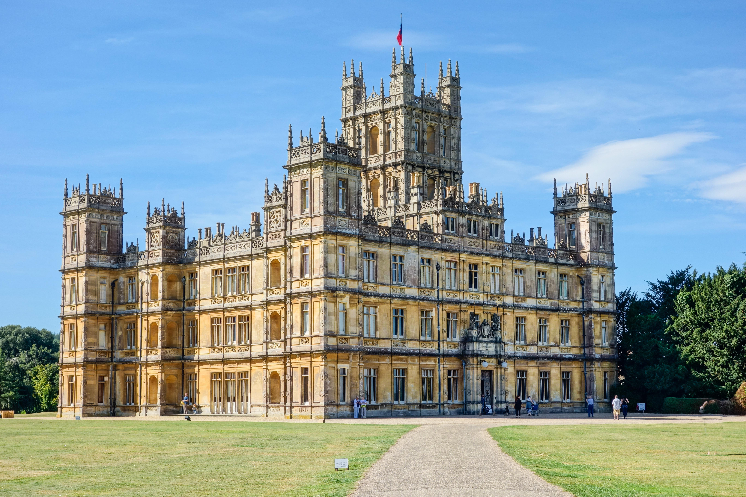

Slide 5
joy
The words joy, joyful, glad, gladness, rejoice and rejoicing are in the Bible 552 times.
God commanded the Israelites to rejoice.
The Bible repeatedly tells us to rejoice in the Lord.

Slide 6
JOY
Rejoice – To be glad, rejoice.
Joy – Mirth, gladness, joy, gaiety, pleasure.
Glad – Rejoice, be glad.

Slide 7
JOY
Joy should not depend on your circumstances.
You can have joy no matter what is going on in your life.

Slide 8
JOY
The enemy does not want you to rejoice, be joyful or be glad. He wants you to have enough fun to follow him all the way to misery and sadness.

Slide 9
Psalm 32
Oh, what joy for those whose disobedience is forgiven, whose sin is put out of sight! 2 Yes, what joy for those whose record the LORD has cleared of guilt, whose lives are lived in complete honesty! 3 When I refused to confess my sin, my body wasted away, and I groaned all day long. 4 Day and night your hand of discipline was heavy on me. My strength evaporated like water in the summer heat.

Slide 10
PSALM 32
5 Finally, I confessed all my sins to you and stopped trying to hide my guilt. I said to myself, “I will confess my rebellion to the LORD .” And you forgave me! All my guilt is gone. 6 Therefore, let all the godly pray to you while there is still time, that they may not drown in the floodwaters of judgment. 7 For you are my hiding place; you protect me from trouble. You surround me with songs of victory.

Slide 11
PSALM 32
8 The LORD says, “I will guide you along the best pathway for your life. I will advise you and watch over you. 9 Do not be like a senseless horse or mule that needs a bit and bridle to keep it under control.” 10 Many sorrows come to the wicked, but unfailing love surrounds those who trust the LORD . 11 So rejoice in the LORD and be glad, all you who obey him! Shout for joy, all you whose hearts are pure.

Slide 12
POINT 1
SALVATION BRINGS JOY

Slide 13
POINT 1
SIN MAKES YOU FEEL DEFEATED
SIN MAKES YOU FEEL WEIGHED DOWN.
SALVATION RELEASES THE WEIGHT.
SALVATION DECLARES VICTORY.

Slide 14
POINT 2
THE LORD IS OUR HIDING PLACE.

Slide 15
POINT 2
GOD PROTECTS US FROM TROUBLE.
GOD PROTECTS US FROM THE SCHEMES OF THE ENEMY.

Slide 16
POINT 3
GOD SURROUNDS US WITH SONGS OF VICTORY.

Slide 17
POINT 3
A 2013 study in the Journal of Positive Psychology found that people who listened to upbeat music could improve their moods and boost their happiness in just two weeks.
In the study, participants were instructed to try to improve their mood, but they only succeeded when they listened to the upbeat music.

Slide 18
POINT 3
And a happier mood brings benefits beyond feeling good. Happiness has been linked to better physical health, higher income, and greater relationship satisfaction.

Slide 19
POINT 4
GOD HAS THE PLAN FOR YOUR LIFE

Slide 20
POINT 4
THE LORD GUIDES US ALONG THE BEST PATH FOR OUR LIFE.
GOD ADVISES US AND WATCHES OVER US.

Slide 21
POINT 5
UNFAILING LOVE SURROUNDS THOSE WHO TRUST IN THE LORD.

Slide 22
POINT 5
SURROUND:
to encompass, surround
to come about, assemble round
to march, go about
to enclose, envelop

Slide 23
CONCLUSION
So rejoice in the LORD and be glad, all you who obey him! Shout for joy, all you whose hearts are pure.
PSALM 32:11

Slide 24
CONCLUSION
ARE YOU HAVING TROUBLE BEING JOYFUL?
WHAT ARE YOU FOCUSED ON?
DO YOU FIND IT EASIER TO FOCUS ON YOUR PROBLEMS THAN ON WHAT GOD HAS DONE FOR YOU?

