Slide 1
BE FILLED WITH THE HOLY SPIRIT

Slide 2
No argument with the command…the problem is making room for the Spirit on a daily basis.
It’s one thing to have the experience of the baptism of the Holy Spirit….it’s another to stay full on an ongoing basis.

Slide 3
Ephesians 5:18b-21
Be filled with the Spirit, 19 addressing one another in psalms and hymns and spiritual songs, singing and making melody to the Lord with all your heart, 20 giving thanks always and for everything to God the Father in the name of our Lord Jesus Christ, 21 submitting to one another out of reverence for Christ. ESV

Slide 4
Ephesians 3:17-19
That you, being rooted and grounded in love, 18 may have strength to comprehend with all the saints what is the breadth and length and height and depth, 19 and to know the love of Christ that surpasses knowledge, that you may be filled with all the fullness of God.
ESV

Slide 5
Here’s the point…
Make room daily for the Holy Spirit and all his blessings.

Slide 6
Romans 1:29-31
29 They were filled with all manner of unrighteousness, evil, covetousness, malice. They are full of envy, murder, strife, deceit, maliciousness. They are gossips, 30 slanderers, haters of God, insolent, haughty, boastful, inventors of evil, disobedient to parents, 31 foolish, faithless, heartless, ruthless. ESV

Slide 7
Who are these people? They cannot be filled with the Holy Spirit because they are filled with other things.
Container law: Two things cannot fill the same place.

Slide 8
Things that take up precious space
Anger
Worry
Jealousy
Self-focus
Depression
Fear
Low expectations
Conflict

Slide 9
More things….
9. Unbelief
Anxiety
Hurt feelings
Offense
Stress
Unforgiveness
Bad attitude
Greed

Slide 10
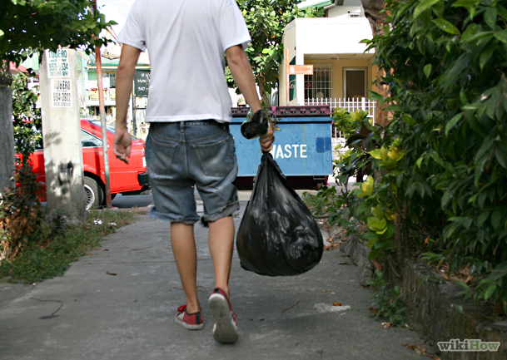
Take out the garbage

Slide 11
This is tough. We are not in the habit of taking out our personal garbage. We tend to collect garbage, explain it, excuse it, and even defend it.
How a habit is formed.

Slide 12
This is a battle we must win if we want to be free, and free depends on staying full of the Holy Spirit.
People tend to obsess over thoughts and experiences, till it fills up their space with junk.
What you dwell on attaches itself to your soul, and becomes a habit.

Slide 13
Here’s what to do
Start this habit:
Empty your garbage at the end of the day of everything that is anti-kingdom. Call it out—throw it out. This might take a while.
Then enjoy the space you have made for God, his wisdom, his joy, his purpose, his blessings.

Slide 14
David got in between us to where there was very little space. He said, “It’s too fat in here.”

Slide 15
You have to empty out if you want to make room for something else.
We should gladly empty out that which is garbage to our spirit, soul, and body.

Slide 16
You are not a self-emptying vessel. It would be nice if there was a disposal installed somewhere.
You empty out with a prayer like this at the end of the day:
“Lord, I don’t sense the fullness of your Spirit. I need to empty out everything that’s taking up valuable space….and incongruent with your Spirit and Christlikeness.
I am going to name every one, and empty myself of everything that is taking up space.”

Slide 17
“I repent Lord of all the junk I seem to hoard. I give it up and cast it out.
Tomorrow I will be careful to stay free and stay full of your Holy Spirit. When a negative thought or bad habit tries to take up space I will reject it and stay full of your Spirit.”

Slide 18
Let this be a red letter day. “Today I am going to stop feeding my history.”
Whatever negative has been there a long time is a part of your dysfunction. Kick it to the curb and make room for the Holy Spirit.

Slide 19
Colossians 2:9-10
9 For in him the whole fullness of deity dwells bodily, 10 and you have been filled in him, who is the head of all rule and authority.
ESV

Slide 20
Say this: The Holy Spirit is filling me with the fruit of the Spirit. I must make room for…
Love, joy, peace, patience, kindness, goodness, faithfulness, gentleness, self-control.
Fill me up with your gifts and your fruit…I’ll hang on to it all day.

Slide 21
Monitor what’s inside, so someone else doesn’t have to tell you. You know what’s there. If we could turn your soul inside out…we’d see.
Garbage smells. You can’t cover it with perfume and breath fresheners.

Slide 22
Empty out the garbage!
Yes it is embarrassing, but take courage, we all have to do it.
Why? We have to make room for the Spirit.
Make good use of your space…be filled with the Spirit.

