Slide 1
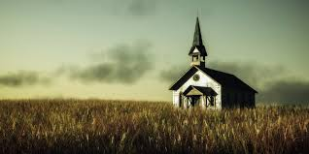
The Church

Slide 2
The Church
¹⁶ Simon Peter answered, "You are the Christ, the Son of the living God." ¹⁷ Jesus replied, "Blessed are you, Simon son of Jonah, for this was not revealed to you by man, but by my Father in heaven. ¹⁸ And I tell you that you are Peter, and on this rock I will build my church, and the gates of Hades will not overcome it. ¹⁹ I will give you the keys of the kingdom of heaven; whatever you bind on earth will be bound in heaven, and whatever you loose on earth will be loosed in heaven."
Matthew 16:16-19 NIV

Slide 3
The Church
¹⁰ His intent was that now, through the church, the manifold wisdom of God should be made known to the rulers and authorities in the heavenly realms, ¹¹ according to his eternal purpose which he accomplished in Christ Jesus our Lord.
Ephesians 3:10-11 NIV

Slide 4
The Church
The church is God’s BIG IDEA
It speaks FAMILY
It runs on AGAPE
It develops CHARACTER
It reflects GLORY
REVIEW

Slide 5
The Church
God’s household and family –
How do I get in?
How do I grow?
How do I impact my world?
REVIEW

Slide 6
The Church
How do I get into this thing called the church?
Accept Christ’s gift of life through being born again
Connect to His plan for togetherness and unity
Express His Kingdom within the world
REVIEW

Slide 7
The Church
God’s household and family –
How do I get in?
How do I grow?
How do I impact my world?
INTRODUCTION

Slide 8
The Church
“ Ask not what your country can do for you, but ask what you can do for your country “
John Fitzgerald Kennedy
INTRODUCTION

Slide 9
The Church
THREE THINGS…
STEWARDSHIP
INTRODUCTION

Slide 10
The Church
TIME
TALENT
TREASURE
INTRODUCTION

Slide 11
The Church
TIME
POINT ONE

Slide 12
The Church
1 Peter 4:1-3 (NIV)
1 Therefore, since Christ suffered in his body, arm yourselves also with the same attitude, because he who has suffered in his body is done with sin.
2 As a result, he does not live the rest of his earthly life for evil human desires, but rather for the will of God.
3 For you have spent enough time in the past doing what pagans choose to do--living in debauchery, lust, drunkenness, orgies, carousing and detestable idolatry.
POINT ONE

Slide 13
The Church
Ephesians 5:15-16 (NIV)
15 Be very careful, then, how you live--not as unwise but as wise,
making the most of every opportunity, because the days are evil.
Ephesians 5:15-16 (NKJV)
15 See then that you walk circumspectly, not as fools but as wise,
16 redeeming the time, because the days are evil.
POINT ONE

Slide 14
The Church
60x24x356=525,600
(24-8) x 365= 5,840
POINT ONE

Slide 15
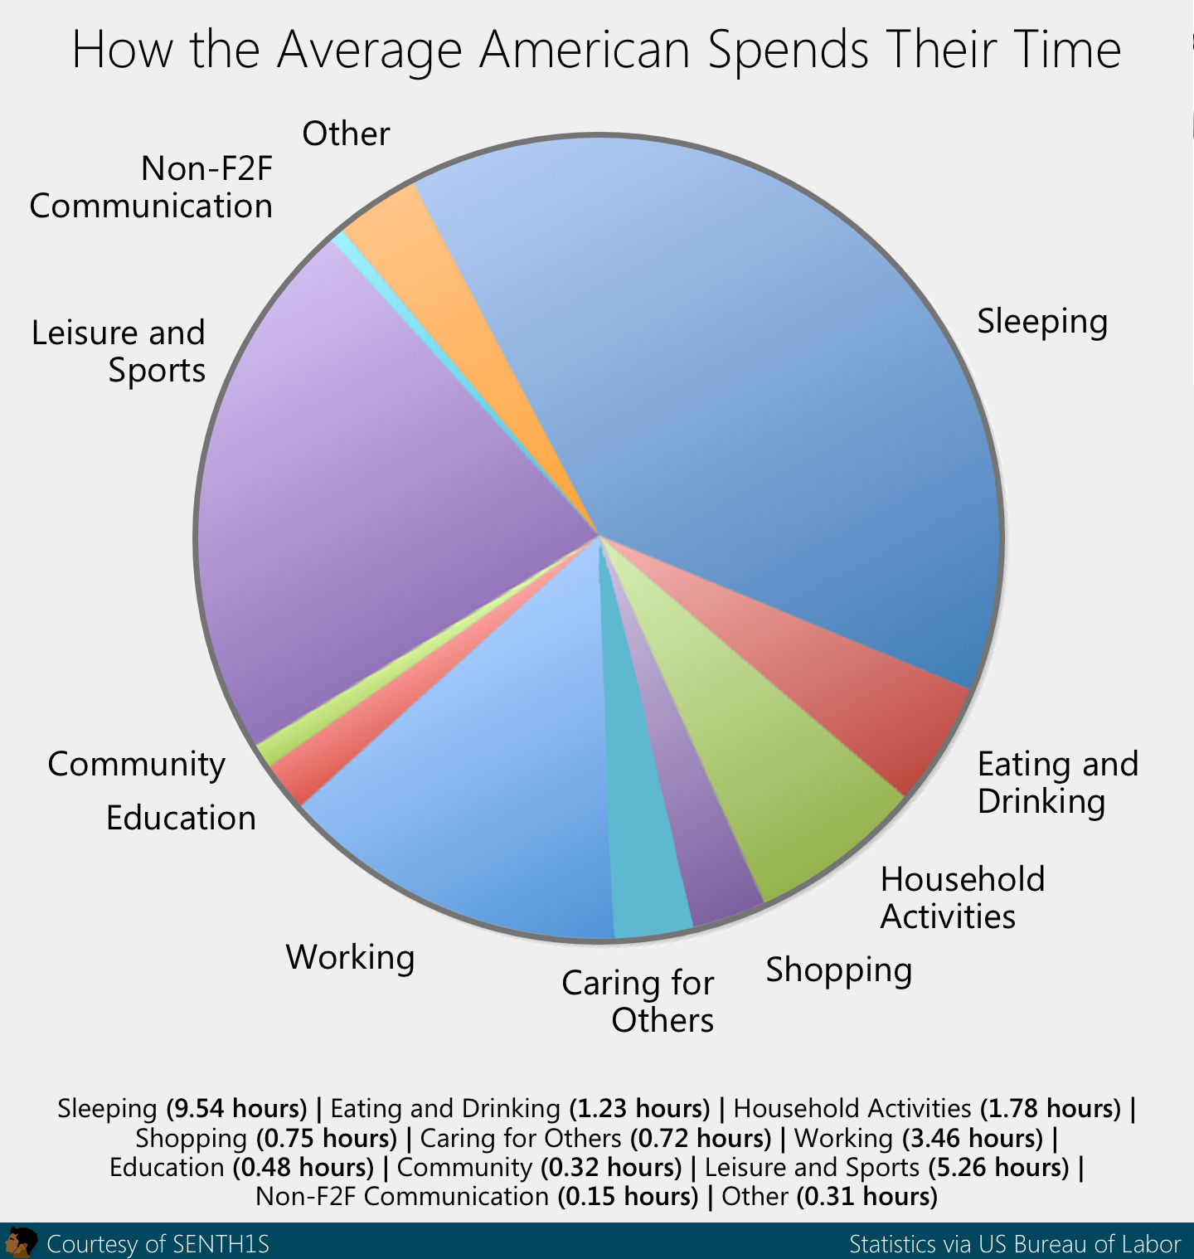
The Church
POINT ONE

Slide 16
The Church
The church community is made for investing time together in synergy leveraging time and presence towards the redemption!
POINT ONE

Slide 17
The Church
INVEST time with and in the church
POINT ONE

Slide 18
The Church
TALENT
POINT TWO

Slide 19
The Church
Exodus 31:1-5 (NIV)
1 Then the LORD said to Moses,
2 "See, I have chosen Bezalel son of Uri, the son of Hur, of the tribe of Judah,
3 and I have filled him with the Spirit of God, with skill, ability and knowledge in all kinds of crafts--
4 to make artistic designs for work in gold, silver and bronze,
5 to cut and set stones, to work in wood, and to engage in all kinds of craftsmanship.
POINT TWO

Slide 20
The Church
Ephesians 4:11-13 (NIV)
11 It was he who gave some to be apostles, some to be prophets, some to be evangelists, and some to be pastors and teachers,
12 to prepare God's people for works of service, so that the body of Christ may be built up
13 until we all reach unity in the faith and in the knowledge of the Son of God and become mature, attaining to the whole measure of the fullness of Christ.
POINT TWO

Slide 21
The Church
We tend to be “Dead-Seas” and “Grace-Hoarders”
POINT TWO

Slide 22
The Church
Skills, abilities, and grace-flows are given to be DISTRIBUTED and benefit OTHERS to the maximum
POINT TWO

Slide 23
The Church
What is your ministry shape?
S pritual gifts H eart A ptitude P ersonality
E xperience
POINT TWO

Slide 24
The Church
The church community is made for investing TALENTS together in synergy of GRACE which IMPACTS the world.
POINT TWO

Slide 25
The Church
TREASURE
POINT THREE

Slide 26
The Church
Matthew 6:19-21 (NIV)
19 "Do not store up for yourselves treasures on earth, where moth and rust destroy, and where thieves break in and steal.
20 But store up for yourselves treasures in heaven, where moth and rust do not destroy, and where thieves do not break in and steal.
21 For where your treasure is, there your heart will be also.
POINT THREE

Slide 27
The Church
Mark 12:41-44 (NIV)
41 Jesus sat down opposite the place where the offerings were put and watched the crowd putting their money into the temple treasury. Many rich people threw in large amounts.
42 But a poor widow came and put in two very small copper coins, worth only a fraction of a penny.
43 Calling his disciples to him, Jesus said, "I tell you the truth, this poor widow has put more into the treasury than all the others.
44 They all gave out of their wealth; but she, out of her poverty, put in everything--all she had to live on."
POINT THREE

Slide 28
The Church
1 Timothy 6:10 (NIV)
10 For the love of money is a root of all kinds of evil. Some people, eager for money, have wandered from the faith and pierced themselves with many griefs.
POINT THREE

Slide 29
The Church
MONEY is a powerful expression of our life
POINT THREE

Slide 30
The Church
Our banking and credit card statements speak volumes of where our heart is placed.
POINT FOUR

Slide 31
The Church
Tithing and Giving can reflect, challenge, and change our heart
POINT FOUR

Slide 32
The Church
The church community is made for investing TREASURE together in synergy of FINANCE which CHALLENGES “Mammon”
POINT THREE

Slide 33
The Church
Where are you investing time within the church community?
Where are you investing talents within the church community?
How are you investing treasure in the church community?
CONCLUSION

