Slide 1
Compassion

Slide 2


Slide 3
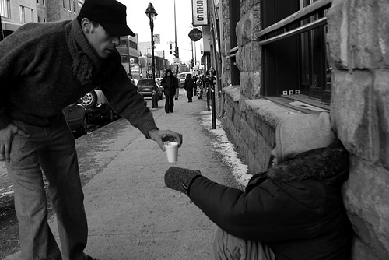

Slide 4
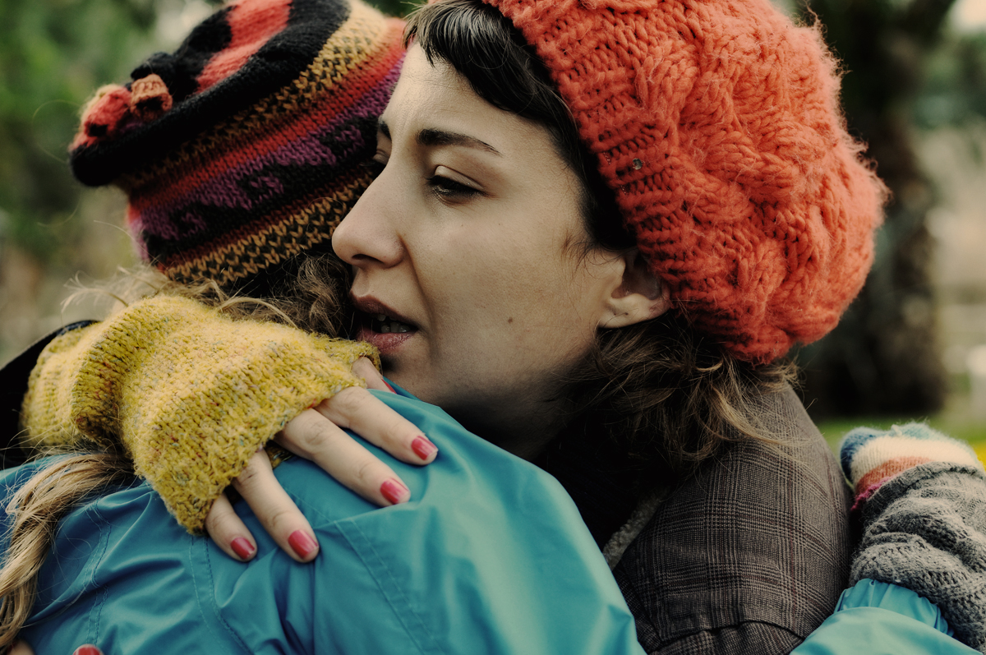

Slide 5
Compassion will cure more sins than condemnation.
Henry Ward Beecher

Slide 6
Colossians 3:12 NIV
Therefore, as God’s chosen people, holy and dearly loved, clothe yourselves with compassion, kindness, humility, gentleness and patience.

Slide 7
Philippians 2:1-2 Niv
Therefore if you have any encouragement from being united with Christ, if any comfort from his love, if any common sharing in the Spirit, if any tenderness and compassion, 2 then make my joy complete by being like-minded, having the same love, being one in spirit and of one mind.

Slide 8
Philippians 2:3-5 niv
Do nothing out of selfish ambition or vain conceit. Rather, in humility value others above yourselves, 4 not looking to your own interests but each of you to the interests of the others. 5 In your relationships with one another, have the same mindset as Christ Jesus:

Slide 9
Philippians 2:6-7 niv
Who, being in very nature God, did not consider equality with God something to be used to his own advantage; 7 rather, he made himself nothing by taking the very nature of a servant, being made in human likeness.

Slide 10
Servanthood should be our goal. Placing others before ourselves goes against our flesh.

Slide 11
Splagchnizomai
Verb
Compassion – To be moved as to ones bowels, hence to be moved with compassion, have compassion (for the bowels were thought to be the seat of love and pity)

Slide 12
Luke 15:20 niv
So he got up and went to his father. “But while he was still a long way off, his father saw him and was filled with compassion for him; he ran to his son, threw his arms around him and kissed him.

Slide 13
It is easier to show compassion to our physical family than to others.

Slide 14
Matthew 9:36 niv
When he saw the crowds, he had compassion on them, because they were harassed and helpless, like sheep without a shepherd.

Slide 15
Jesus had compassion on those in spiritual darkness.

Slide 16
Matthew 14:14 niv
When Jesus landed and saw a large crowd, he had compassion on them and healed their sick.

Slide 17
Jesus had compassion on the physically sick.

Slide 18
Matthew 15:32 niv
Jesus called his disciples to him and said, “I have compassion for these people; they have already been with me three days and have nothing to eat. I do not want to send them away hungry, or they may collapse on the way.”

Slide 19
Jesus had compassion on those who were physically hungry.

Slide 20
CONCLUSION
How compassionate are you?
Do you care that people are lost?
Do you care that people are sick?
Do you care that people are hungry?

Slide 21
CONCLUSION
What are you going to do about it?

