Slide 2
ADVENTURES IN FATHERHOOD

Slide 6
Remember these?

Slide 11
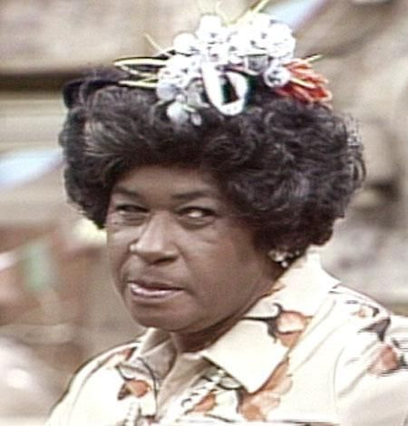

Slide 14
“My father gave me the greatest gift anyone could give another person, he believed in me.”
-Jim Valvano (basketball coach and ESPN)

Slide 15
"A good father is one of the most unsung, unpraised, unnoticed, and yet one of the most valuable assets in our society." -- Billy Graham

Slide 16
Men love adventure.
The most rewarding adventure is fatherhood.

Slide 17
God called Abraham to an adventure.
It was fatherhood.

Slide 18
Abraham, Isaac, and Jacob….the big three fathers in the Old Testament. They each failed and succeeded in unique ways.

Slide 19
Good news fathers: You have been specially equipped to do your job.

Slide 20
Wrong focus
Money
Sports
Worldly ambition
Success
Pleasure
Fame

Slide 21
Right focus
Great husband
Dedicated father
Blessing your Children
Instill virtue
Being kind daily
Believe the best
Ask God’s help
Have faith

Slide 22
WHO YOU REALLY ARE
Created in God’s image, Equipped, Blessed, Capable, Anointed, Favored, Crowned, Able,
Filled, Righteous, a good Father

Slide 23
Your job fathers, is to represent to the family the true nature God—He is your loving heavenly Father.

Slide 24
One soldier’s hope
It is my hope that my son, when I am gone, will remember me not from the battle field but in the home repeating with him our simple daily prayer, 'Our Father who art in Heaven.'
--General Douglas Macarthur

