Slide 1
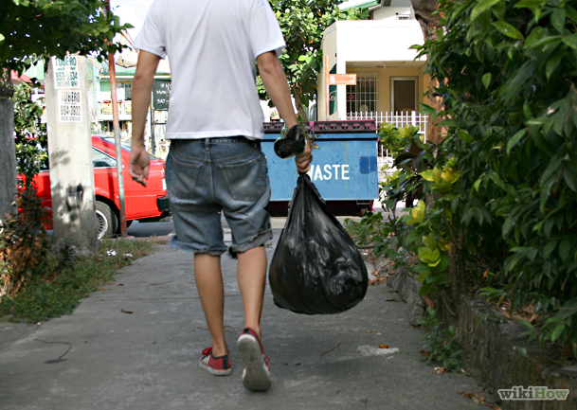
BE FILLED WITH THE HOLY SPIRIT
And take out the garbage.

Slide 2
Ephesians 5:18b-21
Be filled with the Spirit, 19 addressing one another in psalms and hymns and spiritual songs, singing and making melody to the Lord with all your heart, 20 giving thanks always and for everything to God the Father in the name of our Lord Jesus Christ, 21 submitting to one another out of reverence for Christ. ESV

Slide 3
Ephesians 3:17-19
That you, being rooted and grounded in love, 18 may have strength to comprehend with all the saints what is the breadth and length and height and depth, 19 and to know the love of Christ that surpasses knowledge, that you may be filled with all the fullness of God.
ESV

Slide 4
Here’s the point…
Make room daily for the Holy Spirit and all his blessings.

Slide 5
Romans 1:29-31
29 They were filled with all manner of unrighteousness, evil, covetousness, malice. They are full of envy, murder, strife, deceit, maliciousness. They are gossips, 30 slanderers, haters of God, insolent, haughty, boastful, inventors of evil, disobedient to parents, 31 foolish, faithless, heartless, ruthless. ESV

Slide 6
Things that take up precious space
Anger
Worry
Jealousy
Self-focus
Depression
Fear
Low expectations
Conflict

Slide 7
More things….
9. Unbelief
Anxiety
Hurt feelings
Offense
Stress
Unforgiveness
Bad attitude
Greed

Slide 8
Take out the garbage

Slide 9
Here’s what to do
Start this habit:
Empty your garbage at the end of the day of everything that is anti-kingdom. Call it out—throw it out. This might take a while.
Then enjoy the space you have made for God, his wisdom, his joy, his purpose, his blessings.

Slide 10
Your garbage is not auto deleted. You have to be intentional and determined.

Slide 11
Prayer
“I repent Lord of all the junk I have collected.
I give it up and cast it out.
Tomorrow I will be careful to stay free and stay full of your Holy Spirit. When a negative thought or bad habit tries to take up space I will reject it and stay full of your Spirit.”

Slide 12
Let this be a red letter day.
“Today I am going to stop feeding my history.”

Slide 13
Colossians 2:9-10
9 For in him the whole fullness of deity dwells bodily, 10 and you have been filled in him, who is the head of all rule and authority.
ESV

Slide 14
Garbage smells. You can’t cover it with perfume and breath fresheners.

Slide 15
Empty out the garbage!
Why? We have to make room for God.
Make good use of your space…be filled with the Spirit.

