Slide 1
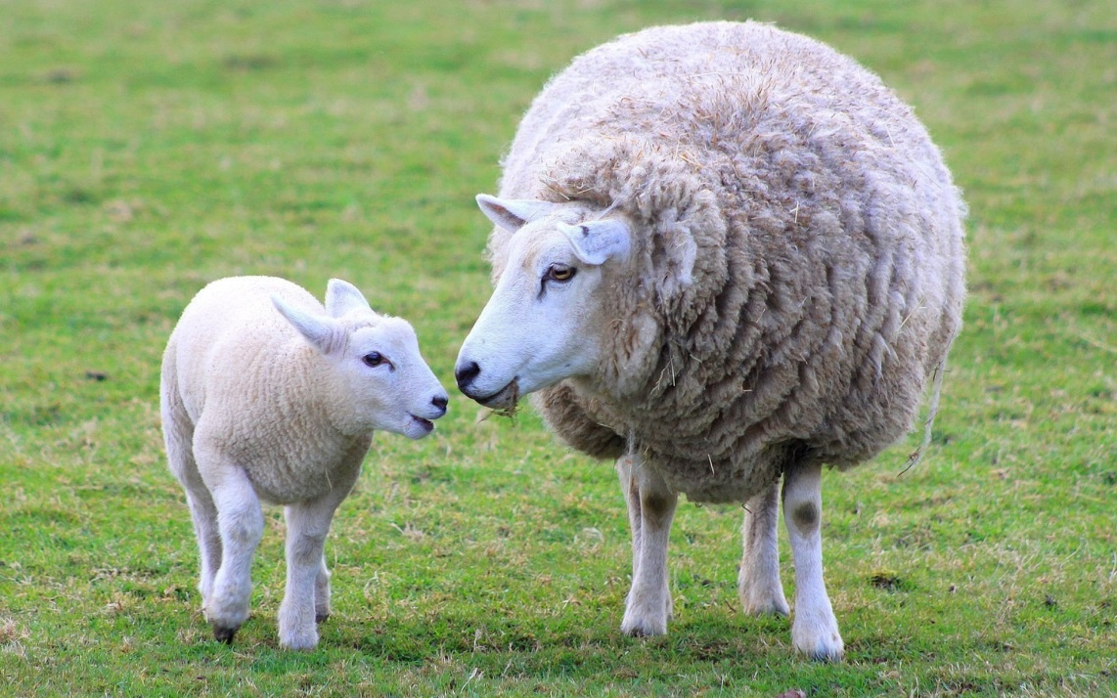
THE LORD IS MY SHEPHERD

Slide 2
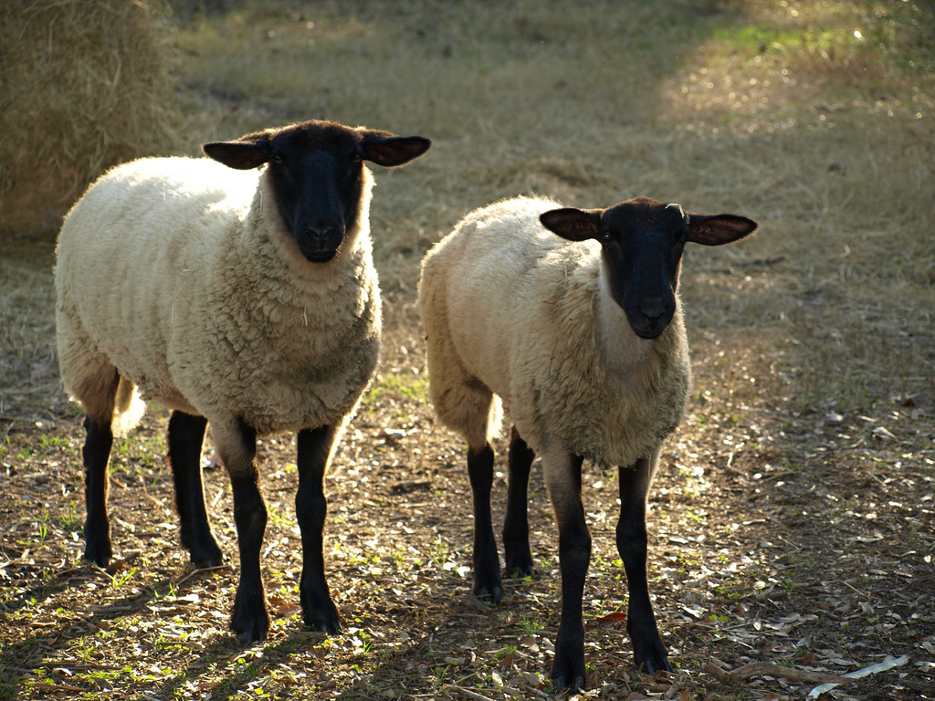

Slide 3
Psalm 100:3
3 Know that the Lord, he is God!
It is he who made us, and we are his;
we are his people, and the sheep of his pasture. ESV

Slide 4
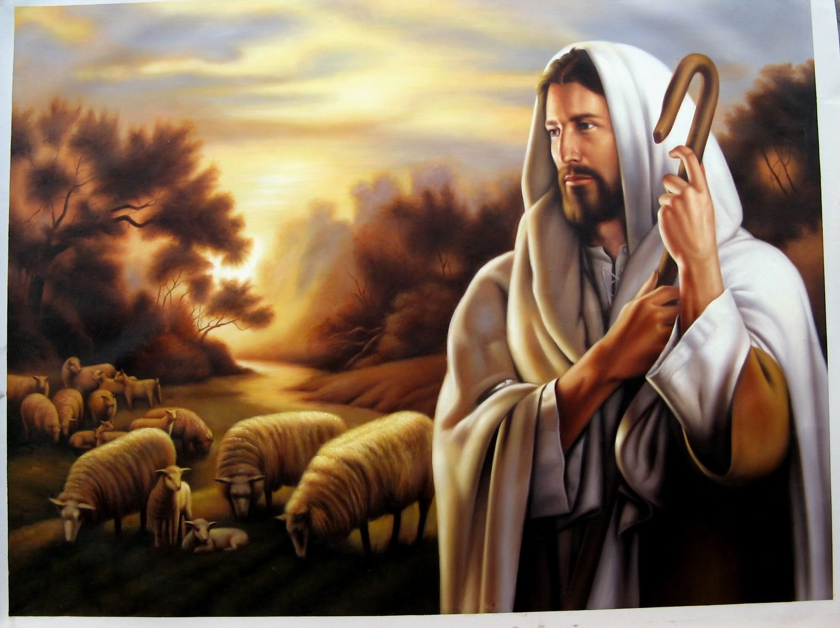
The good shepherd

Slide 5
Psalm 23
3 The Lord is my shepherd; I shall not want.
2 He makes me lie down in green pastures.
He leads me beside still waters.
3 He restores my soul.
He leads me in paths of righteousness
for his name's sake. ESV

Slide 6
Psalm 23
4 Even though I walk through the valley
of the shadow of death,
I will fear no evil,
for you are with me;
your rod and your staff,
they comfort me. ESV

Slide 7
Psalm 23
5 You prepare a table before me
in the presence of my enemies;
you anoint my head with oil;
my cup overflows.
6 Surely goodness and mercy shall
follow me all the days of my life, and
I shall dwell in the house of the Lord forever. ESV

Slide 8
Saved or lost to a sheep is defined in relationship to the shepherd.
Salvation is about a relationship more than a final destination.

Slide 9
John 10:14
14 I am the good shepherd. I know my own and my own know me, 15 just as the Father knows me and I know the Father; and I lay down my life for the sheep. ESV

Slide 10
HEBREWS 13:20-21
20 Now may the God of peace who brought again from the dead our Lord Jesus, the great shepherd of the sheep,
by the blood of the eternal covenant,
21 equip you with everything good that you may do his will, working in us that which is pleasing in his sight, through Jesus Christ, to whom be glory forever and ever. Amen. ESV

Slide 11
THE NINETY AND NINE
But all through the mountains, thunder riven And up from the rocky steep, There rose a glad cry at the gates of Heaven, "Rejoice, I have found my sheep!" And the angels echoed around the throne, "Rejoice for the Lord brings back His own! Rejoice for the Lord brings back His own! "

