Slide 1
The Church God's Orphan Redemption Plan
Notes:
The foundation of Family First is based on the Biblical approach to Orphan Care James 1:27 “Pure and unblemished religion [as it is expressed in outward acts] in the sight of our God and Father is this: to visit and look after the fatherless and the widows in their distress, and to keep oneself uncontaminated by the [secular] world.”
JAMES 1:27 AMP
The pillars of our ministry is to engage, equip, and empower the church to do the work of the ministry according to EPHESIANS 4:11-12, 16 AMP
“And [His gifts to the church were varied and] He Himself appointed some as apostles [special messengers, representatives], some as prophets [who speak a new message from God to the people], some as evangelists [who spread the good news of salvation], and some as pastors and teachers [to shepherd and guide and instruct], [and He did this] to fully equip and perfect the saints (God’s people) for works of service, to build up the body of Christ [the church];
From Him the whole body [the church, in all its various parts], joined and knitted firmly together by what every joint supplies, when each part is working properly, causes the body to grow and mature, building itself up in [unselfish] love.”
EPHESIANS 4:11-12, 16 AMP

Slide 2
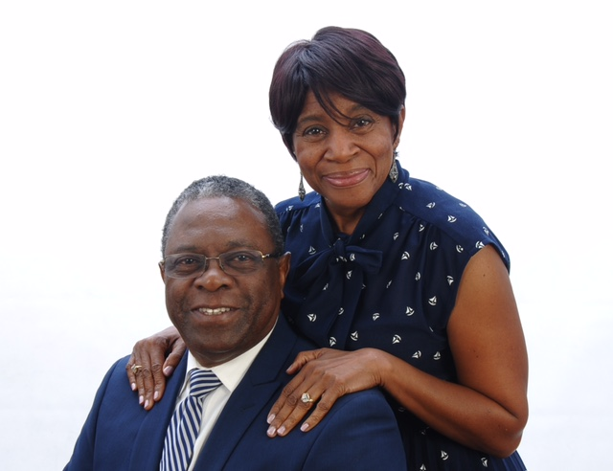

Slide 3
The Church God's Orphan Redemption Plan

Slide 4
WE BELIEVE
THERE SHOULD BE MORE FAMILIES WAITING ON CHILDREN THAN CHILDREN WAITING ON FAMILIES.

Slide 5
The Revelation of the Orphan
Text
God’s …
Passion … James 1:27a (AMP) | ²⁷ Pure and unblemished religion [as it is expressed in outward acts] in the sight of our God and Father is this: to visit and look after the fatherless and the widows in their distress …
Compassion — Isaiah 1:17 (NKJV) | ¹⁷ Learn to do good; Seek justice, Rebuke the oppressor; Defend the fatherless, Plead for the widow.
Plan — Psalm 68:5-6a (NIV) | ⁵ A father to the fatherless, a defender of widows, is God in his holy dwelling. ⁶ God sets the lonely in families …

Slide 6
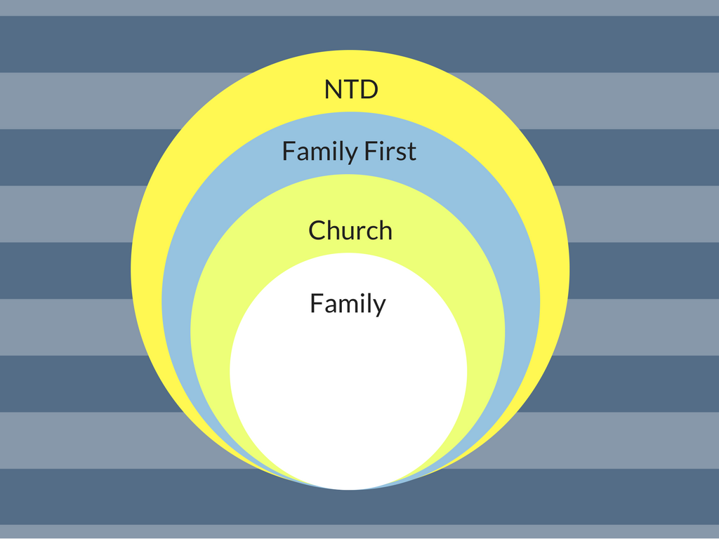

Slide 8
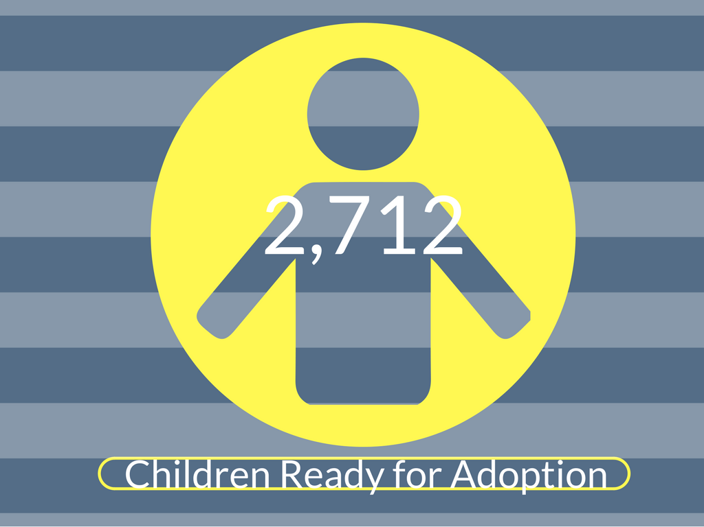

Slide 10
The Reality of Orphan Care
Text
The Reality of Orphan Care
Heart of the Father
Matthew 18:5 (NIV) | ⁵ And whoever welcomes one such child in my name welcomes me.
Help from the Father
Matthew 25:40b (NIV) | … ‘Truly I tell you, whatever you did for one of the least of these brothers and sisters of mine, you did for me.’

Slide 11
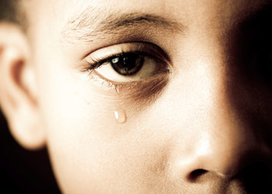
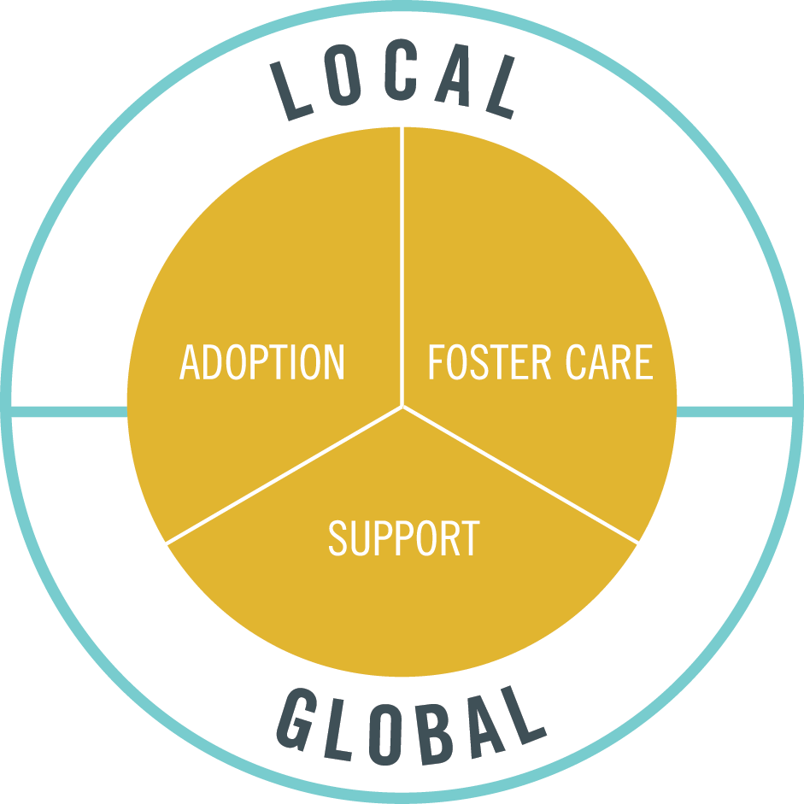
HOLISTIC
ORPHAN
CARE
CULTURE

Slide 12
YOUR
CHURCH’S
HOLISTIC
ORPHAN
CARE
CULTURE
Notes:
# of children in foster care in Oakland county – Over 700
# of children available for adoption in Oakland county – Approximately 23 children

Slide 13
Notes:
““Then the King will say to those on His right, ‘Come, you blessed of My Father [you favored of God, appointed to eternal salvation], inherit the kingdom prepared for you from the foundation of the world. ~‘For I was hungry, and you gave Me something to eat; I was thirsty, and you gave Me something to drink; I was a stranger, and you invited Me in; I was naked, and you clothed Me; I was sick, and you visited Me [with help and ministering care]; I was in prison, and you came to Me [ignoring personal danger].’ Then the righteous will answer Him, ‘Lord, when did we see You hungry, and feed You, or thirsty, and give You something to drink? ~‘And when did we see You as a stranger, and invite You in, or naked, and clothe You? ~‘And when did we see You sick, or in prison, and come to You?’ The King will answer and say to them, ‘I assure you and most solemnly say to you, to the extent that you did it for one of these brothers of Mine, even the least of them, you did it for Me.’”
MATTHEW 25:34-40 AMP

Slide 14
The Rewards of Orphan Care
Text
Personal transformation
Peace through revelation
Power of reconciliation

Slide 15
Text
The Church God's Orphan Redemption Plan

Slide 16
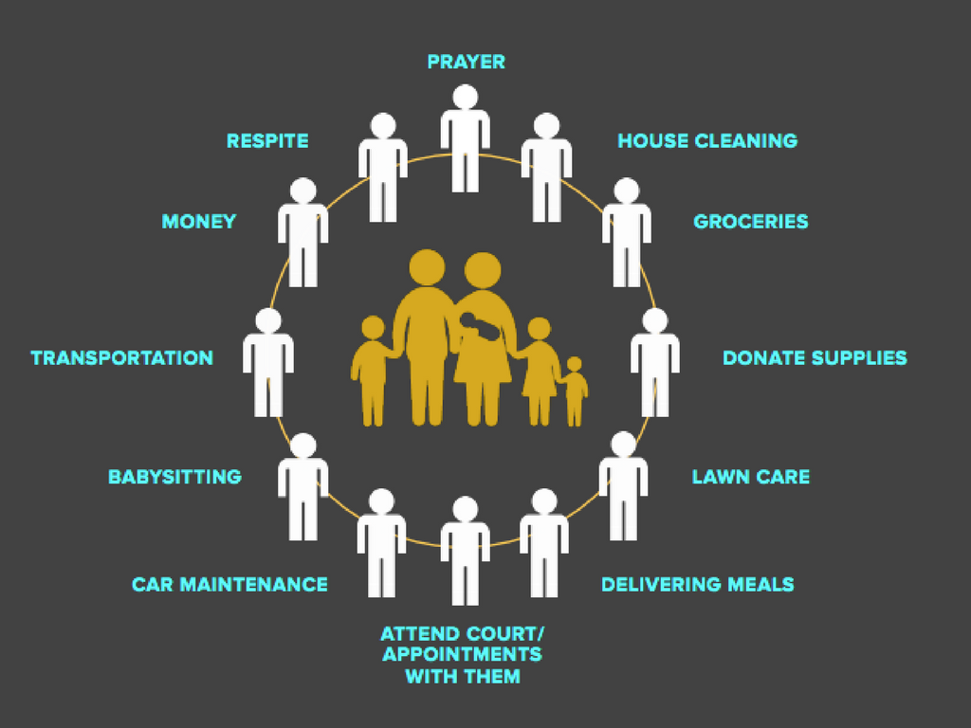

Slide 17
Notes:
The foundation of Family First is based on the Biblical approach to Orphan Care James 1:27 “Pure and unblemished religion [as it is expressed in outward acts] in the sight of our God and Father is this: to visit and look after the fatherless and the widows in their distress, and to keep oneself uncontaminated by the [secular] world.”
JAMES 1:27 AMP
The pillars of our ministry is to engage, equip, and empower the church to do the work of the ministry according to EPHESIANS 4:11-12, 16 AMP
“And [His gifts to the church were varied and] He Himself appointed some as apostles [special messengers, representatives], some as prophets [who speak a new message from God to the people], some as evangelists [who spread the good news of salvation], and some as pastors and teachers [to shepherd and guide and instruct], [and He did this] to fully equip and perfect the saints (God’s people) for works of service, to build up the body of Christ [the church];
From Him the whole body [the church, in all its various parts], joined and knitted firmly together by what every joint supplies, when each part is working properly, causes the body to grow and mature, building itself up in [unselfish] love.”
EPHESIANS 4:11-12, 16 AMP

